Slide 1

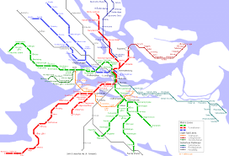
€200m capital project was at a Go-No Go Decision for the Stockholm Subway Red Line to support their signalling system. They brought in one of our partners to help them work out the best way forward
They needed to make the decision quickly, but the outcome needed to be transparent & thorough to justify the use of public funds

Slide 2

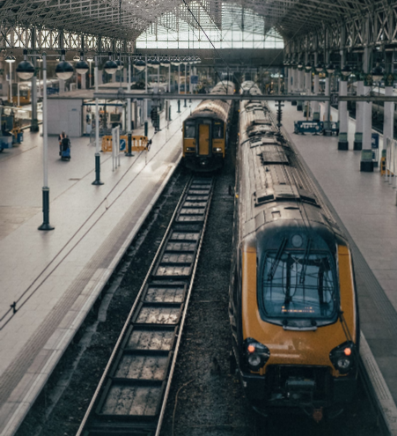
Different ‘Aspects’ were explored in building Criteria – these covered Finance, Technical, Integration & Project Factors to force the client to think through the question from all angles
Defining Criteria was an iterative process:
“you have to re-evaluate the problem you thought you had – but by forcing you to work systematically you hone the structure, so you have a very good decision. And it can be a rapid process… just a couple of hours”

Slide 3

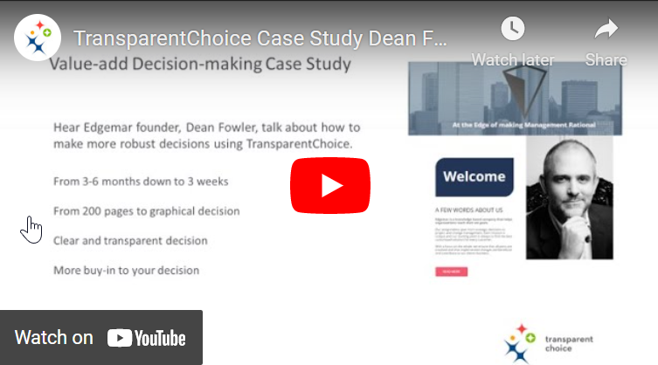
Decision was made in less than half the normal time – faster, simpler… yet more thorough than the client expected
Instead of 200 pages that nobody read, the client received simple clear outcomes with easy to read graphs – less paper better documentation
By involving participants from a broad group of departments the client had a robust decision that was hard to argue against
Want to hear more? Listen to Dean Fowler explain his work with TransparentChoice here

