Slide 1

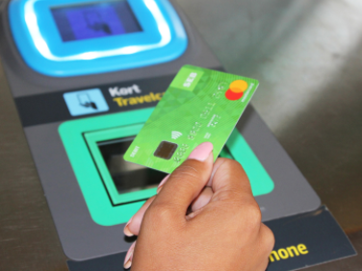
Swedish Public Transport system needed a new ticketing system – but they had to decide on the approach to take – to build in-house or buy an off-the-shelf solution from a vendor
This kind of project takes years, and the resulting systems last for decades, so making the right decision was key

Slide 2


Our client switched to TransparentChoice, replacing a manual solution that needed researchers to calculate tables. Real time data made the process much more effective
Initially stakeholders had strong preconceptions – which were addressed by forcing all sides to listen to others’ arguments – to lawyers, to technicians and to commercial teams
A focused way of working made the process much quicker as getting people aligned meant that they avoided ‘nice to haves’ and prioritized the right solutions

Slide 3

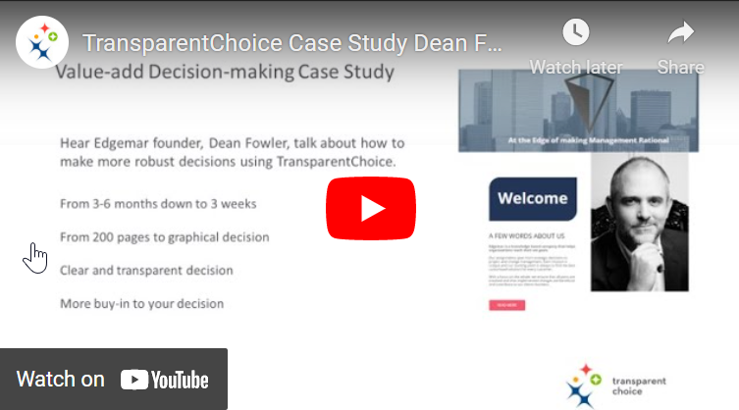
“Listening to each other helped a lot” – and the group aligned to build the solution mainly in-house & moved quickly onto hiring
TransparentChoice was key in “Making Complicated issues more clear”
The system was launched in February 2021, and will replace the existing system by 2023 - Read more here
Want to hear more? Listen to Dean Fowler explain his work with TransparentChoice here

