Slide 1

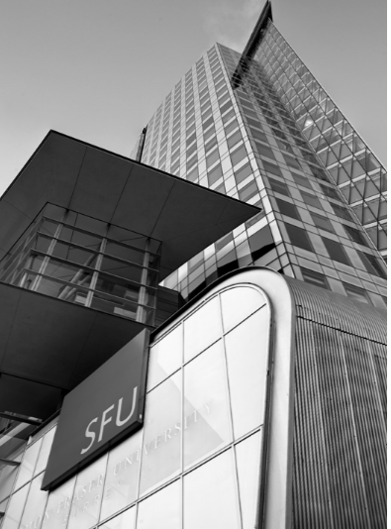
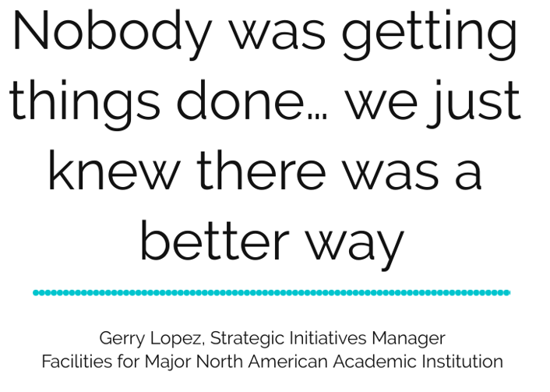

Slide 2
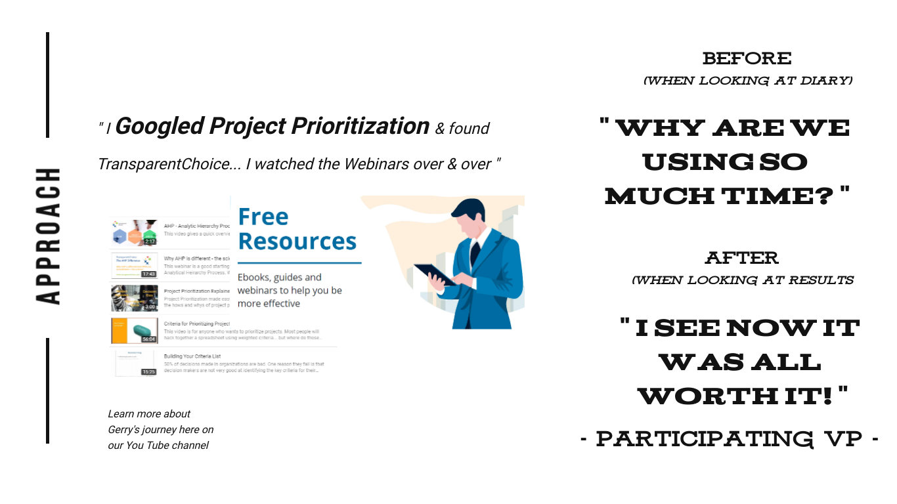
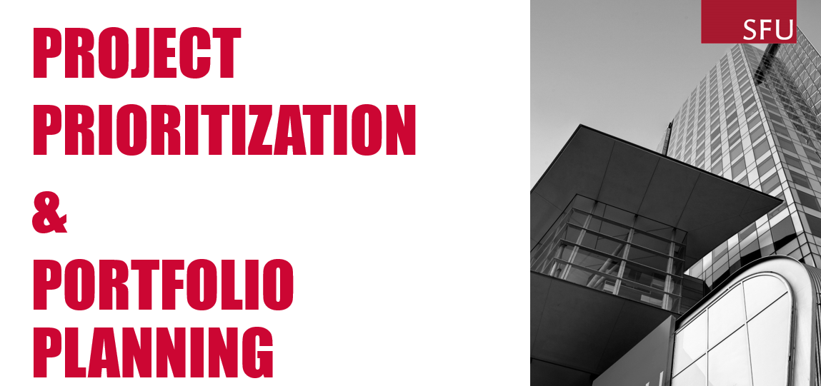
Gerry’s journey started with a Google search, then he had to deal with sceptical stakeholders who didn’t see the point of spending time working on prioritization

Slide 3
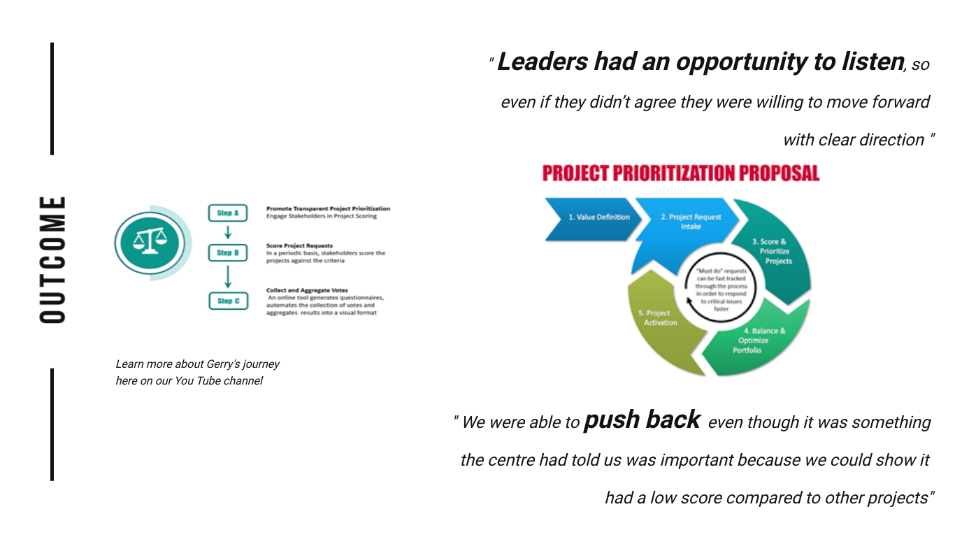
Building a Prioritisation model gave the team the ability to align and to create a structured rational approach that empowered them to challenge low value projects

