Slide 1

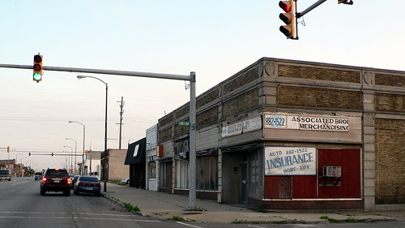
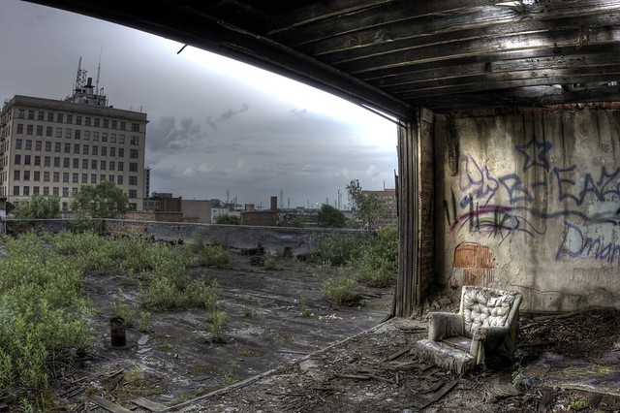
County authorities needed to update property taxation model to better capture the conditions that had seen inner cities struggle, while suburban neighbourhoods thrived in order to advance equitable development.
This was a highly divisive issue, that required extensive stakeholder engagement to develop & align on alternatives to the existing system for generating taxation levels.
Transparency & trust were key in order to minimise political resistance to the outcome:
“They wanted to work out how to best advance economic growth… while fostering community relationships”

Slide 2
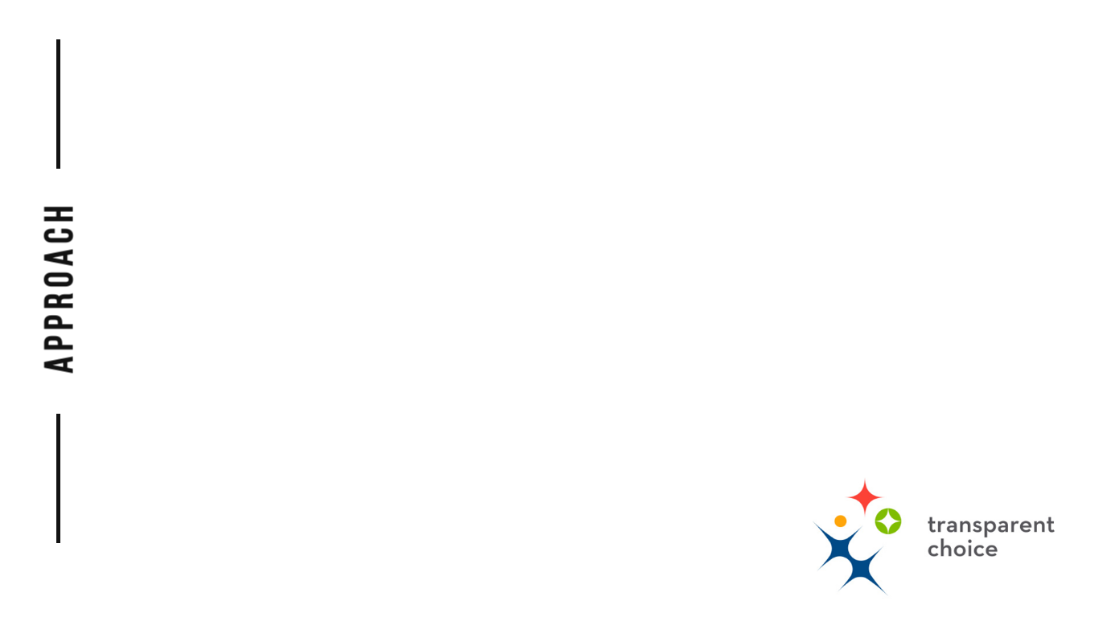
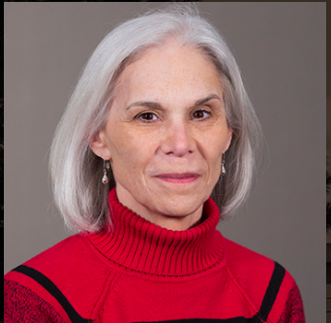
The review bought together a diverse group of stakeholders to provide unique knowledge and sometimes divergent opinions, combining academic, front line & policy based experience:
Municipal Government
County Government
Experts in Property Tax
Economists
Practitioners
This process took around 6 months, and built both the Criteria for the Land Valuation and alternatives for a new valuation policy that would drive property tax assessment:
Build more clarity around complex issues in this public policy
Focus on shared interests amongst the group
Build buy-in for the outcome with community decision makers
Ellen J. Szarleta
J.D., PhD
Director, Centre for Urban & Regional Excellence: Professor, SPEA Indiana University Northwest
“Stakeholders really appreciated the instantaneous feedback from TransparentChoice… it helped develop a deeper understanding… and they enjoyed it too”

Slide 3
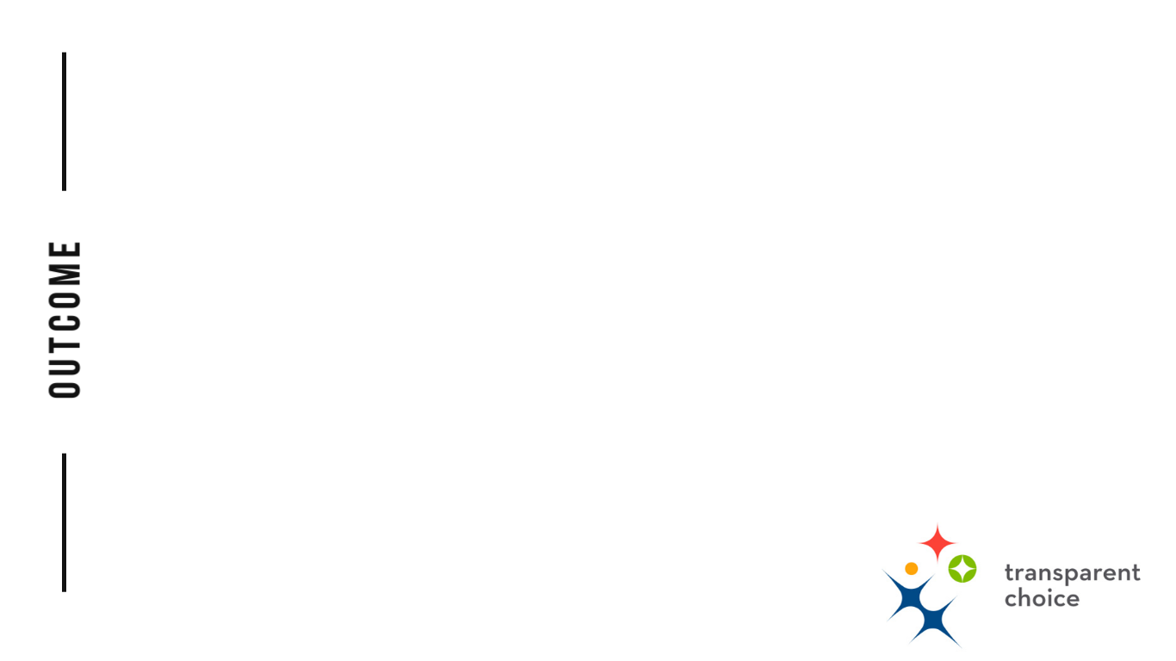
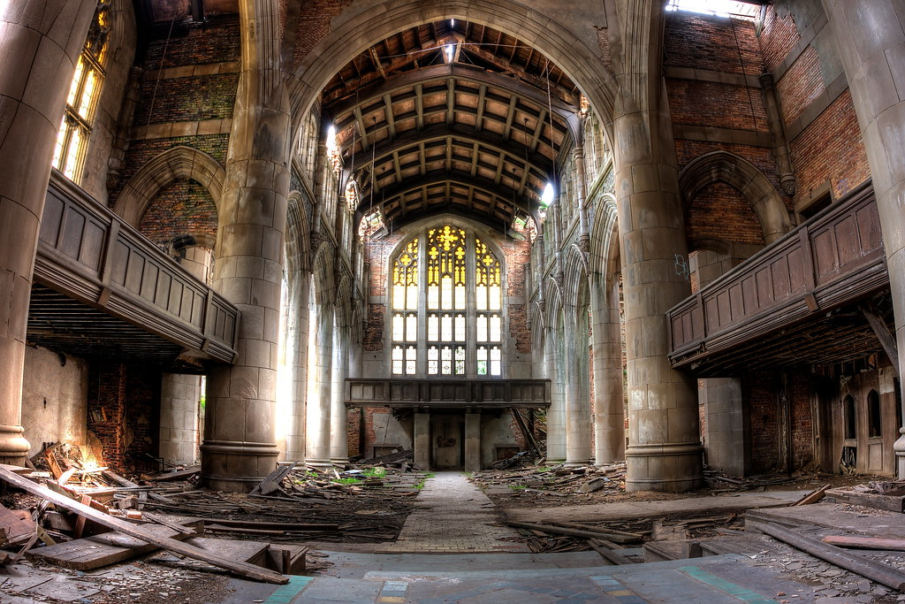
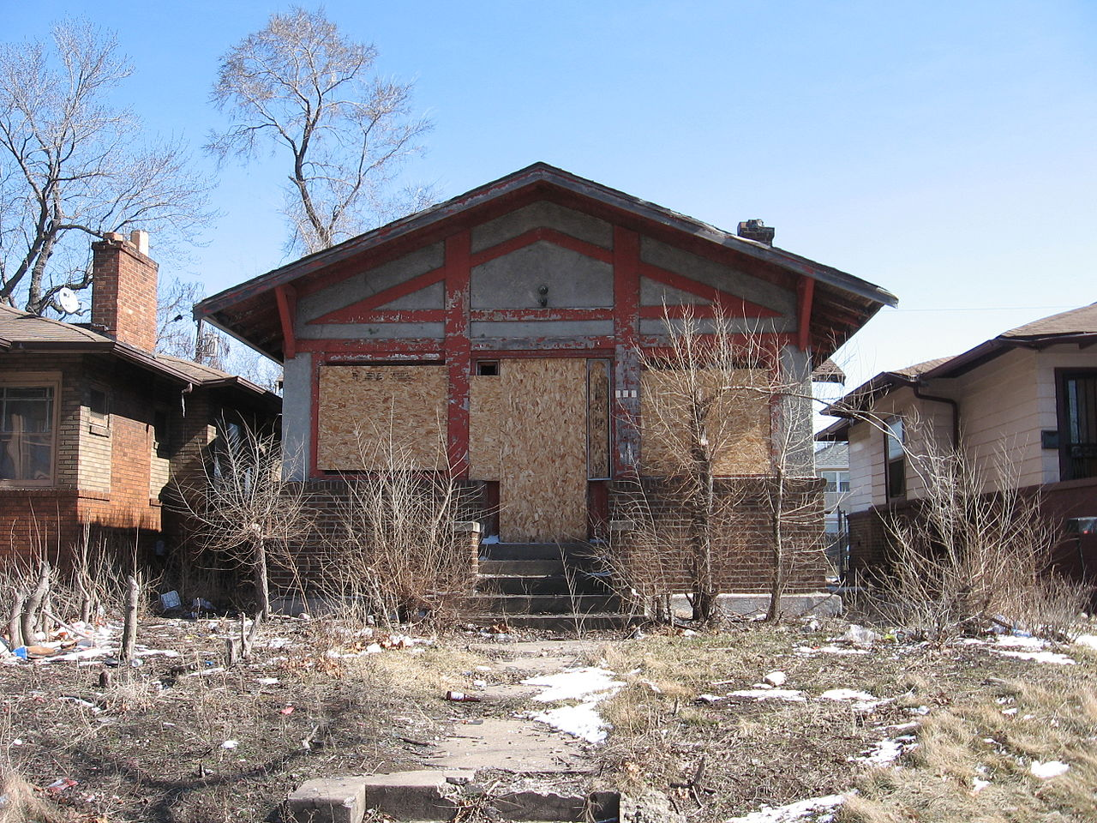

The final decision was published with confidence, knowing there was rigour in the process & quality in the outcome. Policy makers could make transparent decisions with the assurance that they had considered all stakeholders.
The software connected the policy consultation process to the decision making & implementation, a connection that will ultimately lead to more support for the implementation of the new policy.
Click below to listen to Ellen’s story in her own words
“TransparentChoice is a vehicle for collective decision making that local government feels very comfortable with… we are changing the culture of public decision making using this tool”

