Slide 1


TransparentChoice Building Criteria - Best Practice Guide
Best Practice
Client Hub Page

Slide 2
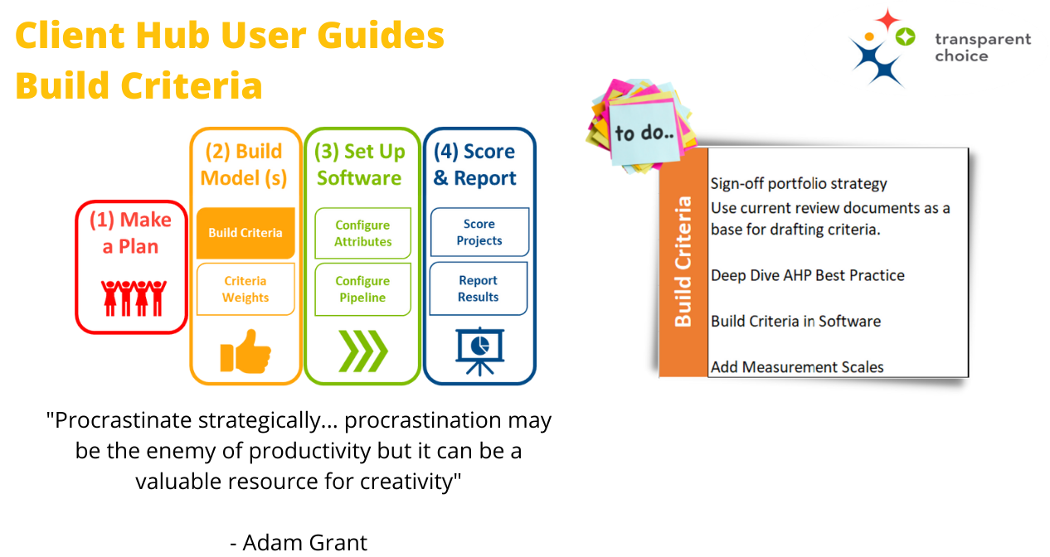

Slide 3
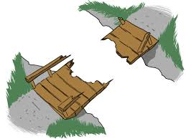
61%
of firms often struggle to bridge the gap between strategy formulation and implementation

Slide 4



AHP Best Practice The start of the journey
We will cover Best Practice:
Criteria Structure
What is not criteria – Constraints, Gating Factors & Risk
Tips – Key things we’ve learned
Example Criteria
Scales – Best Practice & Templates
We recommend continuing your Journey:
Webinar on Prioritization Criteria
How to Generate Effective Criteria e-book
Example Criteria Templates

Slide 5
AHP Best Practice (the short version…)

Slide 6



AHP Best Practice Decide your portfolio strategy
Consider splitting up your portfolio if it:
Mixes ‘Grow’ & ‘Maintain’ type projects
Split into rigid funding pots
Contains ‘must do’ projects
Cost range is huge – e.g. $10k vs $10m projects
Mixes non-comparable resources (e.g. IT vs. marketing)
In the software each bucket = an 1 AHP model, but can all be in 1 pipeline
TIP – Once you have your Buckets, define a Goal for each… that is our start point for building Criteria

Slide 7
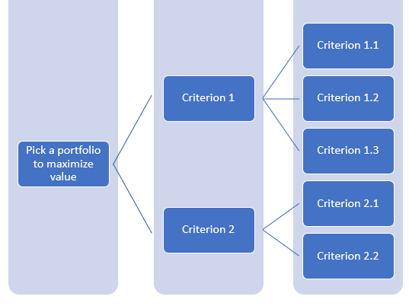

AHP Best Practice Criteria Structure
Break each Goal into 3-7 high level Criteria
Add 3-5 measurable Sub-Criteria underneath each Criterion
Keep hierarchy broadly symmetrical (better maths)
Each sub-criterion will need to be scored for each project (so a huge model will be a lot of work!)
Sub-Criteria will be scored with data to produce a Value Score
Qualitative data from a survey
Quantitative data from a model
Hard data
Create ‘sub-sub’ criteria to add more precision if required
Avoid “Lone Child” sub-criteria which break AHP (see Tips for details)
Sub- Criteria
Goal
Criteria
Check out our template to help get started
TIP – If a Criteria is already measurable then do not add sub-criteria, simply score the criteria… or if a sub-criteria is not measurable then add further ‘sub-sub’ criteria to break it down

Slide 8



AHP Best Practice Popular Criteria
Hit near term objectives for shareholders, customers & internal clients – often linked to KPIs
Deliver strategic objectives that define longer term success for your organization
Revenue Growth
Profit Margins
Strategic Goals
Market Innovation
Transformation
Deliver of SLAs
ROI / NPV
Customer & Brand
Customer Satisfaction
There are 6 typical buckets which cover most criteria in AHP models – so we’ve built them into our software
Make the organization more efficient with its operations, costs & technology
Broader stakeholder impact for key groups who will be impacted by this decision
Cost Savings
Tech Debt
Colleagues
Environment
Productivity
IT Strategy Fit
Community
Partners
Reduce business risk that could ruin everything!
Project delivery risk associated with the project
Security & Safety
Regulation
Complexity
Legal Factors
Compliance
Governance
Senior Buy-In
Readiness – plan / resource etc

Slide 9
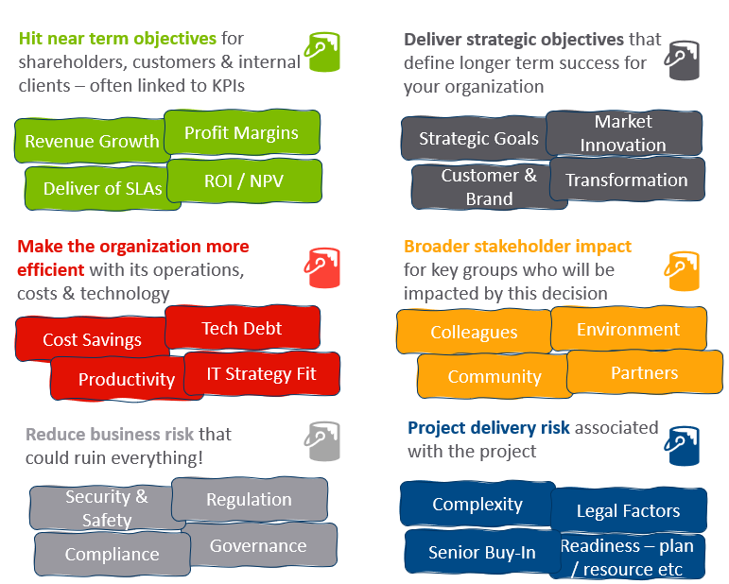
AHP Best Practice Selecting your Criteria
Try asking your leadership team these leading questions to work out what type of criteria you’ll need…
What are your objectives this year?
What is your 3/5 year plan? Highlight the key bits
Where are we on the maturity curve? Should we optimise, innovate or a bit of both?
Who / what do we really care about when it comes to colleagues, partners, environment etc? Note “everything” is not an answer
Are there any company / career killers that we must address? Or is there ‘grey area’ where we have some choice?
What factors make a project more risky? What factors reduce the risk in projects?
TIP – These buckets are just guidelines. You probably don’t need all 6. You may want to group your hierarchy differently…. But ask these questions first so you don’t miss something by mistake!

Slide 10


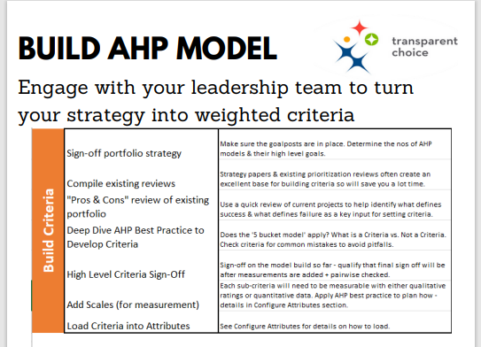
AHP Best Practice Selecting your Criteria
Click here for our deployment guide
Compile existing reviews – strategy papers, benefits realization, current review process, balanced scorecard etc
Review pros & cons of sample projects to highlight what defines success or risk
Ask leading questions to Execs
Download our Deployment Guide (for Building Criteria & everything else)
Iterate with your leadership – make sure they feel ownership of the model
TIP – the best criteria are the ones that drive alignment, so make sure all key stakeholders have a chance to engage in development & a say in final outcome

Slide 11

AHP Best Practice Ensure Criteria have a clear Description
Descriptions will help scorers ‘join up’ headline criteria to questions in a survey
Ensure the description calls out specifics of criteria in question
Always use simple relatable language
Apply the simple rule: Precision is good, ambiguity is bad
These common bases might help…
Evaluate the contribution of the project with respect to…
To what extent does this project help…
What is the projected level of…
To what extent does this project reduce the risk of…
TIP – if you're using built in Template Criteria in the software they are meant as guides only… so edit them to make them less generic

Slide 12
What is not a Criteria (probably)? (but still important in picking your portfolio)

Slide 13

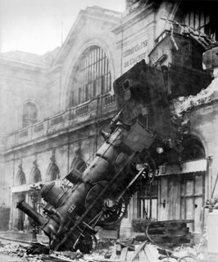
Nothing matters more to a train company than staying on track… but this shouldn’t be criteria in prioritization
Not a Criteria Gating Factors
Meeting a minimum legal safety standard is not a selection criteria – it’s a pre-requisite for all projects
Mandatory projects do not need to be assessed for value if there is no scope to ignore them
Projects solving for Critical Risk belong in their own bucket – mixing it with discretionary spending will distort your model

Slide 14

Not a Criteria Must-Do Projects
Some projects are deemed to be ‘must-do’ commitments – e.g., required by regulation or contractual obligation
If you cannot reject a project, you cannot score it in a prioritization model…
…but that doesn’t mean a ‘free pass’ – we need to confirm that this project really is must-do
We recommend scoring these projects via an Assessment Panel – not to determine value but to validate ‘must-do-ness’ as a team
Is this Project “Must-Do”?
If “no” push into full AHP model – anything here must be ‘rejectable’
If “yes” Add to List for Assessment Panel & Score to create a non-normalised model
This Scale Template can help you get started
…or make your own
100 | Must-Have Solution | This project is a non-negotiable requirement for this risk, which must be funded
75 | Should-Have Solution | This project is an important requirement for this risk, which should be funded
50 | Nice-to-Have Solution | This project will reduce this risk, but is not critical for this planning cycle
25 | Only Slightly Relevant | This project only provides a little help with this risk
0 | Not Relevant | This project is not relevant to this risk
Decide on your cost / risk appetite
This is not really a Must-Do project – consider rejecting
Push back – maybe we can find a better solution?
Sadly you have to pay for this
High
Cost
Makes sense to get this work done
Low
0
Must-Do Score
100

Slide 15

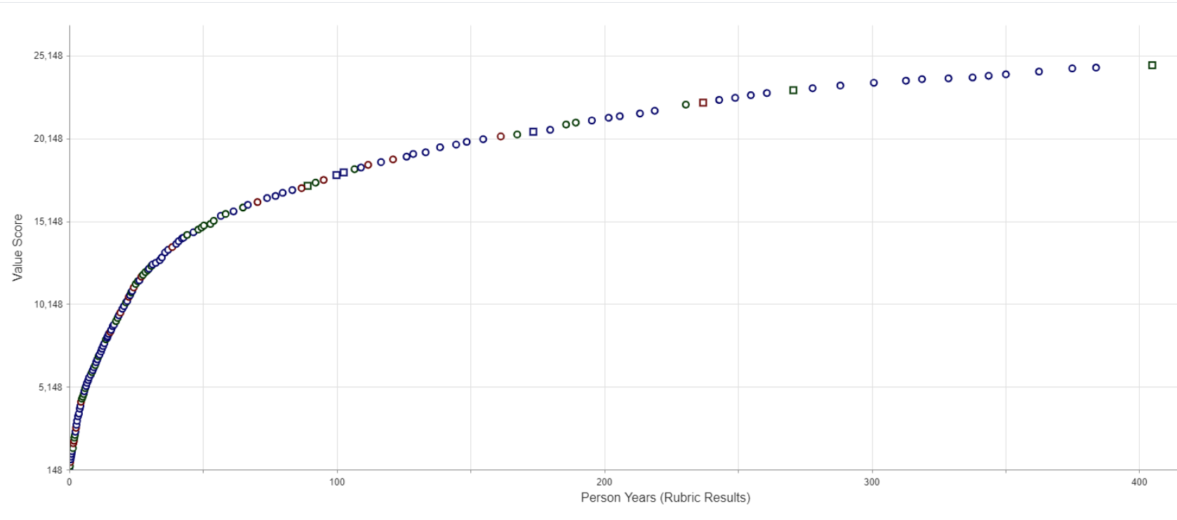

Not a Criteria Value for Money
The cost of a project has no impact on its value – only on its affordability
Cost is therefore a constraint not a criteria
Keep “Cost” out of an AHP model but collect it as a data point to calculate “Value for Money”
Use an Efficient Frontier view of the portfolio to maximise value delivered
Work out when your portfolio stops delivering good value for money – i.e. identify your own “80:20” cut off
Value
Cost
If you have “cost” as a criteria you cannot get this view of your portfolio

Slide 16

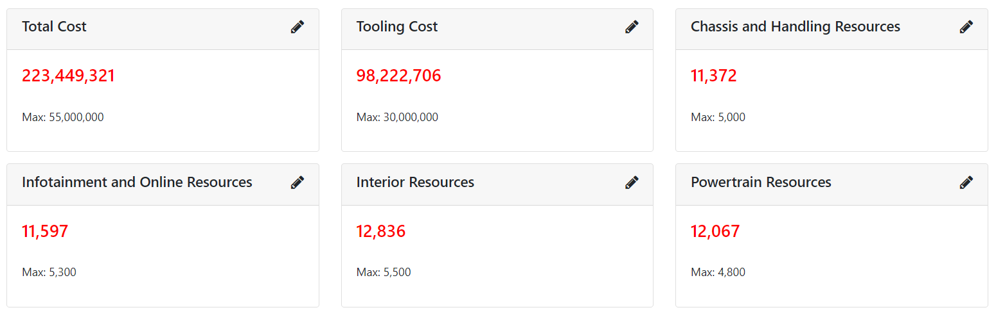
Reports will enable you to set limits… and to see where you have a bottleneck from in-demand resource
Not a Criteria
Resource Constraints
If a project needs an in-demand resource, it doesn’t make it less valuable – it means you have a bottleneck problem to solve
Set up that resource as an Attribute, collect project level requirements, then apply as a constraint during selection (more on this in Reporting)

Slide 17

Not a Criteria Urgency
If a project is urgent, it doesn’t make it more valuable - it just means it needs addressing sooner
Putting urgency into your model distorts value
Consider a separate flag to capture urgency if this is important in your organization – then use this to help order backlog
If this was one model these two would have the same score
Low Priority – do if capacity allows
High Priority –start quickly
Urgency
Low Priority
High Priority – but can wait
Value

Slide 18

Not a Criteria Delivery Risk
Risk of poor project delivery means asking, “what might go wrong if we do this project?”
If issues like disruptions & overruns are significant risks, then consider a Feasibility Model
Low scoring projects can be de-risked by improving plans / conducting further research
Where two projects have similar value, pick the one with less risk
Influence timing based on risk – e.g., don’t start two high risk projects at the same time
If this was one model these two would have the same score
Do subject to capacity
Do first
Feasibility
Stop
De-risk before starting
Value

Slide 19

Not a Criteria Tips
Don’t waste time scoring something you have to do. Use your time to decide where you commit and where you save.
Focus on what matters most for your decision as an additional overlay. Too many overlays creates confusion.
Prioritization is a process, and the AHP model is only part of it. Non-Criteria can still play a key role in selection outcomes.
Cost doesn’t have to be measured in $$. If people are your main resource use FTE, then optimize to maximize “Value for Effort”
If you really want a simple model with one score, then adding a Criteria for these factors is fine. We just don’t recommend it! ☺

Slide 20
Deployment Tips (things we’ve learned, often the hard way)

Slide 21
Deployment Tips Plan your pipeline & model(s) as a joined up process
One Pipeline Collect data for projects
TIP – let the software do the work by automating the Kanban so that a single data collection process can generate multiple models More on this in our Configuration training
Split Portfolio into buckets to determine which model to use
Gating Factor Score ‘must-do-ness’ of projects
Grow Model Weight Criteria +
Score Projects
Maintain Model Weight Criteria +
Score Projects
Decide Risk / Cost trade off
Decide Grow / Maintain funding split
One Backlog Split by priority level

Slide 22

Deployment Tips Ambiguity is bad
Avoid ambiguity / focus on measurable precision (a scale with quantifiable bands is always best) NO “Deliver Growth in North America”
YES “Grow Revenues in North America 2022-23” (+ scale with $)
Avoid woolly ‘mission statements’ / things people don’t understand
NO “Develop a progressive people-led business”
YES “Support retention of talent”
Add clear Descriptions NO “ ”
YES “Write out the detail to help anyone involved in the process know exactly what this criteria means, add a link to a one pager”
Tip – If you have to explain what your criteria means then you need to re-write it!

Slide 23

Deployment Tips Precision is good
Add precision to make criteria score-able
NO “How complex is this project?”
YES “How many teams will need to work on this project?”
& “How many lines of code does this project require?”
Use language people relate to / avoid meaningless buzz-words
NO “Ideate & develop new solutions to enable the development of commercially positive propositions”
YES “Build product features that will generate revenues”
Tip – Criteria join strategy to projects… so need to be broader than specific project deliverables, but more detailed that high level company goals

Slide 24

Deployment Tips Avoid interdependence
Criteria need to be independent of one another, as you cannot do a pairwise review on the relative importance of two linked metrics
NO “Drive Sales $” + “Drive Profit $”
YES “Drive Sales $” + Drive Profit Margins” OR Consider using a modelled metric like ROI Don’t have the same benefits appear across multiple criteria
NO “Drive Sales $ in North America” + “Drive Sales $ of our core product”
YES “Drive Sales $ in North America” OR “Drive Sales $ of our core product”
OR Break goal into complementary drivers rather than interdependent outcomes e.g. “Increase market share in North America” + “Improve Lead Generation for our core product” (under a criteria of ‘Drive Sales’)
Tip – You’ll probably need to decide one way to measure financial goals: resist the temptation to pack in multiple interdependent angles

Slide 25
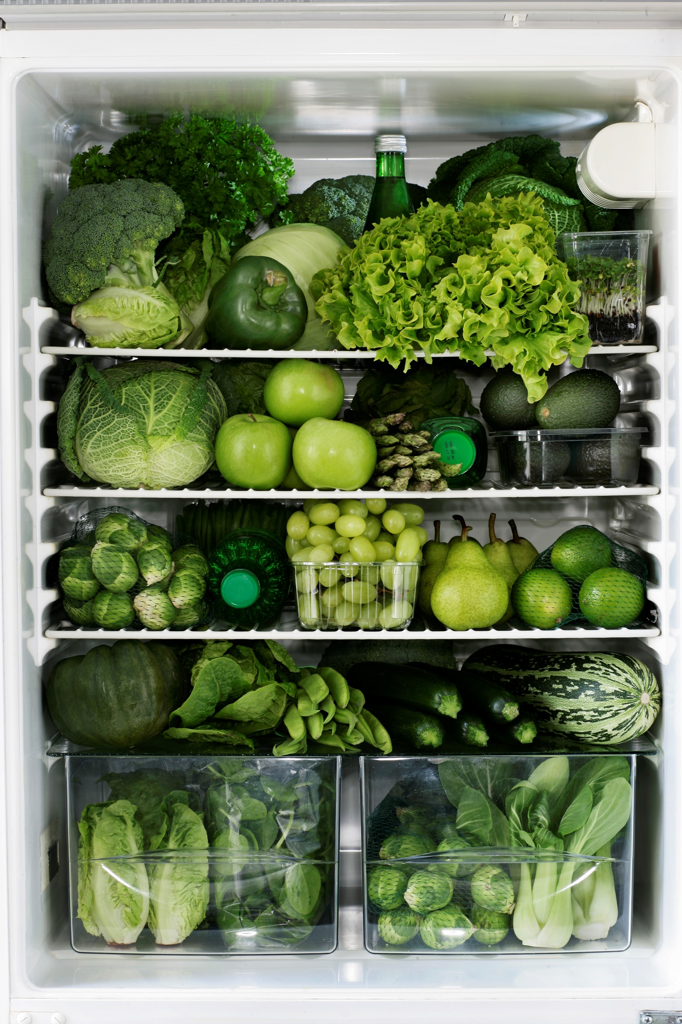
Deployment Tips Don’t pack too much in (even if it’s good stuff)
Avoid ANDs (by splitting into key components) NO “Drive efficiency in Fraud Detection AND in Call Centre”
YES “Drive efficiency in Fraud Detection” & “Drive efficiency in Call Centre”
Unbundle ‘big plans’ into bits
NO “Deliver the CEO’s key initiatives”
YES “Deliver Key Initiative #1”
& “Deliver Key Initiative #2” etc
Don’t have the same benefit in multiple criteria
NO “Improve Client Experience” as sub-criteria in Technology, Geography & Call Centre
YES Dedicated Client Experience Criteria with 3 sub-criteria (Tech, Geo & CC) OR Ensure each sub-criteria is distinct, and precise: “Enhance the Technology our Clients use” & “Customise client services for local lanuages” & “Reduce wait time in our Call Centre” Tip – if you are using a strategy paper as a base they have a tendency to bundle…
If both bits matter have two sub-criteria… if one is not very important then ignore it

Slide 26

Deployment Tips Scales must go up, and be >0
Make sure positive outcomes score higher
NO “How long is the new commute?”
YES “How much time will this new commute save?”
Never use negative numbers
NO “What is the annual cost of maintaining this machine?” (expressed as negative number) YES – “What saving will this new machine give vs. current cost?” (expressed as a positive number)
Tip: You will need to manipulate your data outside the software if you are using a quantitative data source, or you can invert it using a scale if you’re collecting via survey

Slide 27
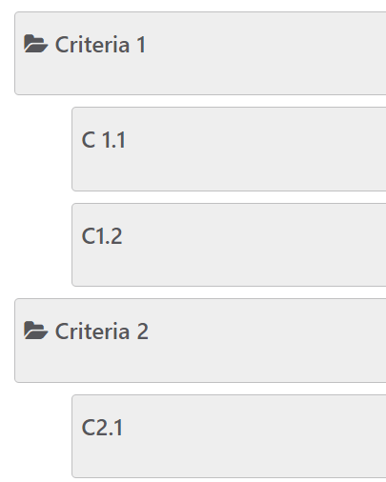
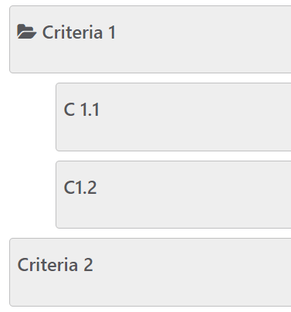
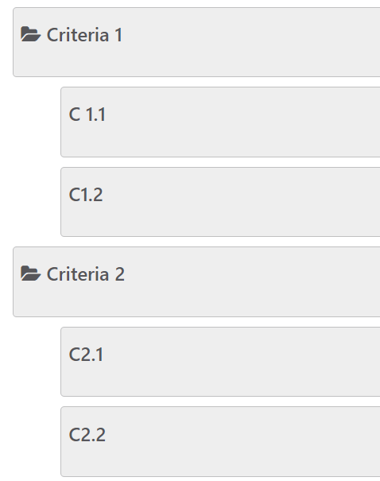


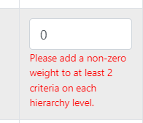
Never have only 1 sub-criteria
NO Add “C2.1” per case study below
YES Either Delete C2.1 or add C2.2 per examples below
Deployment Tips Beware The Lone Child
Criteria 2 will have no weight because 2.1 is a ‘lone child’ – this is not allowed in AHP!
Delete C2.1 and score Criteria 2 This works too, if there are no sub-criteria (just merge C2.1 into Criteria 2)
Add a ‘sibling’ to make C2.1 viable Now there are two sub-criteria Criteria 2 will work
This will break your model
Tip – If you get this message when saving a Weight Set then you’ve got a Lone Child error →

Slide 28
Sample Criteria (to help you see how this all fits together)

Slide 29

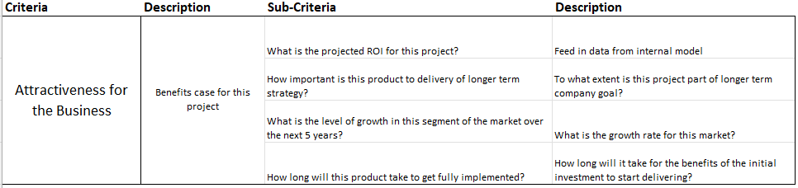
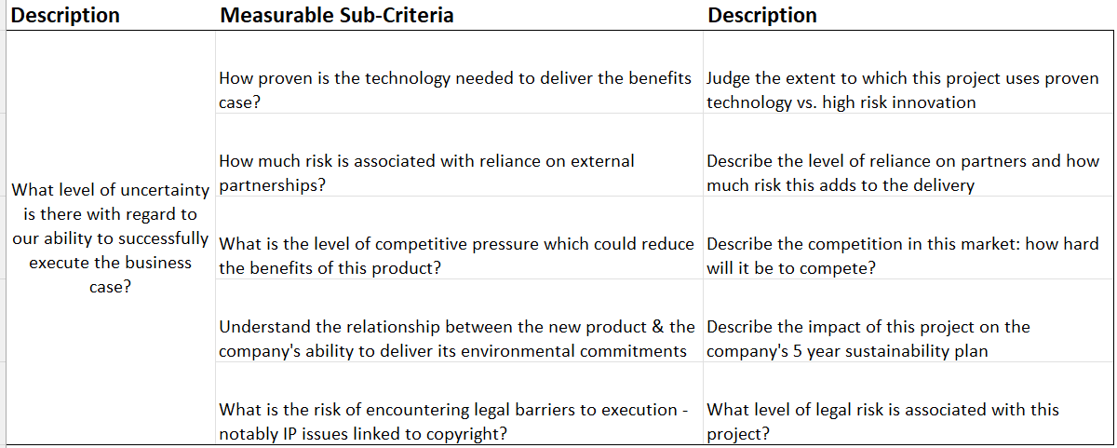
Sample Criteria Prioritize R&D backlog
Split into Value & Delivery Risk (i.e. two models)
Simple metrics define value – ROI will be modelled to combine all financial factors
Delivery Risk is broadly a summary of ‘what might go wrong’

Slide 30
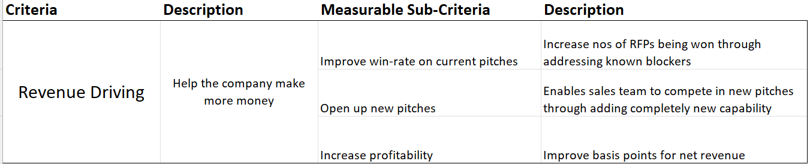
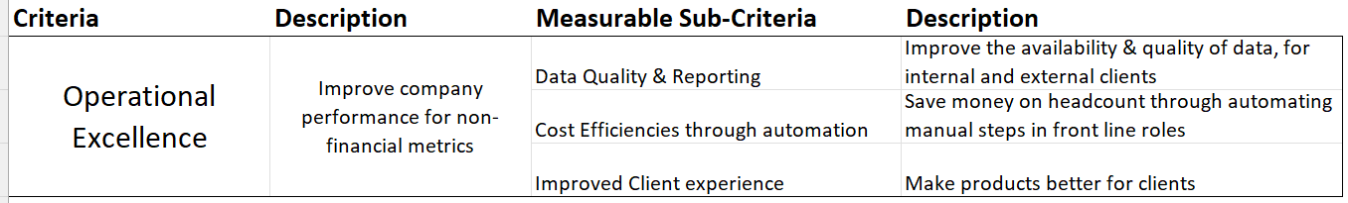
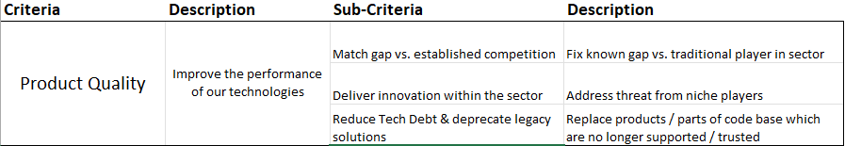
Sample Criteria IT Backlog
Split into Revenue, Efficiency & Quality
Revenue could measured in a lot of ways – but here the focus is supporting Sales in a B2B model
Product Quality helps capture less immediately quantifiable benefits… but are threats that are key long term performance NOTE – In this context Legacy Tech is proactively improving solutions before they break & become ‘must-do’ items

Slide 31
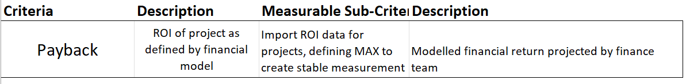
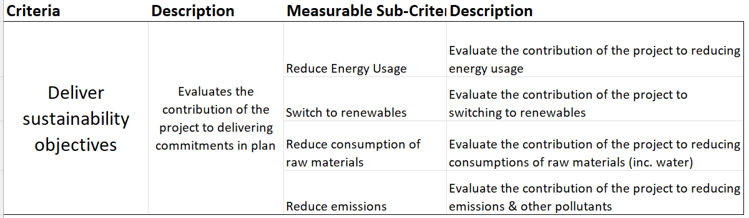
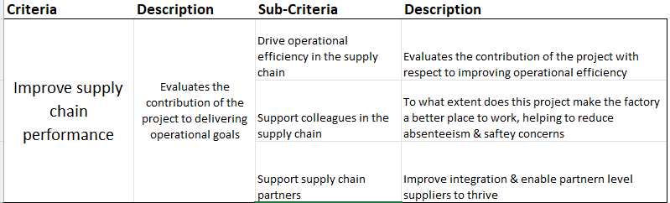
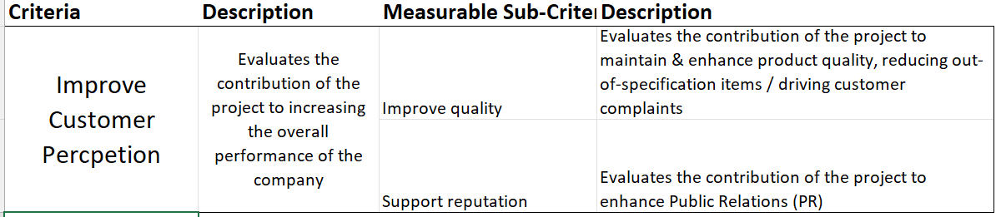
Sample Criteria Industrial Capex Review
Split into 4 main parts
Payback measures shareholder return
Sustainability considers environmental responsibilities
Operational Performance considers supply chain stakeholders & efficiency
Customer Perception factors in end users’ experience (Note that we’re mixing up the 6 buckets here – that’s fine!)

Slide 32
Scales (because a good criteria needs to be measurable)

Slide 33

Scales Measuring direct value
Delivery vs Goal Scale - core 5 tier scale, works for lots of different criteria
Scale templates are in the software as a start but need to be edited
These examples are for good for performance vs. targets
Aim for maximum precision– e.g. quantified scales
Always use the Description to reduce ambiguity in language
100 | Critical Impact | This project is key to the delivery of this goal, a real game changer
75 | High Impact | This project makes an important contribution to the delivery of this goal
50 | Medium Impact | This project makes a solid contribution towards delivering this goal
25 | Marginal Impact | This project makes a marginal contribution towards delivering this goal
0 | No Impact | This project makes no contribution towards delivering this goal
Performance vs. Benchmark Scale - should include quantitative banding
100 | Strongly Exceeds Benchmark | This project has a very high return vs benchmark
75 | Slightly Exceeds Benchmark | This project returns at a higher rate vs. benchmark
50 | Meets Benchmark | This project has a return similar to benchmark
25 | Below Benchmark | This project has a low return vs. benchmark
0 | Zero or less | This project does not deliver a positive return

Slide 34
Scales Measuring less direct benefits
Be specific with your Criteria, so “efficiency” may be split into sub-criteria (e.g. Customer Care vs. Sales)
Quantifiable goals are great (e.g. if you need to save $1m say so)
Consider having a “0” which is destroying value (i.e. this project is bad for this stakeholder)
Where you have targets (e.g. Net Zero Carbon) include them – to what extent does this project enable this goal?
Efficiency Scale - Use for criteria where performance improvement is the objective
100 | Transformational Improvement | This project will enable a step-change in performance for this objective.
75 | Important Improvement | This project will drive a considerable improvement in performance for this objective.
50 | Some Improvement | This project will help improve performance for this objective to some extent.
25 | Little Improvement | This project will only provide a small degree of improvement for this objective.
0 | No Improvement | This project has no impact on this objective.
Stakeholder Impact Scale - Includes negative impact option where project destroys value for stakeholder
100 | Critical Contribution | This project will be critical to achieving this criterion
75 | Significant Contribution | This project will have significant positive impact on achieving this criterion
50 | Some Contribution | This project will have some positive impact on achieving this criterion
25 | Neutral | This project will have no impact on achieving this criterion
0 | Destroys Value | This project will have a negative impact on achieving this criterion

Slide 35
Scales Example Scales: Measuring Risk
Risk is a broad term and can mean a lot of things. Two common choices are:
Business Risk – focus on level of mitigation achieved by project
Project Delivery Risk – Using an inverted scale, projects which are more likely to go wrong score lower
Before adding Risk as a criteria consider if it’s better in a separate model
If Business Risk is dominated by ‘Must-Do’ projects make it a Gating Factor
Project Delivery Risk may be something to add after initial prioritization as final check
Business Risk Scale - includes the significance of the risk
100 | Materially Mitigates Risk | This project effectively eliminates the risk
75 | Manageable Risk | This project will reduce risk to a manageable level
50 | Significant Risk Remaining | This project will reduce the risk significantly, but it needs further mitigation
25 | Some Impact on Risk | This project will make a small contribution to reducing this risk
0 | Not Relevant | This project is not relevant to this risk
Project Delivery Risk Scale - inverted scale to apply high score to low risk
100 | No Risk | This project poses no meaningful risk
75 | Low Risk | This project only poses low level risk
50 | Manageable Risk | This project has risk, but it's manageable
25 | Potentially Dangerous Risk | This project has significant risk with no clear solution in place
0 | Dangerous Risk | This project has the potential to go horribly wrong

Slide 36
Scales Create custom scales with these simple tips
Scales must be ascending (i.e. 0 bad / 100 good)
Scales cannot be negative numbers
Include zero (i.e. project has no relevance to that Criterion)
Scale Values to signify relative importance
i.e. If a project scores 75 it is 3x more important than one scoring 25
If a project scores 35 it is 7x more important than one scoring 5
Use a Description to give the scores meaning to people taking the survey
5 level linear progression (our standard approach)
Doubling
Ad-Hoc / Best Feel

Slide 37







Building Criteria Summary
Set your portfolio strategy up front
Always recycle by starting with existing reviews & documentation
Don’t use meaningless jargon or ambiguous ‘strategic’ language
Decide what’s not in the model but is in the data collection process
Engage your leadership so this is their model
Sub-criteria need clear descriptions & measurable scales
Don’t create a monster scoring survey by saying yes to all criteria
AHP rocks
Look no ands!
What a good idea, let’s add even more criteria

Slide 38
TransparentChoice Building Criteria – User Guide
Software Set-Up
Client Hub Page

Slide 40
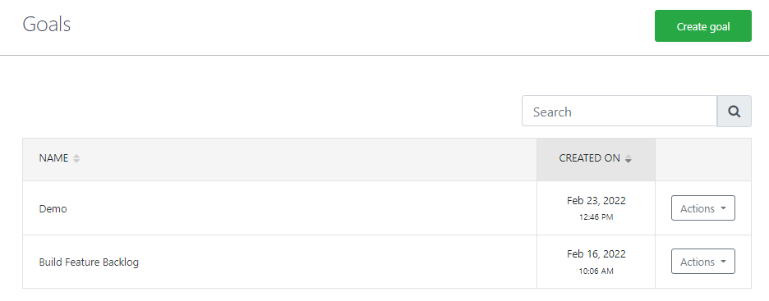
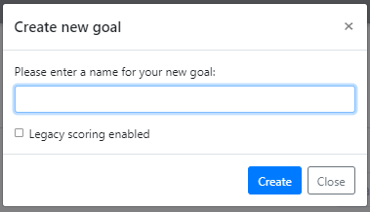
Build Criteria Create new model
Go into the Evaluation menu & Create goal – it’s name will become the top level in your model
Use Action button to Clone existing model
Only enable Legacy scoring if want to do a Pairwise review of alternatives (this is typically only suitable for some Pick One decisions)

Slide 41
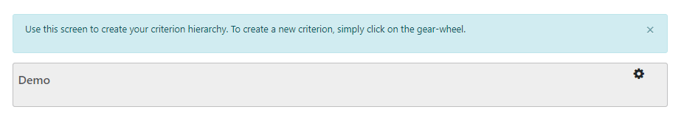
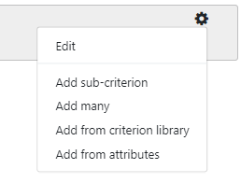
Build Criteria Load Criteria
Click on Cog to start adding Criteria…
Change the name or description of the criterion Also use this to DELETE a criterion
Use our Criteria Library to get started
Add Criteria manually – one by one or as a batch
Pick a Numeric Attribute from the database to link to model

Slide 42
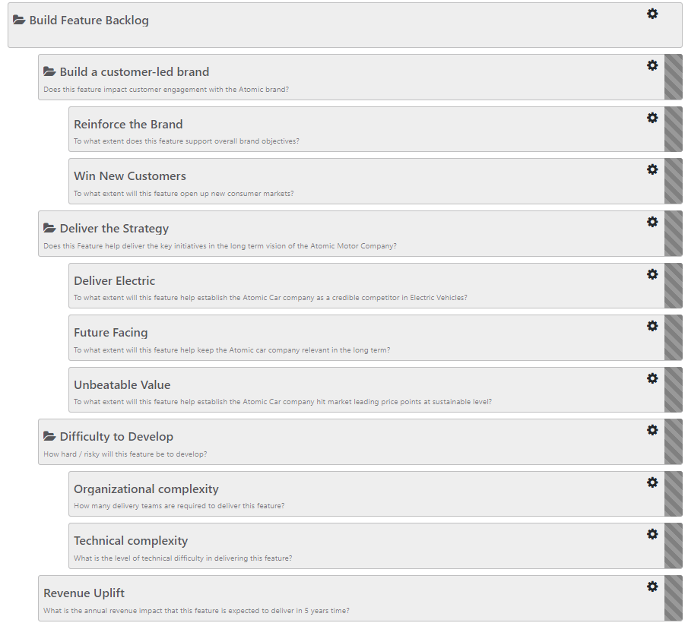
Build Criteria Cluster Criteria
The top level of your hierarchy will be weighted against one another in your pairwise review
Within each Criteria the sub-criteria will ‘share’ the weight assigned to that branch – so if you have too many sub-criteria they’ll not be worth very much individually!
While it’s usual to have sub-criteria beneath your criteria, it’s OK not to (you’ll score at this higher level)

Slide 43
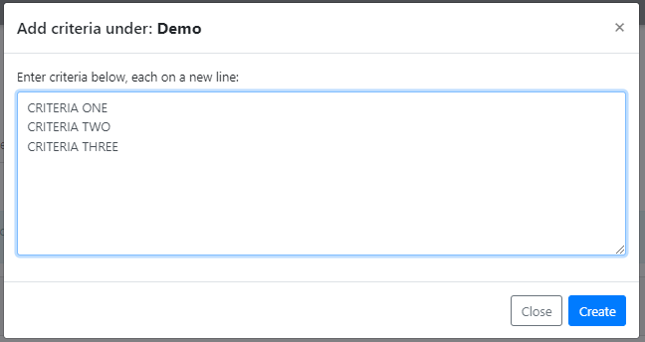
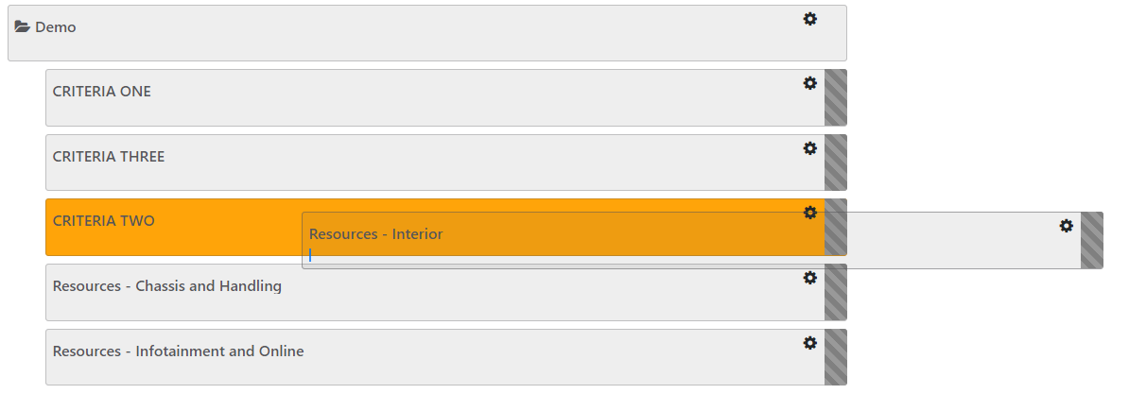
Build Criteria Best Practice – when to use what
1
2
3
Manually add Criteria if:
You’re discussing as a group and typing as you go
You have an Excel template to copy in
Tip - If you’re using Library or Attributes for sub-criteria you’ll probably want to add in Criteria to cluster – use the Manual Option to add them, then click & drag to create your hierarchy.
1
Use Criterion Library if:
You want a quick ‘proof of concept model’ with a selection of generic criteria
Using typical criteria as a base to edit for your use case
2
Use Attributes if:
You already have an AHP model and you are ‘recycling’ criteria / scoring
You have already imported hard data to use for scoring
3

Slide 44



Add Measurement Scales 2 critical steps for linking AHP model to Projects
Linking Criteria to Attributes enables data collection
Adding a Scale or Min/Max to the Attribute to make it measurable
Configuration is simple, but we recommend spending time to get scales well built
1
Criteria
Pairwise
Criteria Weights
2
1
Value Score
Scale
Assessments
2
Attribute
Min/Max

Slide 45
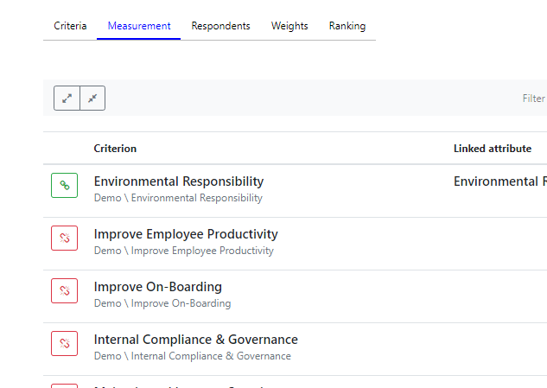
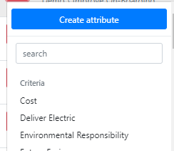
Add Measurement Scales Link Criteria to Attributes
All happens from Measurement Tab
Linked
Not Linked
Create a new Attribute with which to measure criteria
Link Criteria to an Existing Attribute

Slide 46
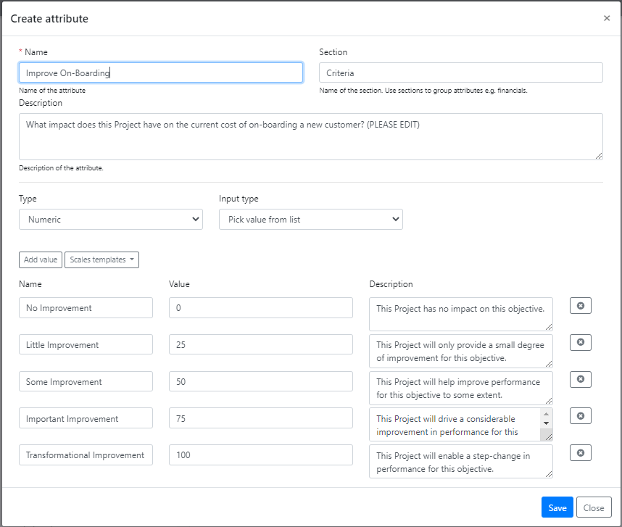
Add Measurement Scales Add a Scale to an Attribute (1)
For Criteria from our library we’ll recommend a scale
Please edit these scales to make them relevant to your Respondents

Slide 47
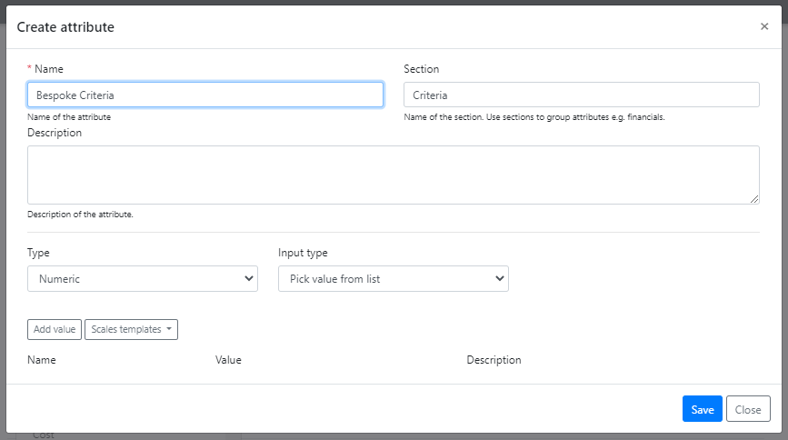
Add Measurement Scales Add a Scale to an Attribute (2)
If you’ve created your own criteria you’ll need to add a scale
1
Ensure you have added a Description in the Criteria Tab – this will then appear here: DO NOT EDIT HERE AS IT WILL NOT SYNC!
2
Pick From List creates a scale – use as default for most criteria (see Advanced set up for how to use manual option)
1
2
3
Add Value enables you to manually build a scale with bespoke values & number of levels
3
4
Scale Template enables you to pick from pre-defined scales (see Advanced set up on how to add / edit scale templates)
4

Slide 48
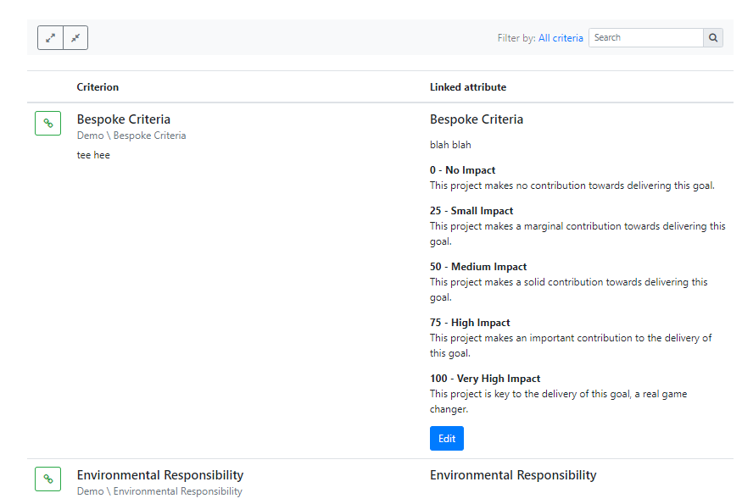
Add Measurement Scales Review All Attributes + Scales
1
3
1
Open / Close ALL to view scale detail – recommended for final sign off
2
… or click on the Attribute Name to Open / Close one by one
2
3
Use Filter to limit view to one part of Criteria hierarchy. Ideal for larger models
4
Hierarchy details below Criteria – handy for reference
4

Slide 49
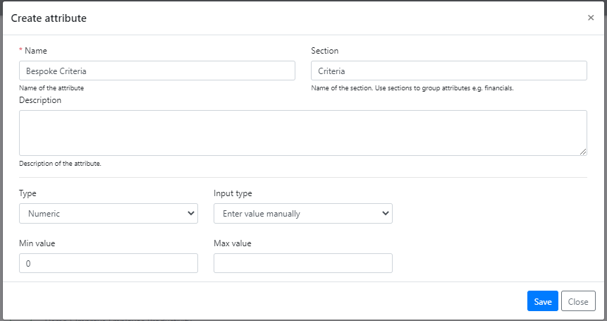
Add Measurement Scales (advanced) Measuring criteria with objective data
Setting your Attribute to Manual means you have no scale – just a field for adding data
For a Criteria you must define a MAX value
MAX value will define “100” score in your criteria – all other scores become a ratio of this. Without it your model will be unstable
Define MAX based on ‘beyond this point there is no extra benefit’
For example, “Years in Operation” might be a criteria in a vendor assessment, but 100 years is no better than 20 years. Without a MAX (of 20) 100 would score 5x more than 20, which does not reflect reality.
MIN should always be 0 for an AHP scale
Collect data without a scale

Slide 50
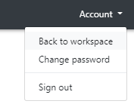
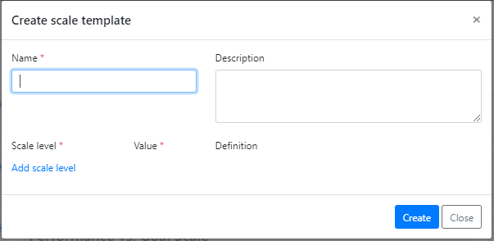

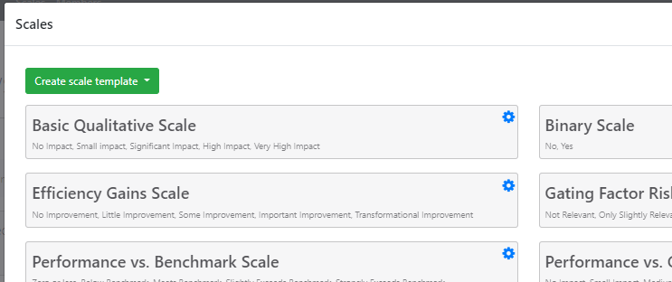
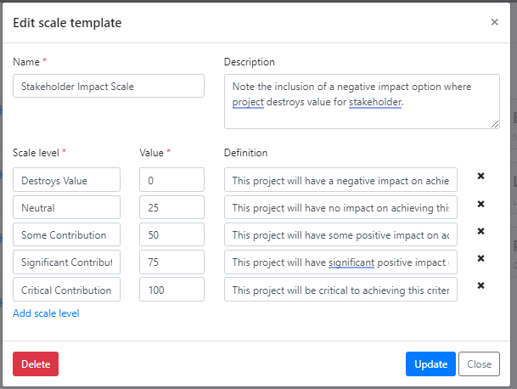
Add Measurement Scales (advanced) Add a new scale template
To Edit Scale Templates Navigate out of your Portfolio & back into your Workspace
To Create New – Add name & Description then start Adding New Levels
1
… or edit existing scales by Clicking the Cog
1
2
2

Slide 51
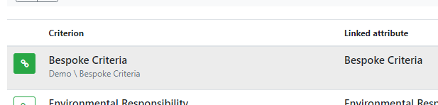
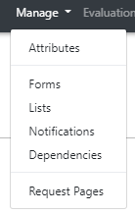
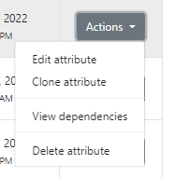
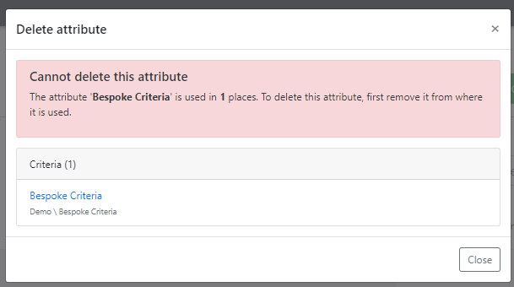
Add Measurement Scales (advanced) Delete an Attribute
To Remove an existing Attribute Select a new Attribute for your Criteria OR Delete the Criteria itself (you cannot ‘unlink’)
Go to the Attributes Menu, Criteria Section, and use the Actions button to Delete the Attribute you no longer need
If you see this flag it means the Attribute is still being used elsewhere in the software and cannot be deleted until the dependency is removed

