Slide 1


TransparentChoice
Configure Pipeline – Best Practice Guide
Best Practice
Client Hub Page

Slide 2
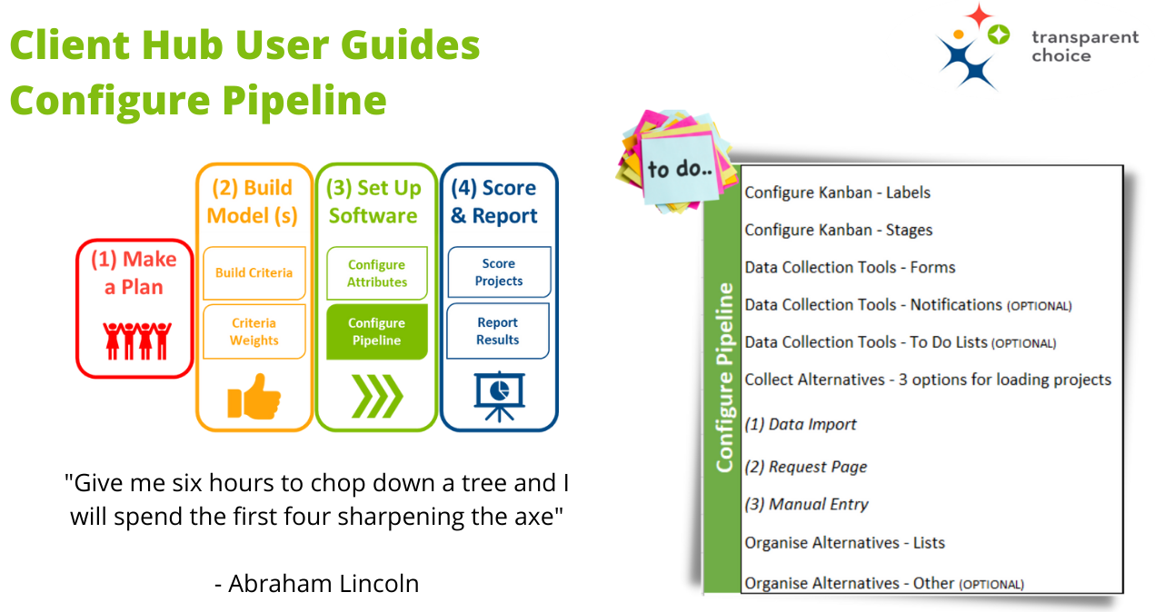

Slide 3

Pipeline Configuration
Product Features Checklist
The Kanban is your decision process – customise in order to manage projects based on status within a workflow
Forms capture data defined in Attributes – customise for different stakeholders to make it easy for stakeholders to contribute
Notifications are targeted emails that trigger when a project changes Kanban Status
Lists are groups of Alternatives, typically defined by Attributes and/or Kanban Status, which will drive Reports and Assessment Panels
There are 3 ways to add Alternatives into your model
  Directly via Kanban Create Projects button
  Requests Pages sent to stakeholders
  Upload from a spreadsheet

Slide 4

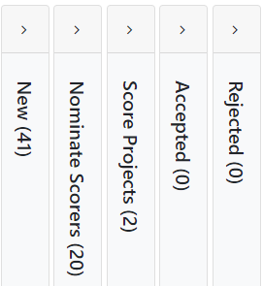
Kanban
Use Cases
Name the Stages in your decision pipeline
  Gating Factors identified in Criteria review
  Data collection steps (e.g. Add Costs / Score Benefits)
  Outcomes (e.g. Q1 / Q2 / Reject)
Use movement between Stages to trigger Notifications to designated project contacts. Embed a Form to collect Attribute data.
Create Lists for Dynamic Surveys based on Stage to create an automated survey trigger
Build Stages into Reports to visualise the portfolio & create analytical insight
(we’ll deal with this later when we build Reports)

Slide 5
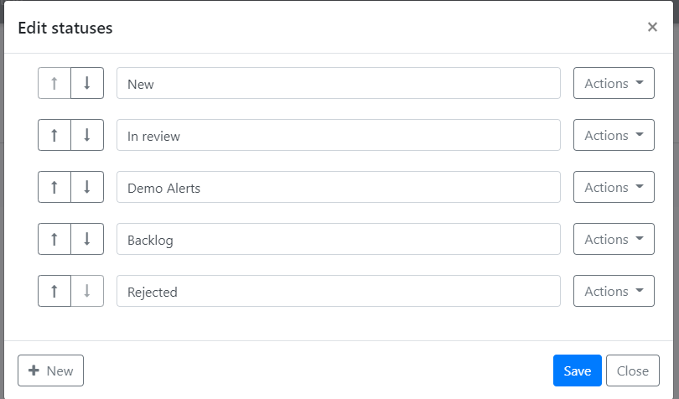
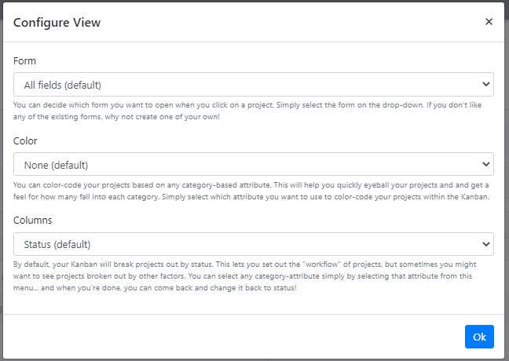
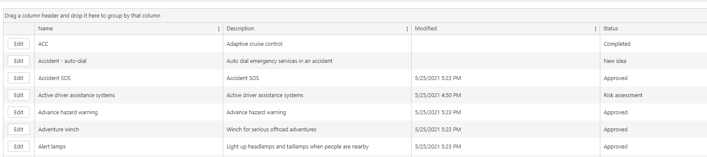
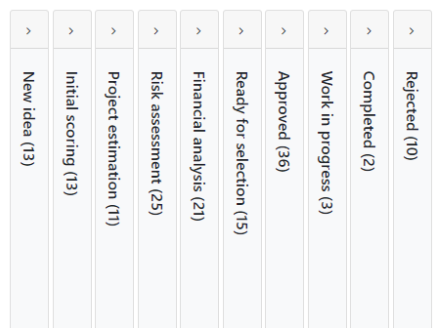
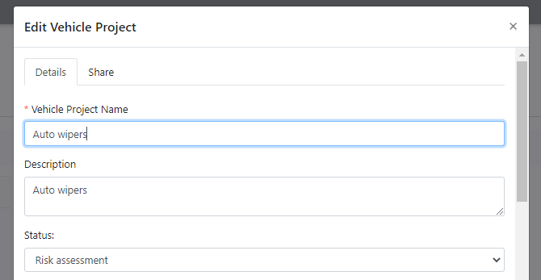
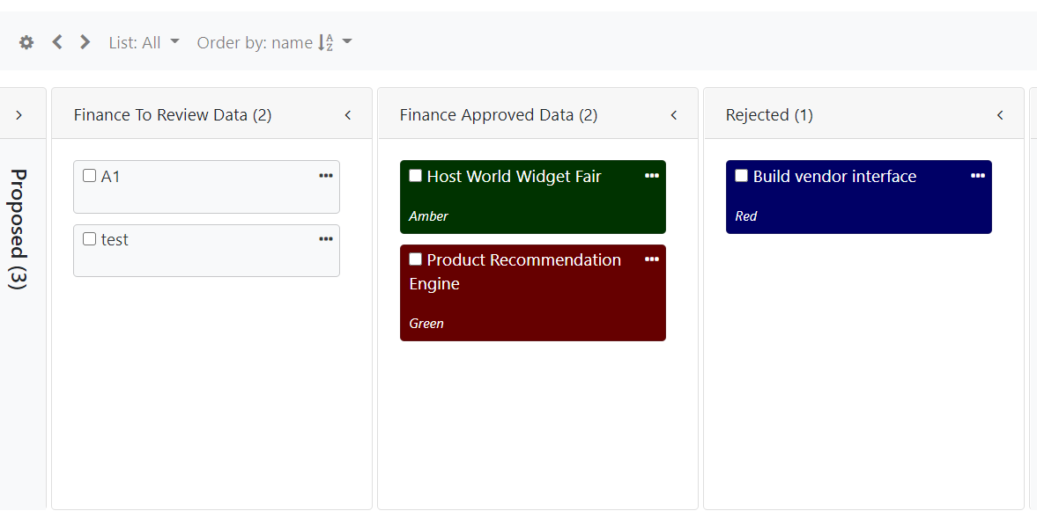
Kanban
Configuration
Configure Kanban
  Edit Statuses to change name & add/delete steps in Kanban
  Edit Labels changes “Projects” to whatever term works best for you
Edit & Review project level data
  Select Form to enable editing
  Click into project to see all data + decision log
Change how the Kanban displays
  Grid View: for checking data
  Colour code projects: use Text / Pick from List Attribute to break up portfolio
  Sort by Column: Quick scoring for Numeric / Pick from List Attribute
Note: changes to views are saved to Cookies (i.e. local only)
  Reports may be better for Grid view data that you want to revisit

Slide 6

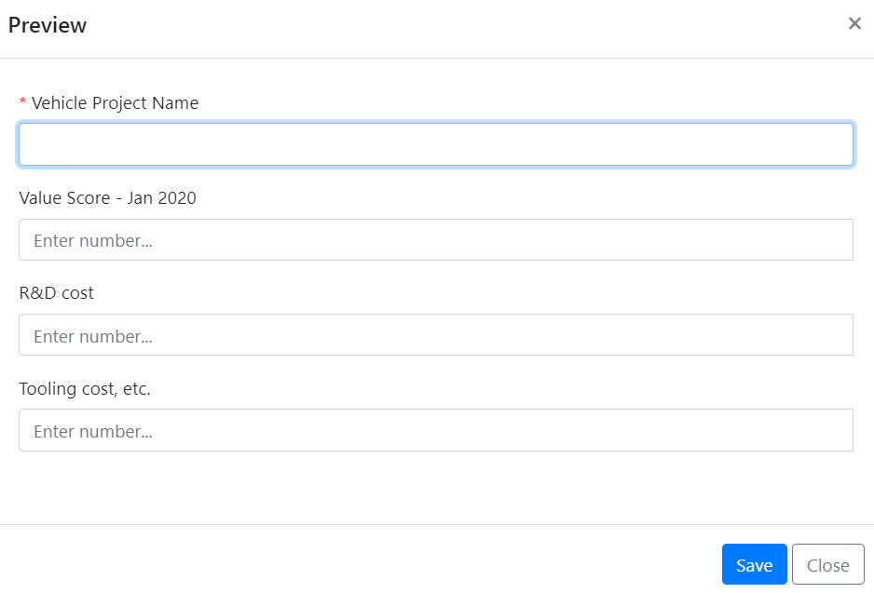
Forms
Collecting & Sharing data for Alternatives
Used to collect Attribute data
Embed in Notifications or Reports, access from Kanban or URL
Organise your Form using Sections
Customise Labels for extra clarity
Use Required to force compliance
Use Read Only to make specified fields ‘FYI only’
Customise Forms – use Clone to make it easy to replicate templates
Build Forms
Design them to be easy to use, well labelled & bespoke to the recipient
Target Notifications
Send to specified contacts based on project roles
Use Forms
Realtime data collection with a live connection to the database
Embed Forms
Make it convenient for people to find & complete + minimise admin

Slide 7

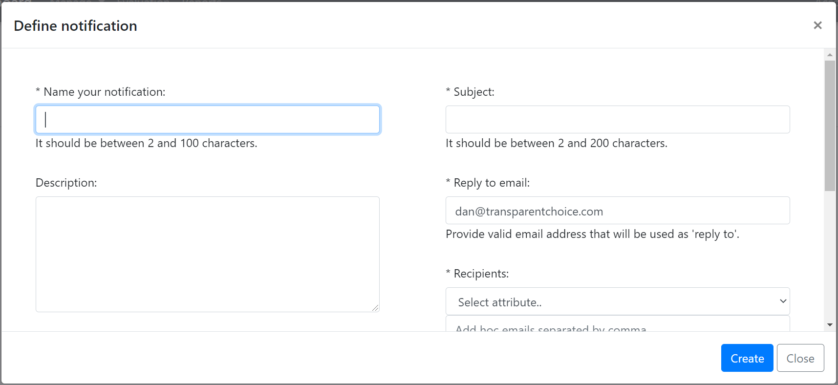
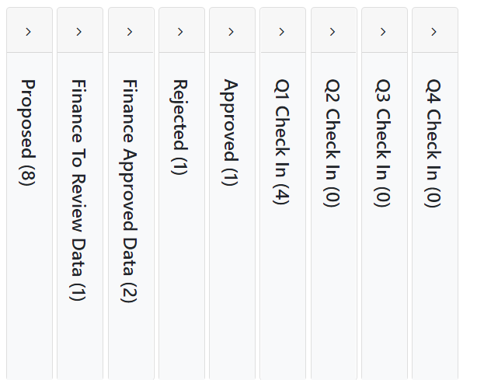
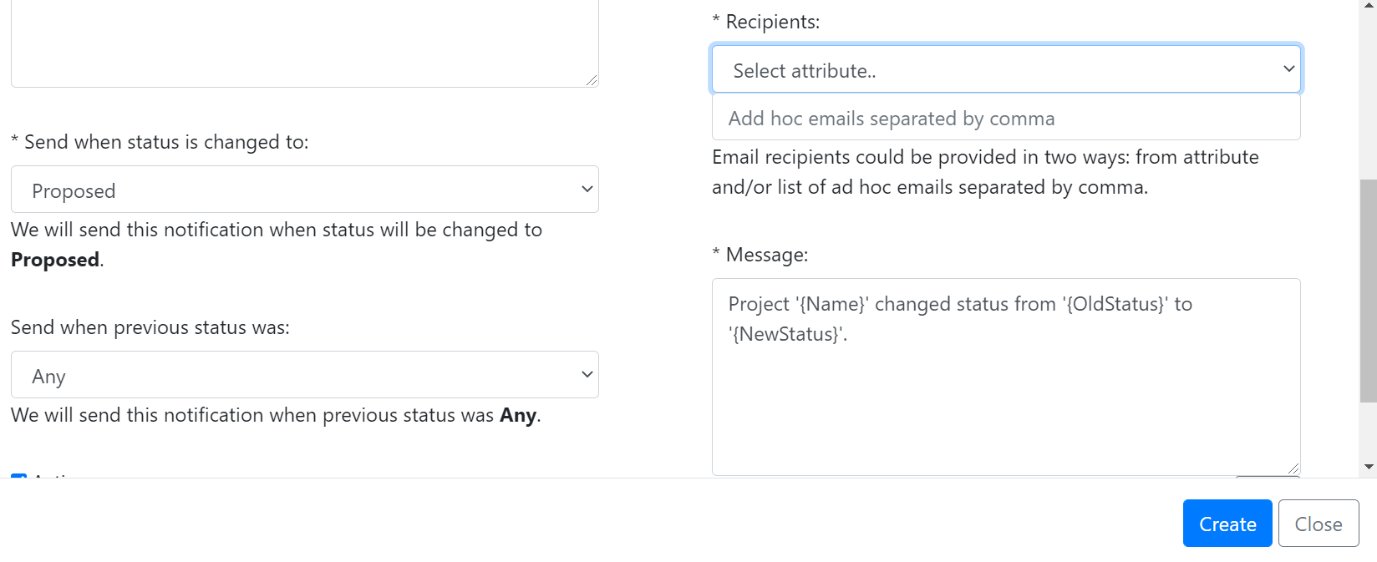
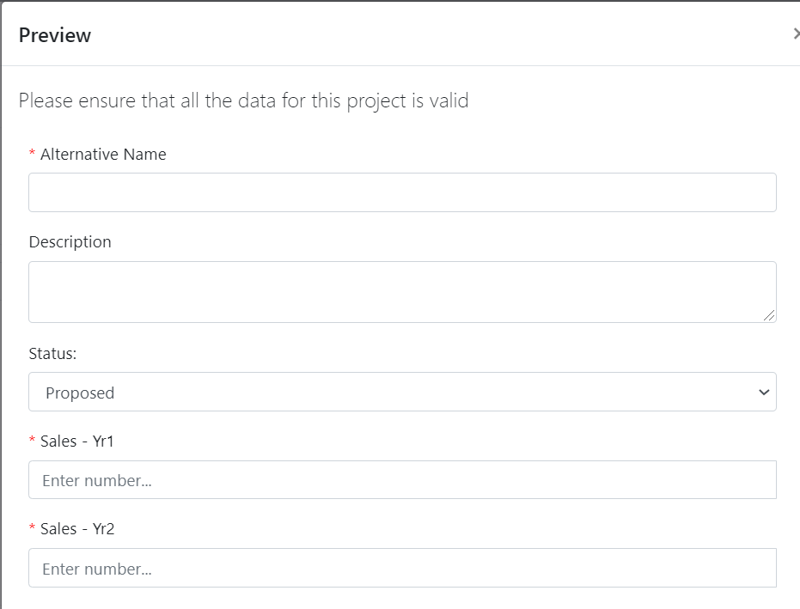
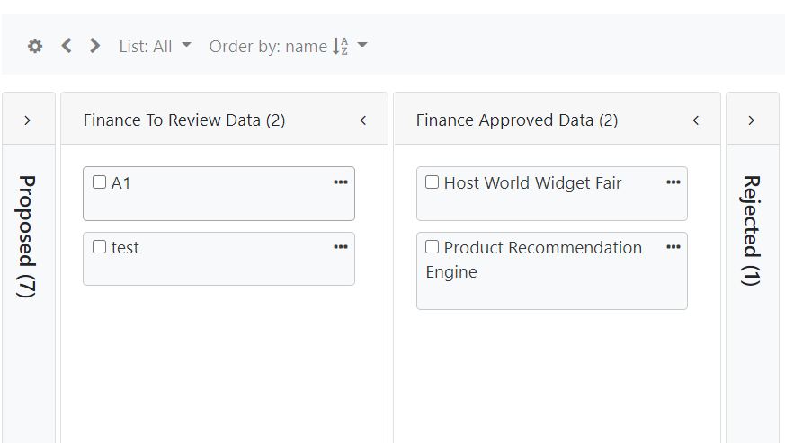
Notifications
Alerts triggered by change in Status
Moving Status in Kanban triggers a Notification
Add a Form into the Notification if you want to collect Attribute data as part of the Notification
Notifications are directed by email, using an address you can enter manually or customise at Project level via Attributes
Email Attributes for firing Notifications can be manual, pick from list or multi-select

Slide 8

Lists
Group projects together
Configure Lists using Reporting Hierarchy & Kanban Status
Lists group together projects, and can be Static or Dynamic
Dynamic Lists are based on Status, Attributes & other Lists, and change as data comes into the model
Static Lists are fixed
Lists are used to configure Assessment Panels, filter Reports & filter Kanban
Lists can be set up anytime but configuring Lists as part of set-up is advisable
Create List for all Projects in Department A – use this for Reports
Create List for All Projects in Kanban Status “To Review”
- use this for Reports
Create List all projects in both – use this for Assessment Panel

Slide 9

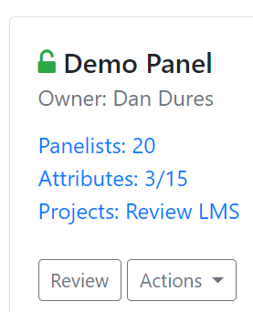
Assessment Panels
Configure data collection
Manage your Respondents with email reminders, completion tracking & targeting changes
Assessment Panels are for collecting Attribute data
Ideal for scoring Criteria, but can be used for any numeric Attribute
Combine multiple scorers’ knowledge to reduce noise & bias
Use Lists & Targeting Attribute to configure
Customise your survey with an enriched Description Attribute
Pick any numeric Attribute to score – “Pick from List” types will give you a handy scale to make data capture easy
Configure your survey - pick projects using a List, pick Respondents using a Targeting Attributes + add a detailed Project Description

Slide 10

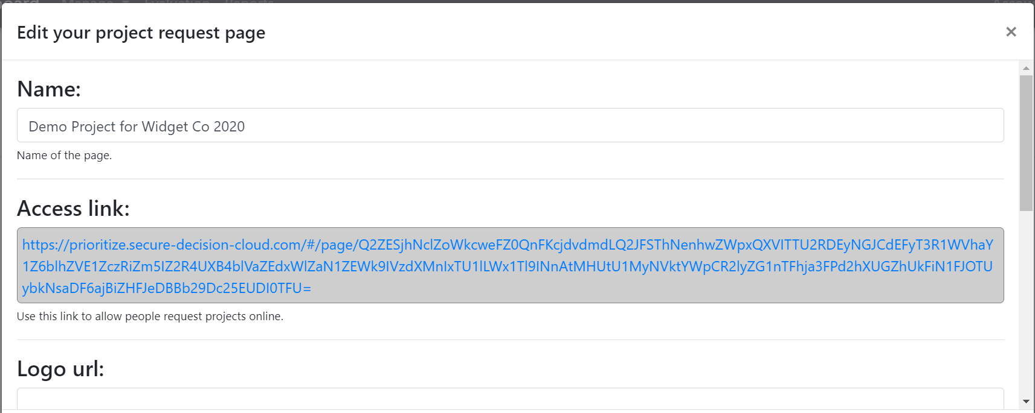

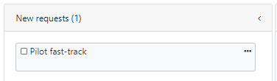
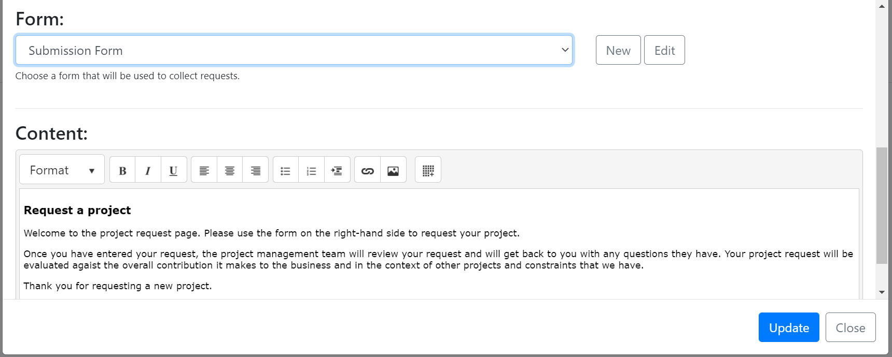
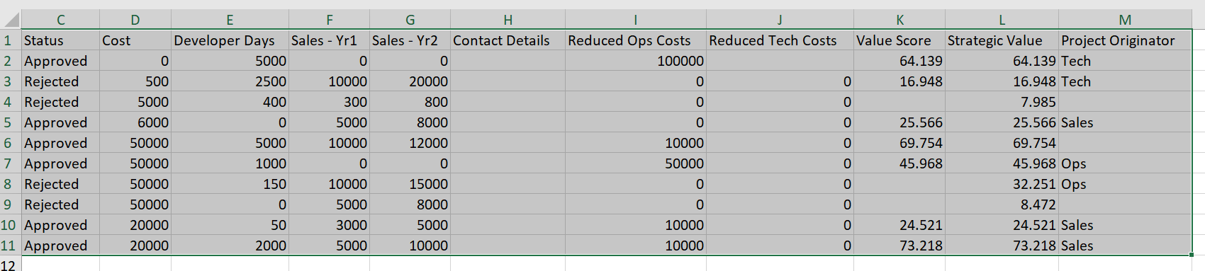
Load Alternatives
Add Projects in 3 ways
Ask colleagues to submit requests & ideas using Request Pages URL – embed a Form to capture set-up data
Add projects one at a time via Kanban
Batch import via spreadsheet to fetch data from another system
It’s fine to mix – e.g. initial setup via Excel then add last minute projects manually

Slide 11
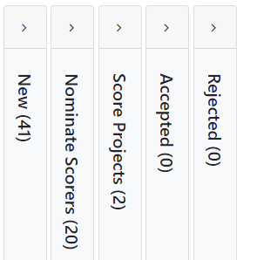
Use Cases
Build Pipeline configuration based on business process
New– all new ideas arrive in Kanban
Set up your Pipeline
Automate your Pipeline
Request Pages to add projects
+
Forms to collect project data
Nominate Scores
Add assessors to rate each project
+
Lists + Assessment Panels to score projects
Score Projects
Notify scorers they have projects to review
Once projects are scored, review in Reports & set outcome
Notifications to alert scorers of new projects

Slide 12
Use Cases
Use Excel to get your model started quickly
Configure Decision Pipeline
Collect Data to feed into model
+
Configure Attributes
Criteria
Cost
Dept
Targeting cell
Configure Pipeline
Kanban
Lists
Assessment Panel
Load in Respondents
Set Lists / Targeting / Attributes
Import Projects
Excel template
Update Kanban
Move projects to “REVEW”
Get Scoring
Send Links
Chase Completion
Save Scores into model
TIPS
Iterate Criteria in Excel to get buy-in before copying them into Attributes – you can use this template
If you’re using the same scale across multiple Criteria, then use Clone to save you time re-keying
If “Resource” is an estimate get a small panel to submit views separately then compare their answers – reduce noise
Organise Respondent data in Excel – it’s easy to copy-paste directly into the software
TIPS
Use the CONCAT function in Excel to combine multiple cells into a comma separated string – then feed this into the model
Set up Notifications using your Targeting Cell, so that Scorers are alerted when they have new projects to review
Set yourself reminders to chase completion on outstanding surveys to increase compliance and reduce noise

Slide 13

Use Cases
Do you have a “Spaghetti Mess” challenge?
Project requesters
You →
Delivery Teams
Oh Crikey
Everything matters!
We can’t do all this!

Slide 14
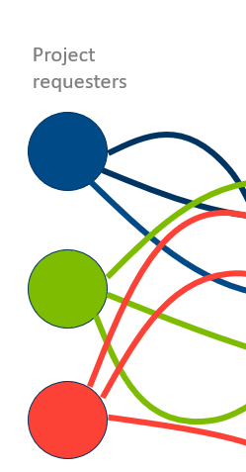
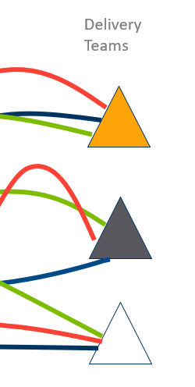
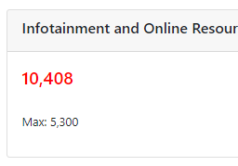
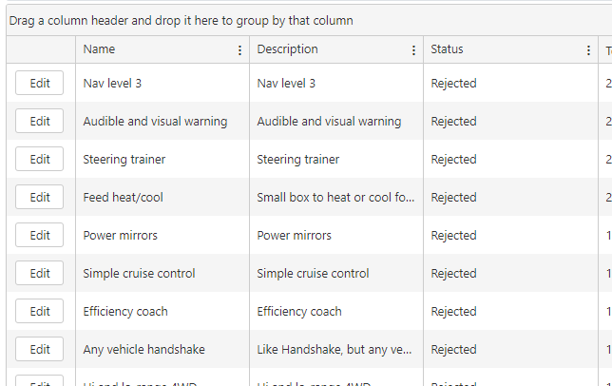
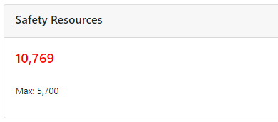
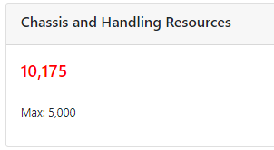
… take control with a well structured model
Create Attribute – teams benefiting from project
(Set up each Team as Y/N Text Attribute)
Build Lists – Projects for Team A / B / C that are used to produce custom Reports
Create an Attribute for each delivery team
(Resource requirement broken down)
Build limits into Reporting to show capacity vs. selected portfolio
Select Projects based on value & resource limits & use data to shape outcomes
Iterate to deliver fairness between teams
Deploy precious resource to unblock bottlenecks

Slide 15


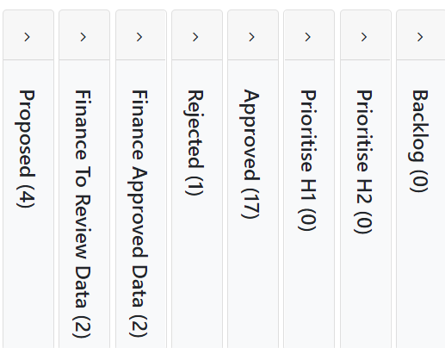
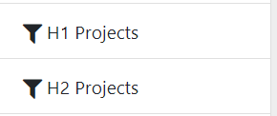

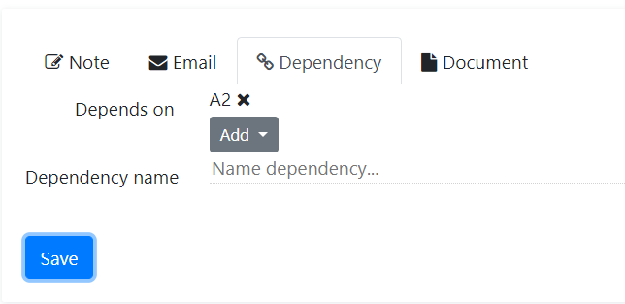
Use Cases
Set up the Kanban for modelling
Manage Pipeline
Prioritize
Now we’re going to drop the Approved Projects into a Prioritization Step based on how we will implement
In this case let’s put it into the plan for H1 / H2 or… another time!
TIP - Create Dynamic Lists built on these Statuses
TIP Make sure you have Dependencies flagged
We’ve used our staging gates to get this far

Slide 16
Checklist – Pipeline Set Up
Know how to use the Product’s core functions
Attributes
Kanban
Forms
Notifications
Import Data
Project Request URL
Create Project Button
Assessments Panel
Design the process you want to follow
Portfolio structure (“Spaghetti mess”)
New project request process
Data collection (to capture data for all Attributes)
Gating factors
Sign-off process

Slide 17
TransparentChoice
Configure Pipeline – User Guide
Software Set-Up
Client Hub Page

Slide 19
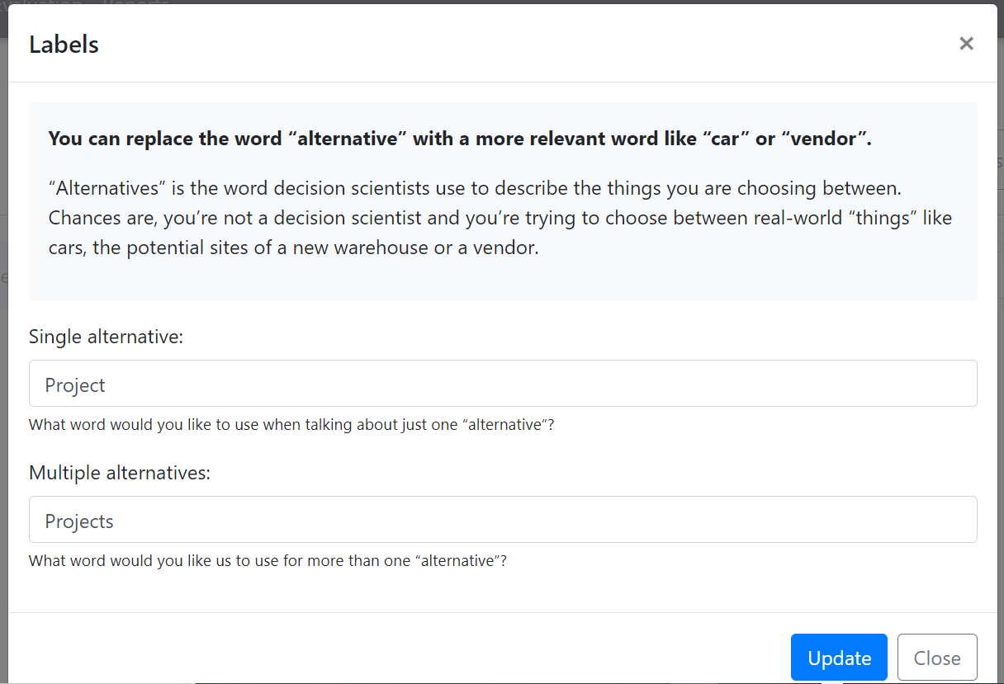
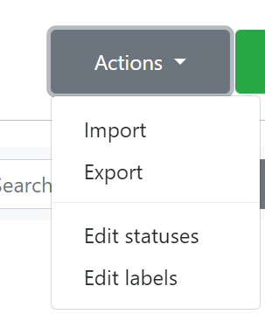

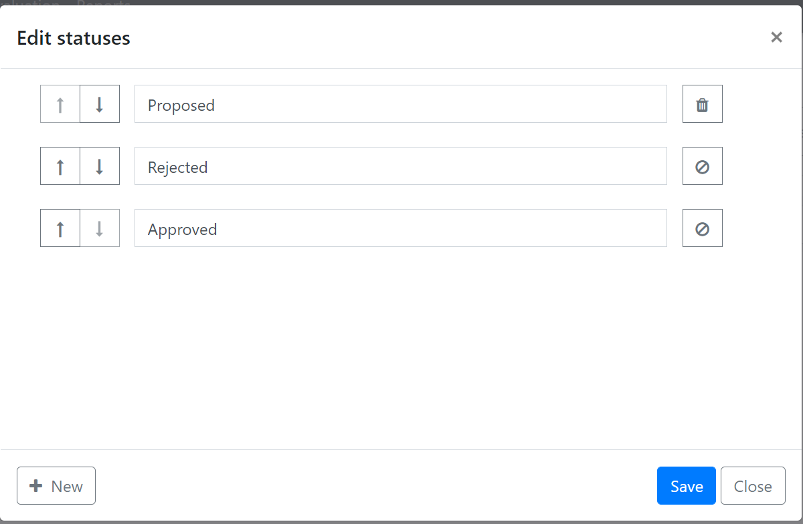
Configure Kanban
Set Labels & Stages
Customise your Kanban
Create the labels that you want to see
Adapt the steps of the Kanban to suit your internal ways of working
TIP
Kanban status can feed into your Reporting to help communicate progress, and show benefits of Alternatives at different steps
Kanban staging can be used as a decision log, with sign off steps supported by embedded email triggers to make it easy to set accountable sign-off

Slide 20
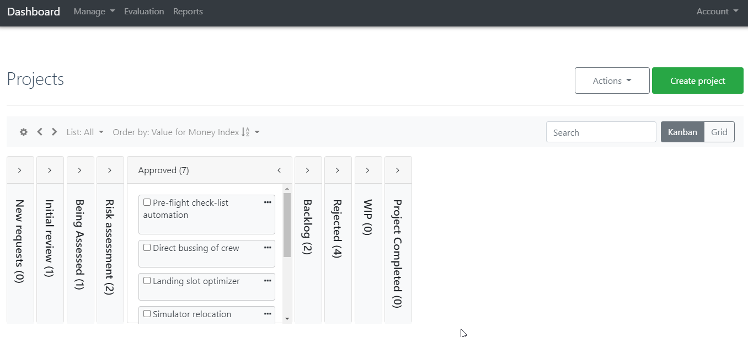
Configure Kanban
Manage Stage in the Pipeline
Create a new Alterative
NB this button changes if you relabel Alternatives
1
Return to this screen at any time by clicking here
2
5
3
Expand to see Alternatives
5
4
Counts the number of Alternatives in this step
5
Advanced configuration – will revisit this after adding in Alternatives
TIP – Set up a couple of dummy projects to get started. You can use them to test your Kanban & delete them later

Slide 21
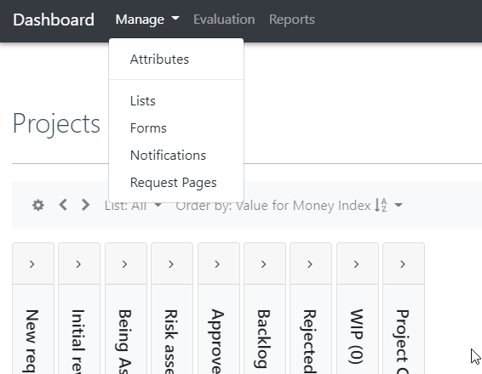
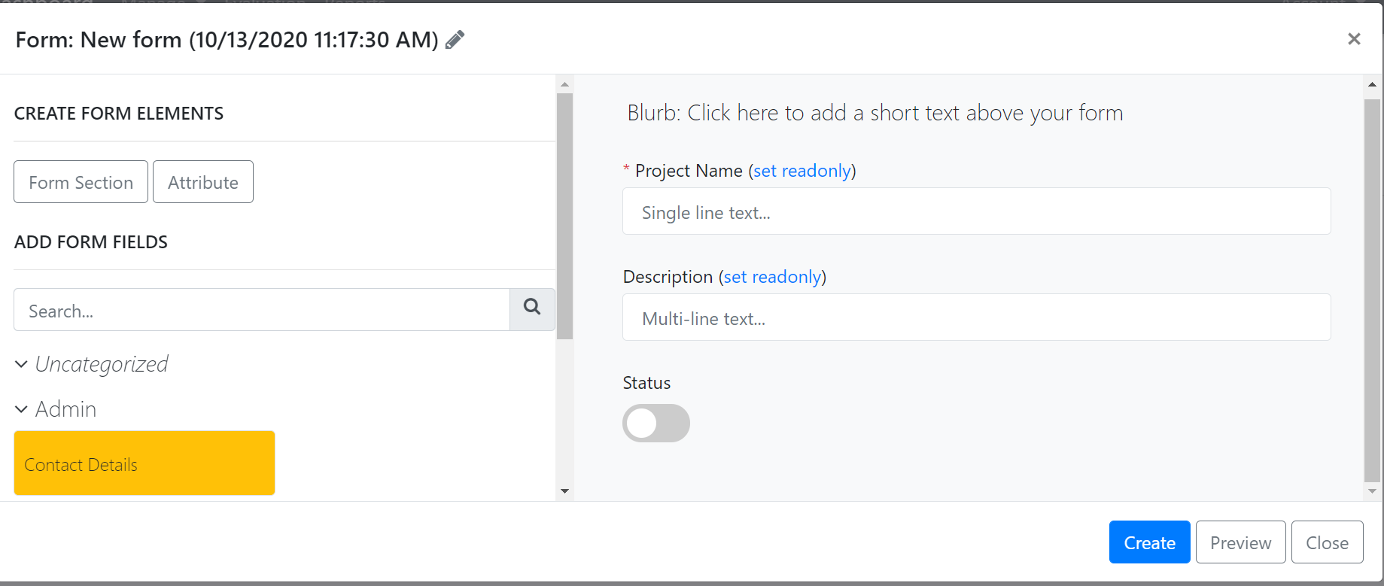
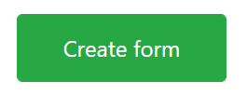
Data Collection Tools
Setting up Forms
(3) Give the Form a name to make it easy to manage later
(4) Customise the Blub to appear at the top of your Form
3
1
2
5
6
(5) You can now pick from Attributes you set up in the Data Ask that you include by dragging them over into your Form
(6) This will create your Form which you can preview before you publish.
Hit Create to publish the Form which can now go into your Notifications as a call to action
(1) Forms will enable you to decide the data you need to request data at different stages in the Kanban
(2) Create form to get started…

Slide 22
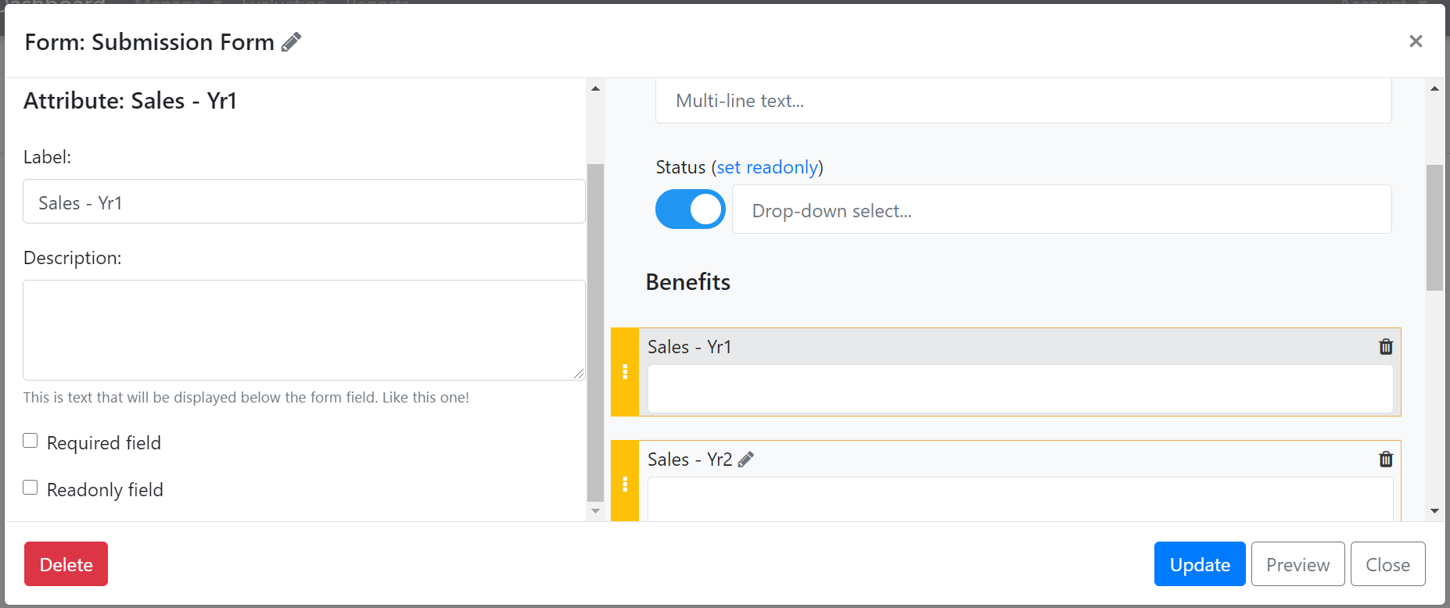
Data Collection Tools
Setting up Forms
(1) Status links to the Kanban progress – this will allow status to be managed via the Form so is ideal as proof of sign-off within de-centralised an approvals flow
1
3
2
(2) Click on the Pencil to edit an attribute for the Form
(3) Fields can be set up as Required or Read Only to manage compliance
Required is recommended for Attributes you will need to model your portfolio, as missing fields will undermine your analysis
Read Only is recommended for stakeholder updates where you are informing only
TIP – Set up Read Only Forms to enable stakeholders to review data but not change it – these can be embedded into Reports

Slide 23
Data Collection Tools
Setting up Notifications
Notifications are automated messages that the software sends out when a project / alternative reaches a specific point in the Kanban.

Slide 24

Data Collection Tools
Setting up Notifications
1
(1) Complete the Notifications form to set up automated alerting
(2) Create a name & description to make it easy to manage
(3) Set email subject & sender to manage how this presents itself in colleagues’ inboxes
(4) Recipients can either come from an Attribute linked to the project or be added ad-hoc
(5) Set the trigger linked to the Kanban – defining prior status and new status
(6) Embed a Form in a custom message
2
3
4
5
6

Slide 25
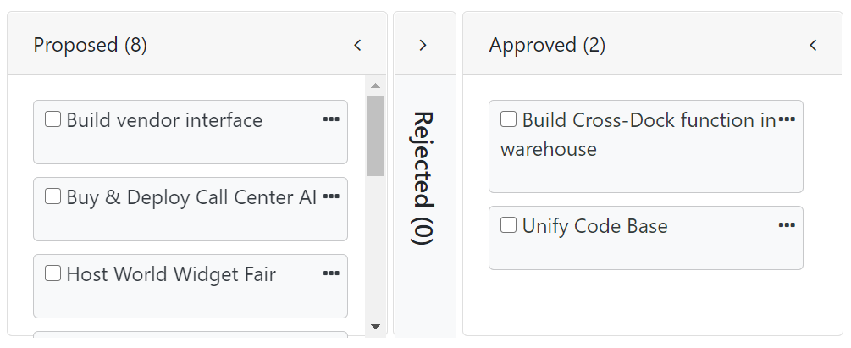
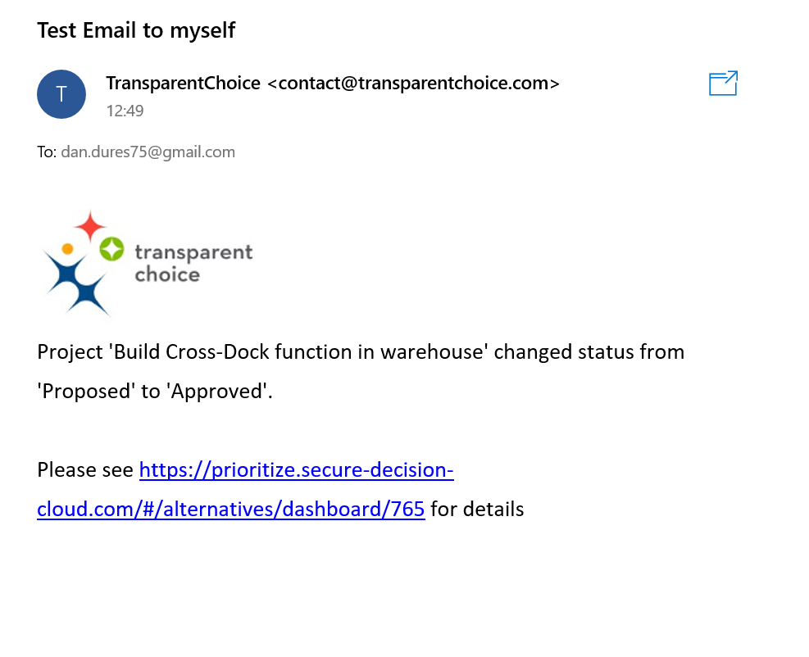
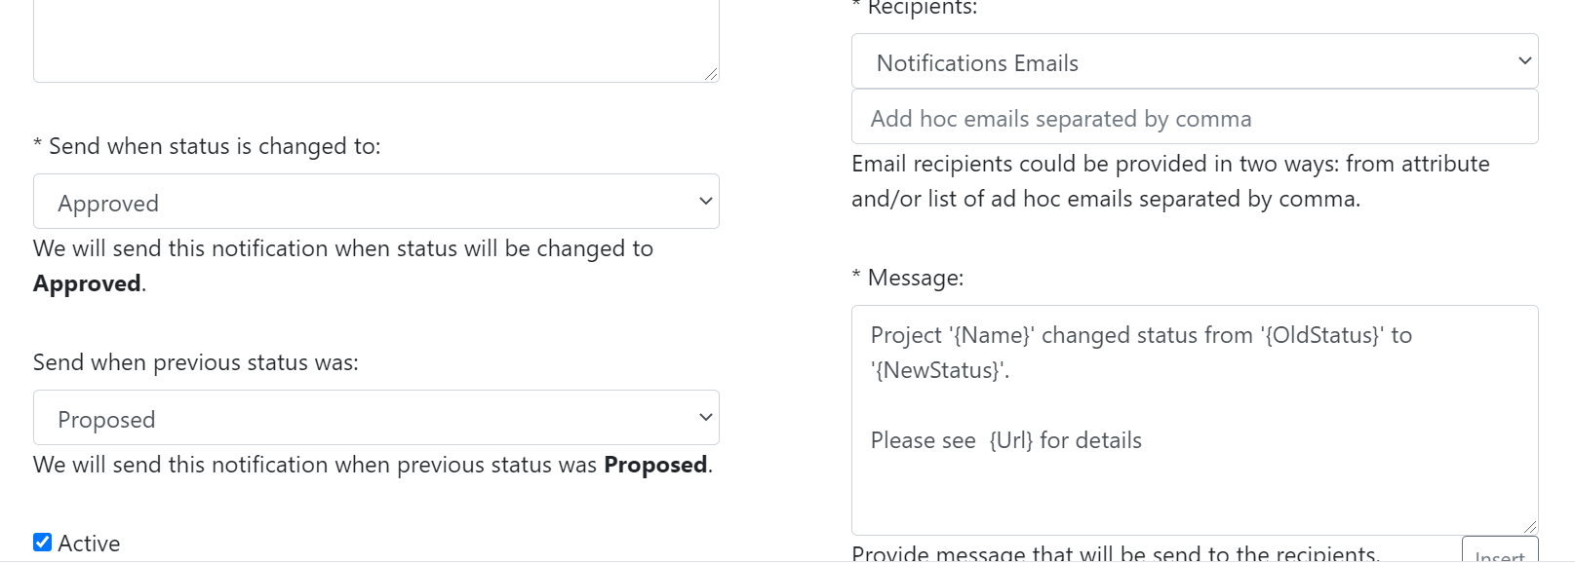
Data Collection Tools
Triggering Notifications
1
Start by moving a Project from Proposed to Approved
3
And then we get this email with the news our project has progressed
2
Notifications are set up to trigger on this change, using the contacts we added in an Attribute to our project

Slide 26
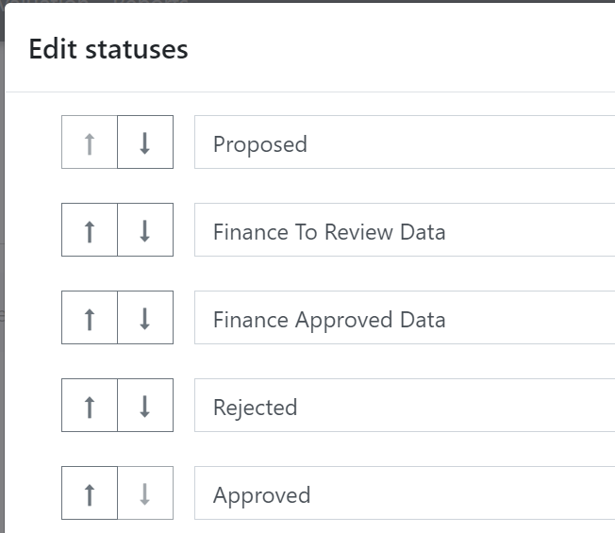
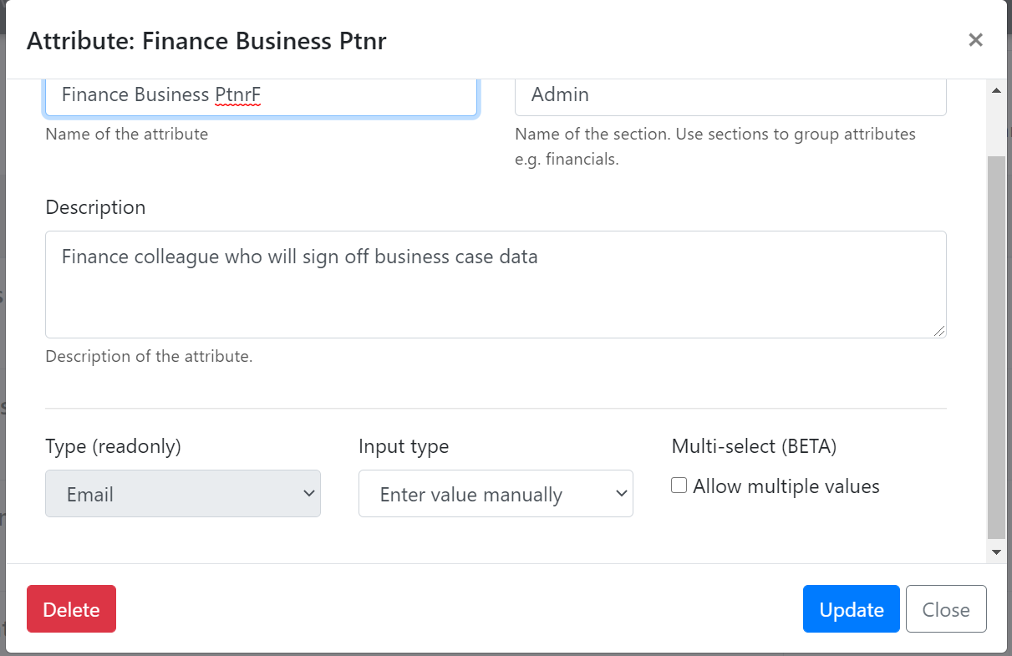
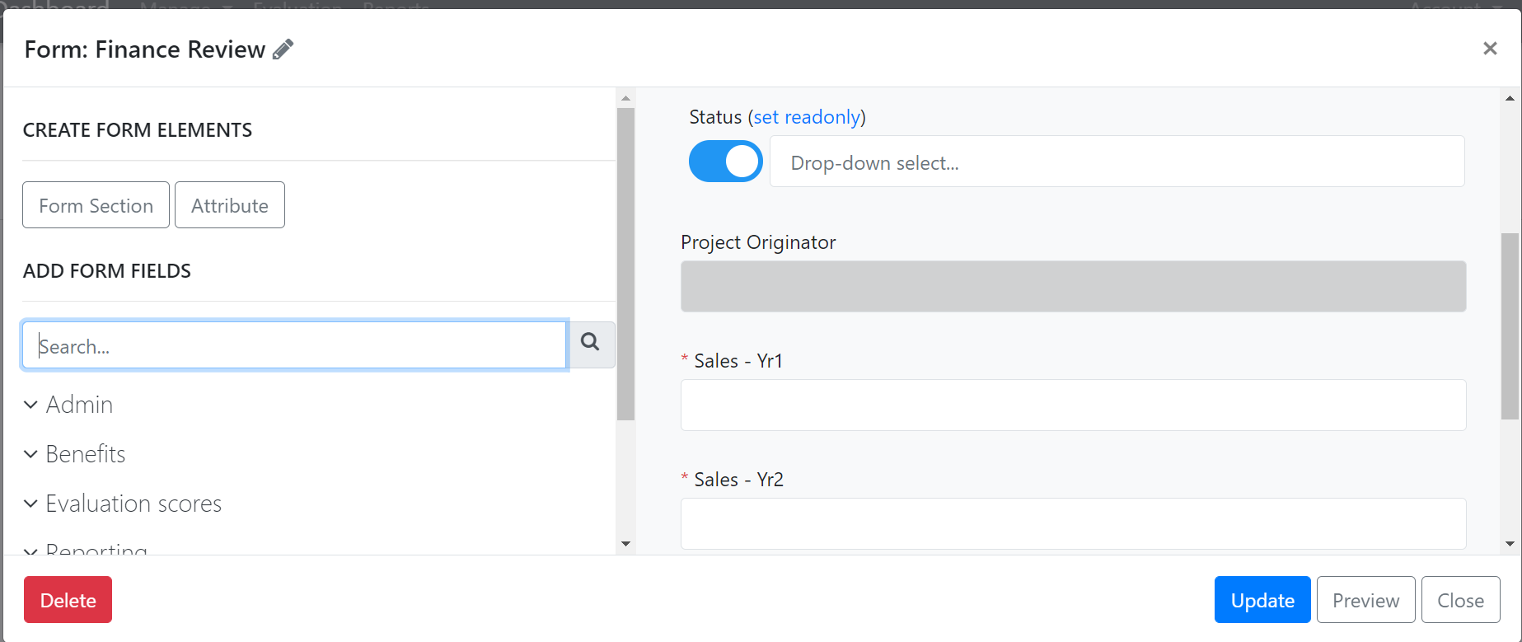
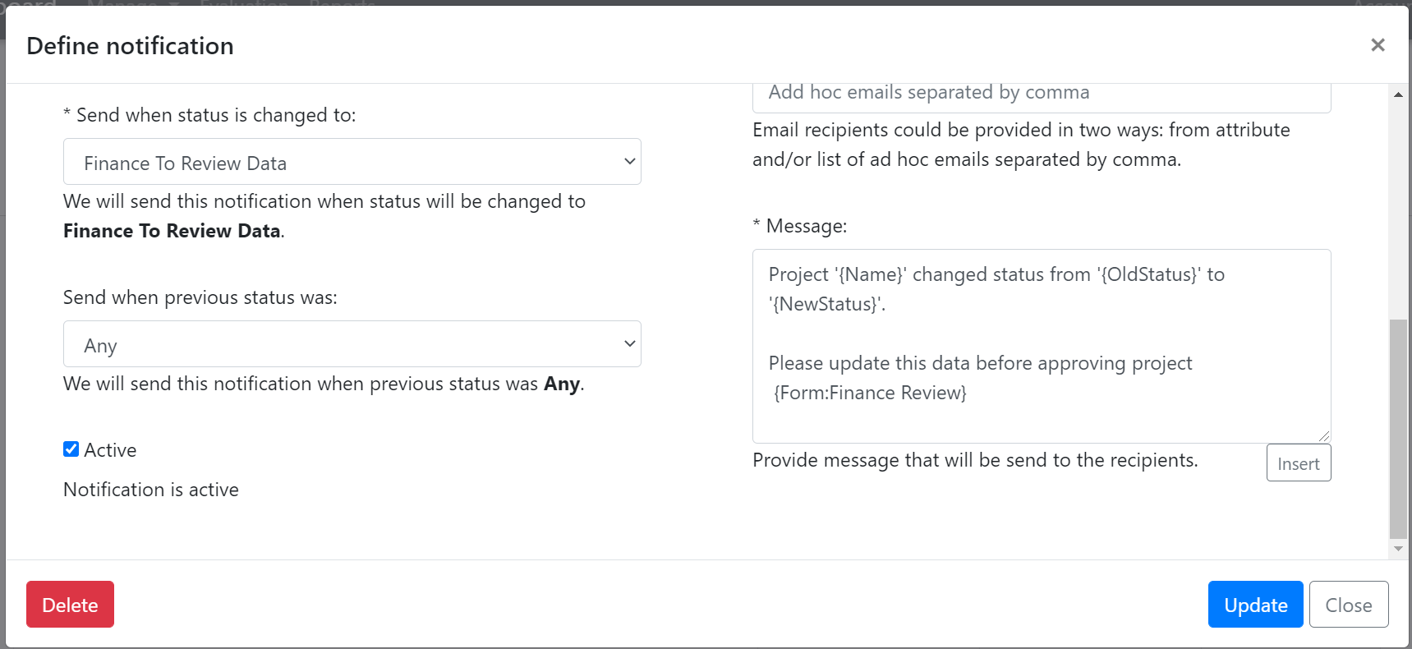
Data Collection Tools
Worked Example – setting up a Gating Review (1)
1
Edit Kanban & include 2 stages – 1 to trigger review, 1 to complete it
3
Create Attribute to nominate a Finance Business Partner to contact for data – this would need be Required for a Proposed Project Form (or you can manually add it later)
Create Form to define data required. Provide contextual data as Read Only, and other fields Required
2
Add Notification which will email the Finance Partner when a project moves into “Finance to Review Data” step & will contain a link to the Form we just added
4

Slide 27
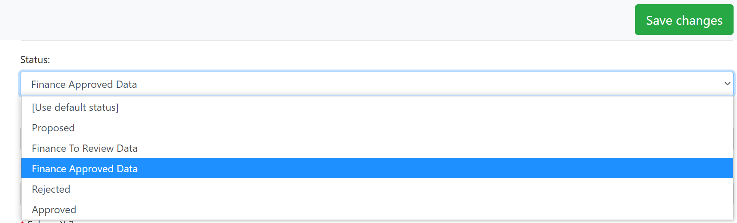
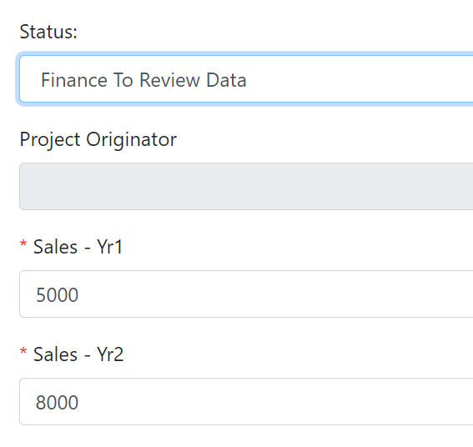
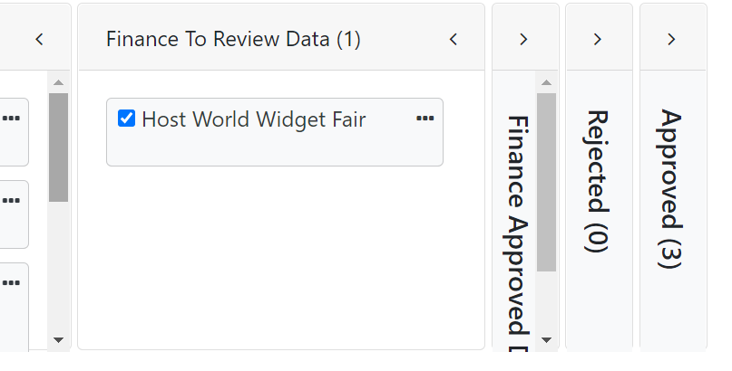
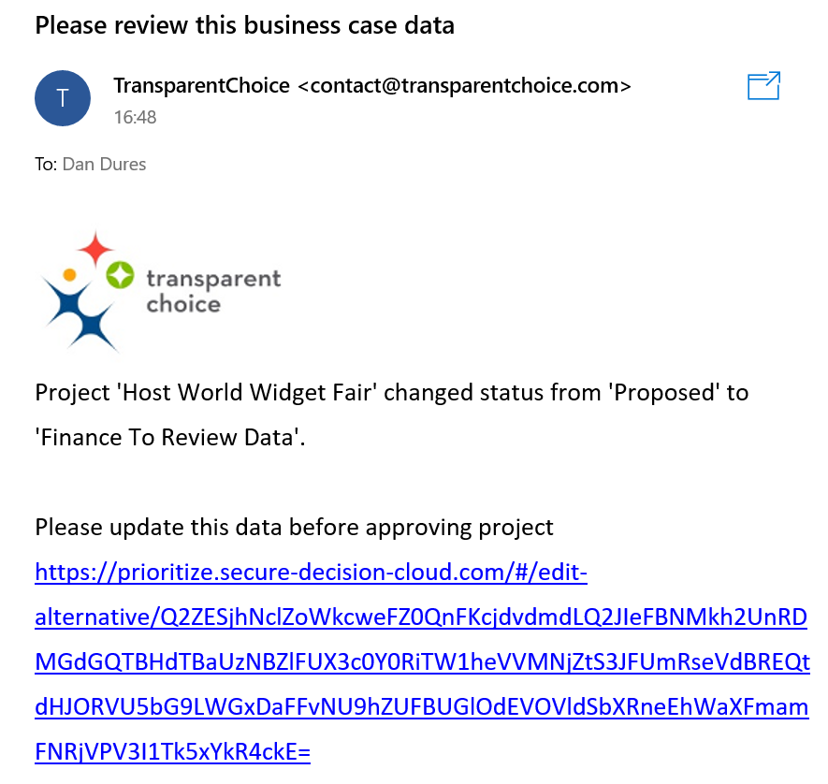
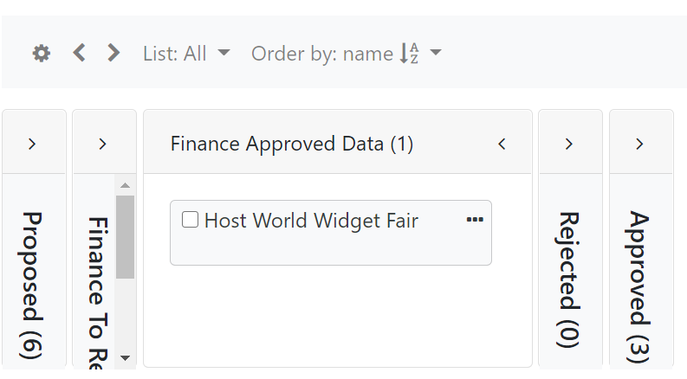
Data Collection Tools
Worked Example – setting up a Gating Review (2)
5
7
This project is moved to Finance to Review, so triggers a Notification
Review / enter data, change it if needed, then progress the approval level.
Save Changes to update the Kanban
Finance get an email with a Form link
6
The contact linked to the project gets an email with a message & a link to click on
8
Project now moves along the Kanban automatically (NB may need to refresh page if model is open)

Slide 28
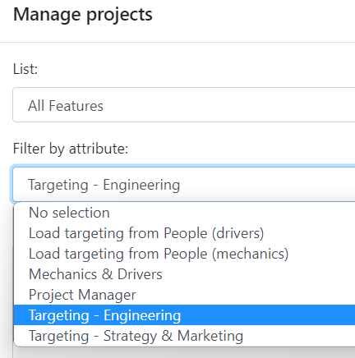




Data Collection Tools
Worked Example - Using Targeting Attribute for Automating pipeline
(1) Set up targeting cell in Attributes using People section to create list
(2) Add Attribute to Form and send to project owners – who will score this project?
(3) In Assessments pick the Attribute for scoring – Nominated People will get the survey
(4) In Notifications pick the Attribute to get updates on status
- e.g. “Check your Survey Link… you have this new project to score!”
Consider putting this Form into a Report for a To Do List – see below … or a Request page as part of project set-up
TIP – use Control Key to add multiple people

Slide 29








Data Collection Tools
To Do Lists
1
(1) Create a new Report (Portfolio Dashboard)
(2) Pick a Form to embed – this will pop up when users click the EDIT button in the report
TIP – create Read only Form if you don’t want users to be able to edit from here
(3) Customise the Report:
* Select Attributes (3.1)
* Drag column headers to create sections to order your report (3.2)
* Adjust display settings for data (3.3)
(4) Include a Status Update in your Form – to let people change Kanban status
(5) Share your report as a URL which you can share or publish
2
3.3
3.1
3
3.2
4
5

Slide 30

Collect Alternatives
Request Pages
(1) Request Pages enable you to ask stakeholders for project nominations
(2) Select a Form for users to complete, then customise the communication with a message & branding
(3) clicking on the link are taken to a Form to generate a project

Slide 31


Collect Alternatives
Import
This will then enable you to generate an import file with the relevant columns already in place – please don’t change this formatting, but copy in the project data, with a row for every project
1
2
To batch import your altneratives, first define the Attributes you want to see using the software, then click here from the Kanban screen
4
3
Your Excel file can then be populated and loaded back into the model

Slide 32
Collect Alternatives
Batch export Alternatives to edit portfolio
This generates a populated export template that you can use to drop into other models, or batch edit before uploading back into TransparentChoice
Please note – your spreadsheet can’t have formatting / filters or blank rows so works best if you copy / paste values into a new sheet before export
To batch export your project data use the Export option instead

Slide 33






Collect Alternatives
Add a new Attribute across all Alternatives
1
3
Your column headers will appear in the upload prompt – now match them to an existing Attribute or Click Create attribute to add a new one
Using your import file to capture the Attribute Data you want
2
4
Click on Import & From Spreadsheet
Create attribute will drop you through to the regular screen – don’t forget to set the Type to match the data you have uploaded

Slide 34

Collect Alternatives
Important Import WARNING!!
If you import an Attribute with blanks these will overwrite data you have in the model already
Do not try to re-import all exported data once you have completed Assessments – this can break your import
TIP – if you want to add data later in the process limit your import to NAME + ATTRIBUTE(S) WHERE DATA IS NEW / CHANGING only
If you do not check this box data for existing Attributes, data will not be imported (so you don’t wipe out existing data by mistake!

Slide 35

Collect Alternatives
Why is this hanging / Errors reported on some projects
TIPS
Always press F5 to refresh your browser
Check your Excel File is clear of formatting & you save it on the correct sheet
Check your data conforms to Attribute configuration esp. where you are using Pick from List to limit to specific value or you have Dates requiring specific formats
Sign Out of the Product & Back in if this screen is ‘stuck’ to clear cached data

Slide 36



Organise Alternatives
Lists
Lists are groups of Alternatives you will use for managing & analysing your portfolio – see Reporting for Details
There are two types of list
  Static lists are manually chosen from all Alternatives
  Active Lists are based on 3 types of condition, which you can combine in dynamic combination
    Attributes set to given value (e.g. strategic value >30)
    Status is stage in Kanban (e.g. Proposed)
    Member of another list (e.g. Dan’s Projects)
    TIP – Once you have scored you can publish Rank: Use Lists to create ‘Top 10’ filters for quick reference
What is the difference between a List & a Text Attribute flag?
  Alternatives can only have 1 value for a given Text Attribute (i.e. project is in bucket A, B or C)
  … but for Lists Alternatives can be in many buckets – they are not mutually exclusive
1
2
3

Slide 37
Organise Alternatives
Kanban views
You can group Alternatives by status or any other “category” and can “colour code” your Alternatives by clicking here..
You can expand or collapse all columns using these arrows
You can create Lists – pre-defined filters for your Alternatives / alternatives. To filter Alternatives by a particular list, simply select the list name here
This can be useful to look at Alternatives that are part of one particular program, or if you want to group Alternatives at different stages in the Kanban

Slide 38




Organise Alternatives
Adding data using the Kanban
2
4
5
1
1
Click Flywheel to Configure View
2
Pick a Form to use for Data Capture
3
3
Click on an Alternative to Edit it
4
Details – Lets you update the Form to enter the new data
5
Share – Creates URL’s for any Form to collect data (for this Alternative)

Slide 39



Organise Alternatives
Kanban views – Change Colours
(1) First you’ll need to set up a Text Attribute with “Pick value from list” option (and input this data for your Alternatives)
(2) Use the Flywheel to configure the Kanban and Select your Attribute
(3) Alternatives with a value for this Attribute will now colour co-ordinate
(4) Note that this Attribute can also be used to produce Reports too
1
3
2
4

Slide 40




Organise Alternatives
Kanban views – change Columns
2
3
1
1
Set Up a Numeric Attribute with Pick from List
2
Click Flywheel to Configure View in Kanban
3
Click on Columns & Select your Attribute
4
You Kanban will now present itself according to the Attribute – rather than Status
4

Slide 41





Organise Alternatives
Kanban views – Grid
Chose which columns you want to see
1
Click on Grid to get a list of Alternatives
2
3
Click and Drag columns to sort by an Attribute
Note: Please ensure your browser is zoomed to 100% if you want to be able to change the column width

Slide 42





Organise Alternatives
Dependencies
Setting up Dependencies can be a key feature of a complex portfolio, where there are Alternatives have to be completed prior to another project becoming viable – this feature lets you record those Dependencies
1
2
Click on Project Details to open up the Decision Log / Attributes for the project with a Dependency
Search for the enabling project (NB you can repeat for multiple dependencies), and name the link
3
This dependency is now in your Decision Log, and will create a reminder to review dependencies whenever you move the project along the Kanban

Slide 43



Organise Alternatives
Add Dependencies
Definitions
Foundations – projects that are required to deliver another project
Dependents – projects that are reliant on a Foundation project
How to add
From Dashboard View select the project you want to link, then add a relationship to another project. You can set this up in either direction.
To remove this relationship click the button next to it.

Slide 44


Organise Alternatives
Review Dependencies
Goal
Make sure you don’t accidentally separate a Dependent from its Foundations
(i.e. approve the high value project that relies on some underlying work…. but not approve that underlying project)
How to check
Go to the Manage Menu and select Dependencies. Use the Filter to see all or just “issues” (i.e. where Kanban status is different between linked projects)
Use the View button to go back to the project level view to edit

Slide 45


Organise Alternatives
Decision Log / Alternative Level data
3
1
2
4
1
Hit DETAILS from Kanban
2
See All Attribute Values for the Alternative
3
Add Notes, Docs or Email a link
4
Track updates made to value in the Decision Log

Slide 46



Organise Alternatives
Quick Scoring
Configure View of Kanban using Numeric Pick from List Attributes
Then Click & Drag Alternatives to change their value
TIP – Use an Attribute in a model then ‘score’ using the Kanban

