Slide 1

TransparentChoice
Criteria Weights - Respondents’ Guide

Slide 2
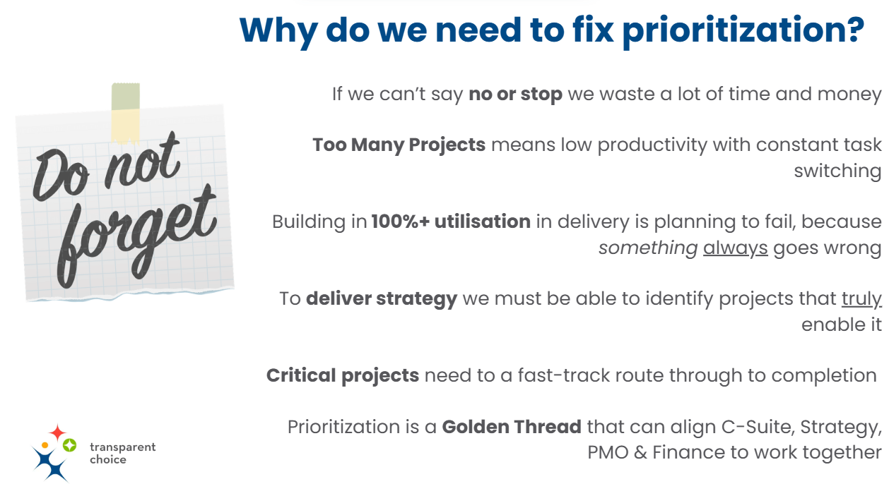
Firstly, a reminder….

Slide 3
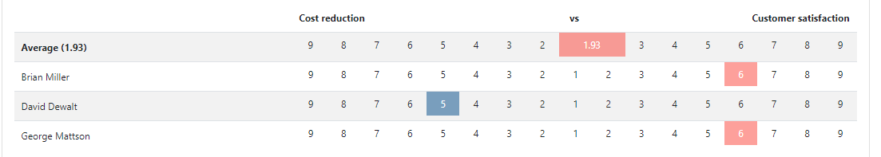
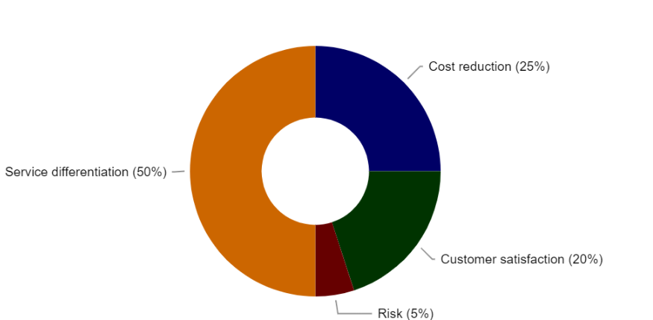
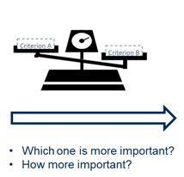
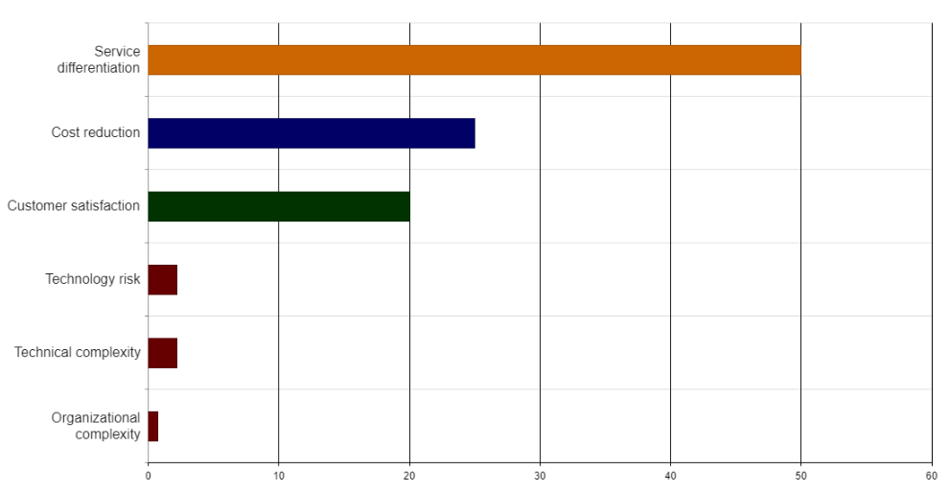
Quick Guide for Respondents
(1) Overview
Why do we do it?
Not all your Criteria are of equal importance – Analytic Hierarchy Process (AHP) enables you to quantify those different values
These are subjective judgement calls – by taking a survey & joining a follow up session, you will help create the ‘wisdom of the team’
What if there is disagreement between voters?
We will meet to discuss the results – and use the software to focus on the points of disagreement. From there we can learn from one another, change votes, or agree to differ and use an average.
How do we do it?
Instead of direct allocation of weights, AHP uses Pairwise Comparisons to weigh criteria
This is because the human brain works better with comparing two choices than it does with abstract values
How will this be used?
Each of our Sub-Criteria will have a Weight – these are multiplied by a score for each Project for each sub-criteria… the results will be an overall Prioritization Score for all prospective Projects

Slide 4

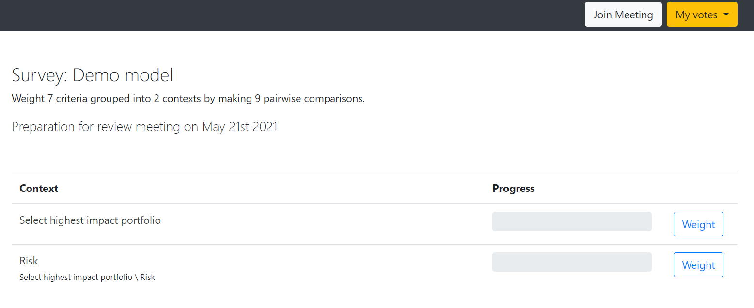
Quick Guide for Respondents
(2) Navigation
1
Paste URL / Click the Link / Access via Dashboard – Opens up a tab to complete your survey – note this is the same link for meeting + survey
1
6
7
2
Survey Details – Shows the structure of the model & number of questions you need to complete
2
3
Criteria – Click to see detailed description (which your admin added when building the criteria)
4
Progress – Shows proportion of survey completed
3
4
5
5
Weight – Hit the button to start the survey
6
Join Meeting – Move into the ‘live’ meeting, once the Facilitator starts the session
7
My Votes – Analyse your responses once you have completed the pairwise review (see below for tips on this)

Slide 5
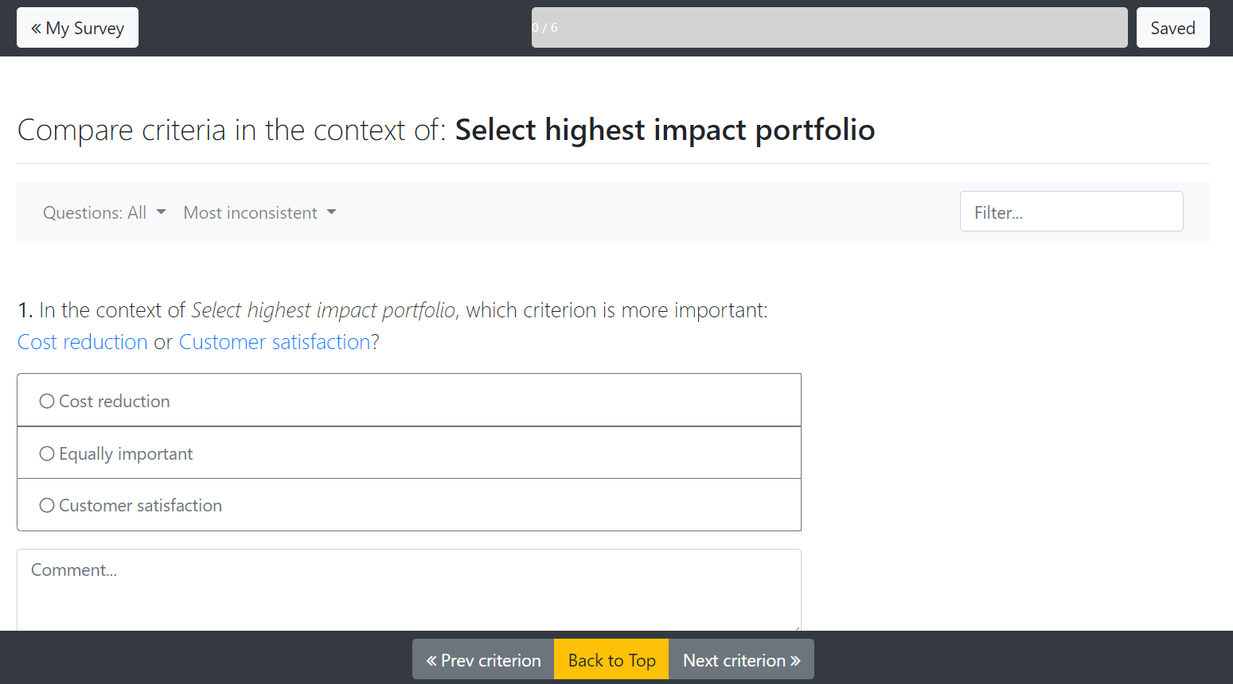
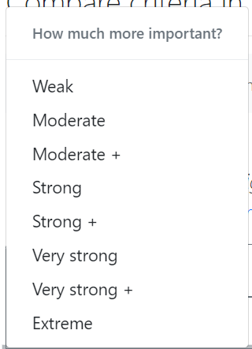
Quick Guide for Respondents
(3) Pairwise Review
1
1
Navigate – Save progress, return to survey landing page & see progress so far
2
Navigate – Move within the Survey, selecting Criteria through the hierarchy, text, or by inconsistency (see below for details)
2
3
Question – Always appears in the format:
In the Context of (i.e. the criteria one level up)
What is more important Criteria 1 or Criteria 2?
3
4
4
Vote – Pick from 1 of 3 options: Criteria 1 / Criteria 2 or Equal using the Radio Buttons
6
7
5
Vote – Then (unless you vote ‘equal’) score the extent of the difference using the 9 point scale (AHP Best Practice)
5
TIP – using Strong or above will generate a very low value for the other factor so we recommend moderation
6
Comment – Add key points to capture rationale behind vote – this is great to support discussion
7
Navigate – Move onto Next question or return to the top of the Survey page

Slide 6
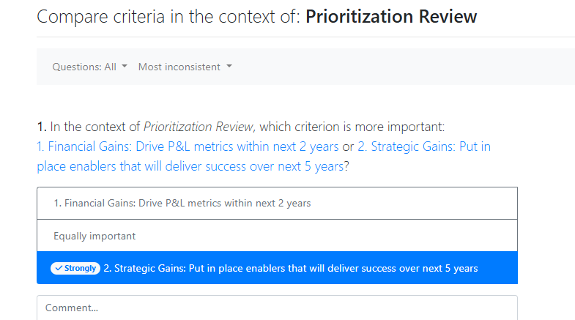

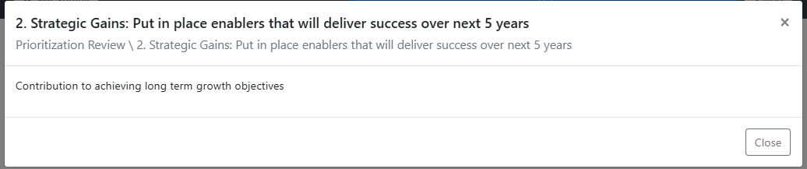
Quick Guide for Respondents
(4) Vote thoughtfully
Make sure you understand the criteria
  Criteria are click-able and should contain detailed descriptions
  Check with your admin if you feel they are not clear
Focus on what matters most to deliver the goal of the portfolio
  This is your opportunity to say what kind of projects will get done
  Pairwise is designed to force you to pick between “nice to have” and “must have” factors
Work as a team to provide leadership to the organization
  Bring your point of view to the table: add comments to capture your thinking and be prepared to share
  Be open minded – the key is for the steering group to agree, as providing clear guidance to the organization is key

Slide 7
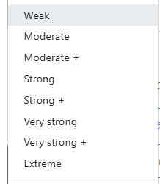



Quick Guide for Respondents
(5) Don’t Vote higher than STRONG
Each step is a ratio
  “Weak” is 2x more important..
  “Extreme” is 9x more important
If you rate Criteria A 9x more important than Criteria B…
  “Criteria B” will be worth very little
  Most models should not have this scale of difference (implies Criteria B should not be in model at all if it’s this unimportant)
Why have the high ratings?
  Some models do have genuinely big differences
  It’s AHP standard… we’re just applying our best practice with this advice!
2x
3x
4x
5x
6x
7x
8x
9x

Slide 8
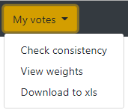
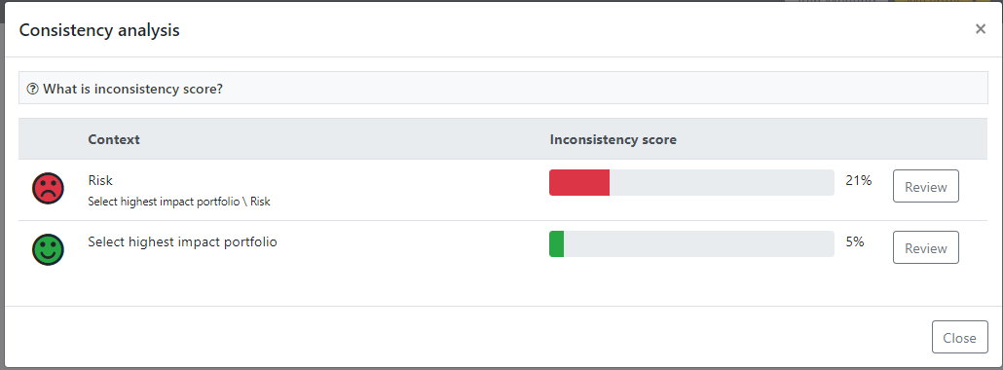
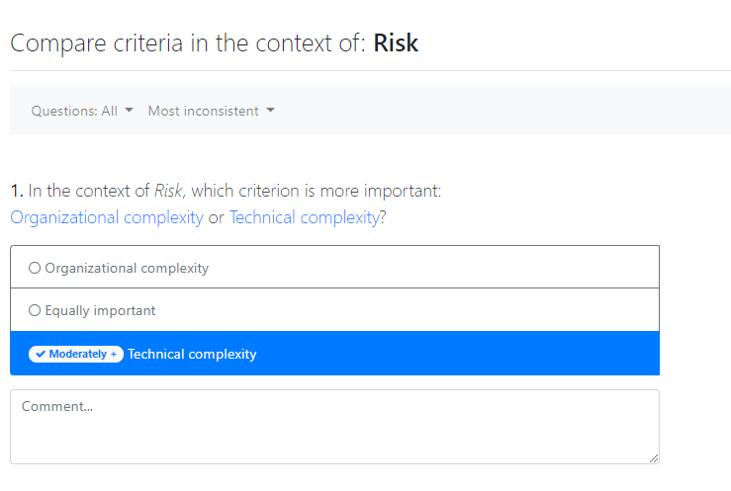



Quick Guide for Respondents
(6) Check Consistency
Inconsistency score is a measure of how much your answers make logical sense compared to themselves
For example, if A>B and B>C but A<C this makes no sense – it’s logically impossible
The software calculates this rate of ‘error’ & prompts you to review your answers:
>20% - Answers are too inconsistent: Please Review them & adjust some votes
TIP – think about reducing ‘Strong’ (or more) scores so they are less extreme
10-20% - Acceptability depends on the type of Criteria. For Strategic criteria this level of inconsistency is OK. For more technical criteria this may be too great. Align with your Survey administrator to agree.
<10% - Answers are fine. This is an acceptable level

Slide 9
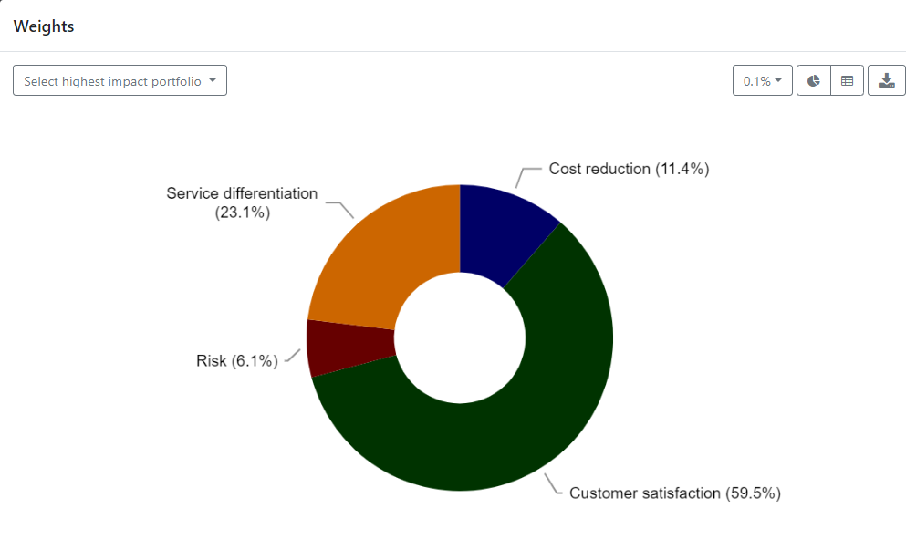
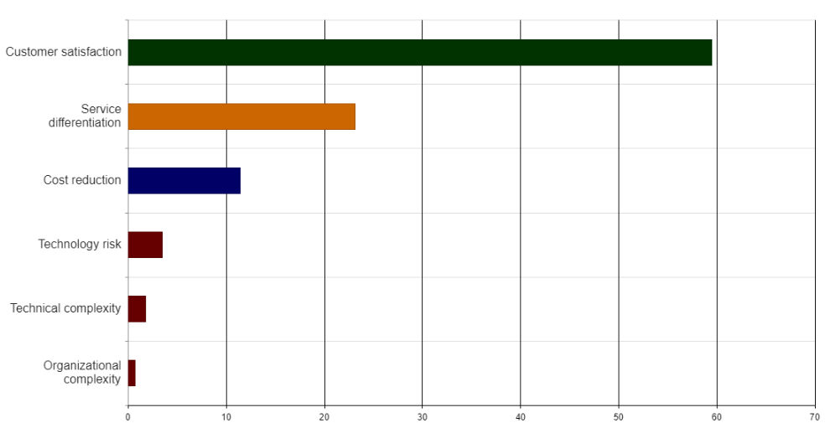
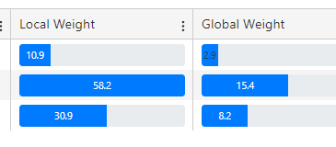
Quick Guide for Respondents
(7) View Weights
1
2
3
TIP – Once you have answered all questions, go to View Weights.
Criteria Weights represent the output of the algorithm that converts pairwise votes to a normalized weight for AHP model criteria.
If they don’t pass your ‘gut check’ go back to your votes and double check them: have you made a mistake, or been too extreme in one of your votes?
Iterate until you are happy with both the votes and the outcome.
1
Drill into the Criteria – to move between high level & detailed view of outcome
Scroll down to see Bar Chart view
2
Decimal Places – change display of data
3
Toggle View – To see scores for Global & Local Weights
TIP – Local Weight shows how the sub-criteria compare to each other (they always add up to 100)
Global Weight shows the sub criteria share of the total model (calculated as Local Weight * Criteria Weight)

Slide 10

We know extra tasks add time pressure, and promise that this support will save you time later when it comes to picking the right projects
Finally, a promise….

