Slide 1


TransparentChoice
Criteria Weights - Best Practice Guide
Best Practice
Client Hub Page

Slide 2
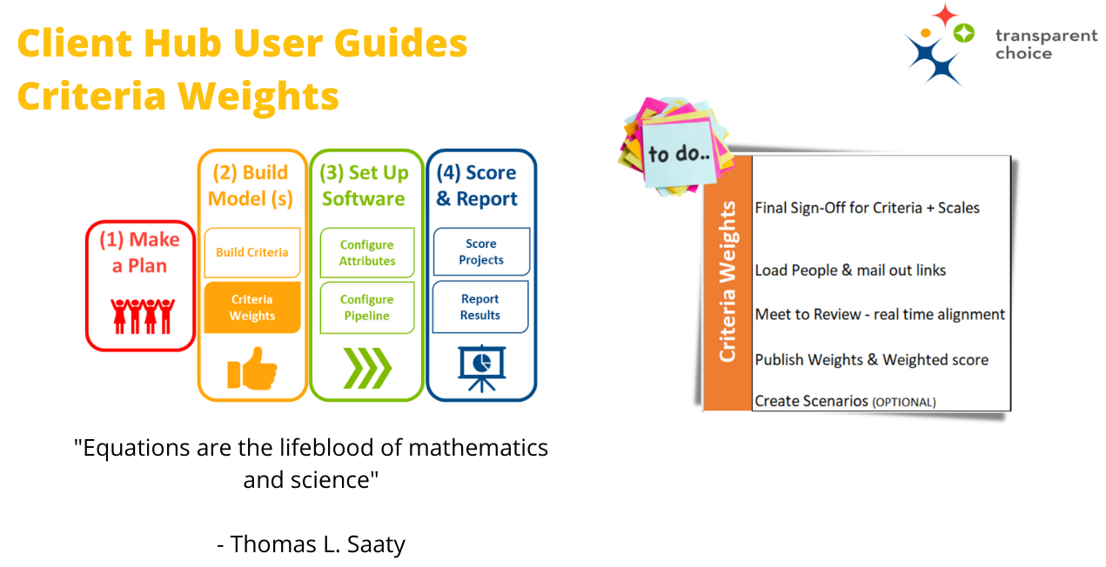

Slide 3
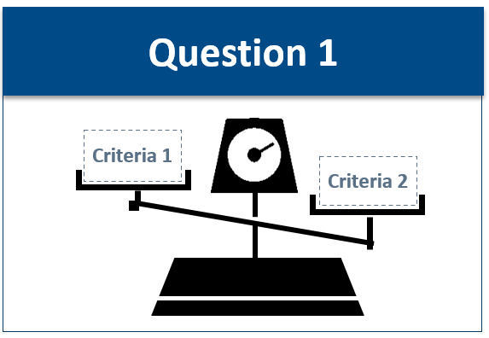
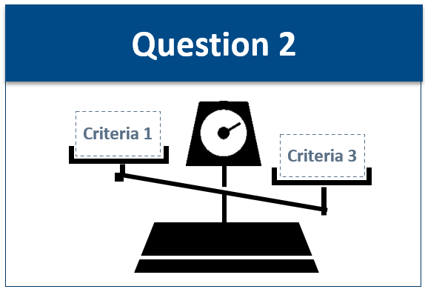
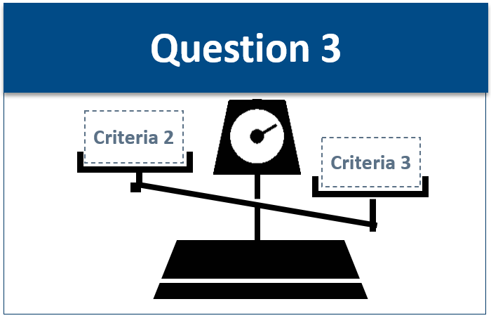
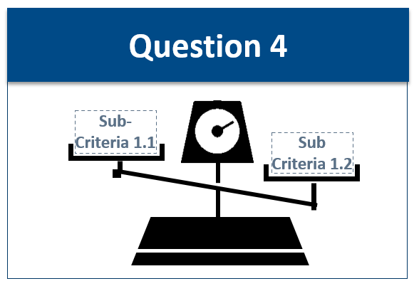
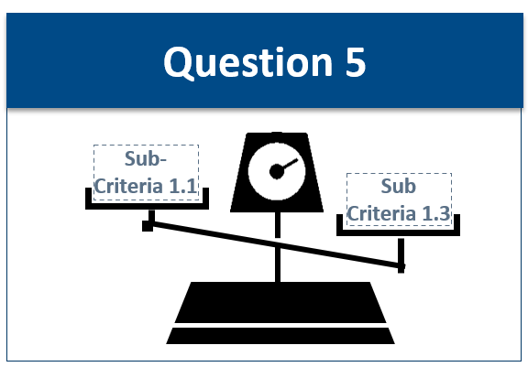

Weighting Survey = Pairwise model
Pairwise model will determine the relative importance of our criteria
Score all the criteria against each other…
…then score the sub-criteria within each ‘branch’
Number of questions will be driven by number of Criteria in your AHP model
  # questions = (n2 – n) / 2
  where n = number criteria
Score Top Level Criteria
Goal
Q1
Q3
Criteria 1
Criteria 2
Criteria 3
Q2
Question 2
Question 3
Score Sub-Criteria
Criteria 1
Q1
Q3
Sub Criteria 1.1
Sub Criteria 1.2
Sub Criteria 1.3
Q2
Question 1
Question 2
Question 3
Notes:
Roberto

Slide 4

Weights– how to score criteria
which is more important?
Verbal scale is proven to be more effective than numeric
&
by how much?
Criterion 1.1
VS
Criterion 1.2
9
8
7
6
5
4
3
2
1
2
3
4
5
6
7
8
9
Extreme
Very Strong
Strong
Moderate
Equal
Moderate
Strong
Very Strong
Extreme
Notes:
Roberto

Slide 5

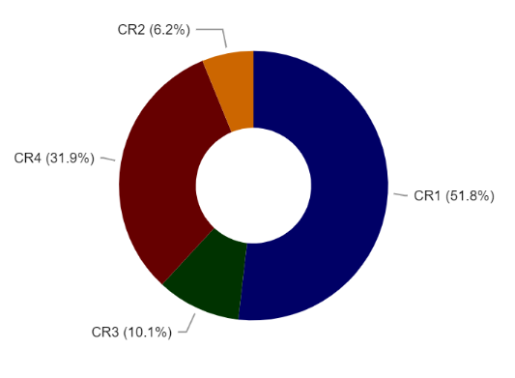
Weights– Be careful of using high scores
If we use “Very Strong” in a pairwise….
Very Strong
Moderate+
CR2
Weak
CR3
Weak
CR4
CR1
Scores should be no more than 5 (“Strong”) in a typical balanced model
Especially important at the Criteria level as a very small weight for one branch will render it’s sub-criteria of very low importance
Too many extreme scores are a red-flag
  Not a good criterion
  Lack of understanding
  Lack of buy-in
  Game-playing
Strong
…the less important criteria end up with very little weight
Notes:
Roberto

Slide 6
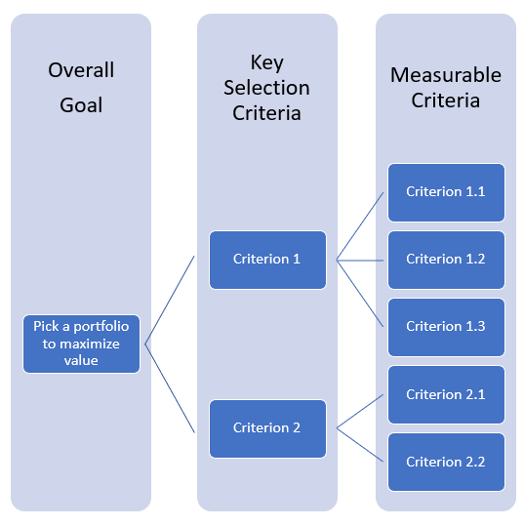
Weights – the maths (1)
Pairwise logic asks Respondents to compare criteria to measure relative importance
Here we see a slight preference to Criterion 1 > Criterion 2
Within each criteria we then do the same for all the sub-criteria
Outcome will always add back to 100% - i.e. normalization of data
100%
60%
20%
30%
40%
60%
Overall Goal
Key Selection criteria
Local Weight
50%
40%
Global Weight
Notes:
Roberto

Slide 7
Weights – the maths (2)
The key output from our model is the Global Weight
All our Projects will be scored against all our sub-criteria using Global Weight
High scoring projects will typically either:
- Score highly for Criteria with a high Global Weight
- Score consistently across multiple Criteria
100%
60%
20%
30%
40%
60%
Overall Goal
Key Selection criteria
Local Weight
50%
40%
Global Weight
x
12%
18%
30%
x
24%
16%
This always adds up to 100%
Notes:
Roberto

Slide 8
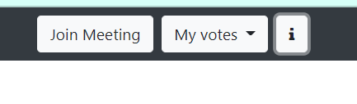

Quick Guide for Respondents
Available via the “i” button in Respondent’s Survey Link
Includes overview pairwise, how to guide & tips on consistency & visualization
Click here to download

Slide 9

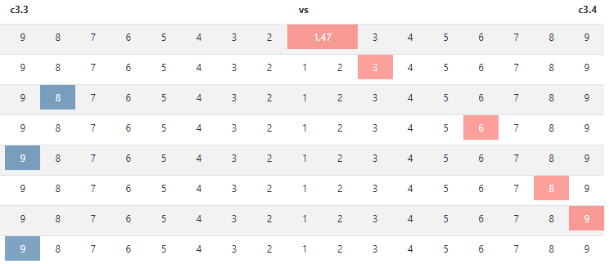

“Wherever there is judgement there is noise, and more of it than you think”
There are proven real world effects from Noise
Judges impose harsher sentences on hot days
Individual underwriters in an insurance firm came up with valuations differing by 55%
Our clients find they don’t always agree on things
(1) People have totally different views on this… let’s discuss to see if anyone wants to change
(2) Even if they don’t align we can use an average*
Exploring these difference in opinion is key to a better decision & better buy in
*The software has a geometric average function built in

Slide 10
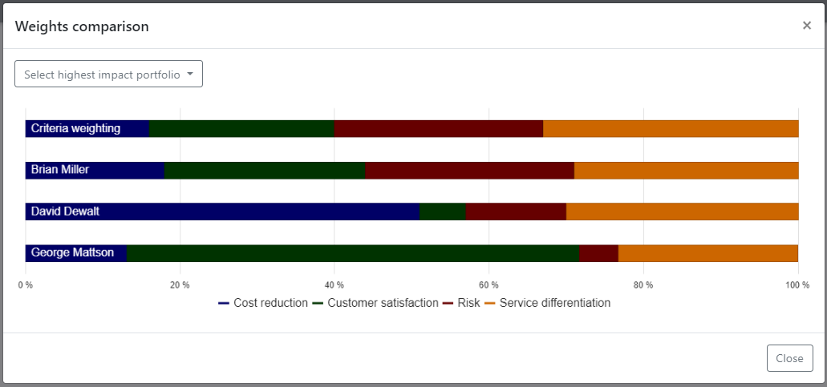
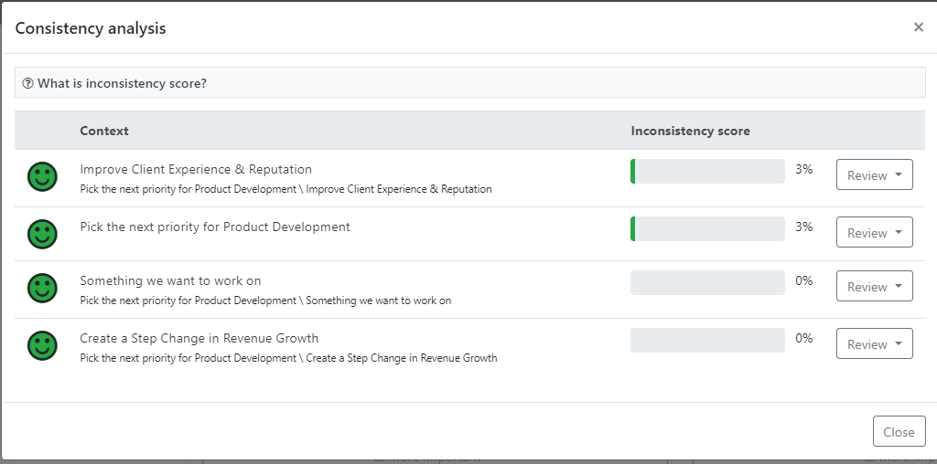
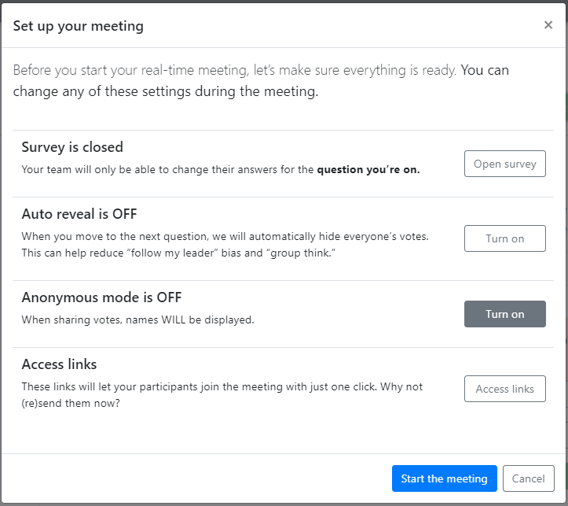
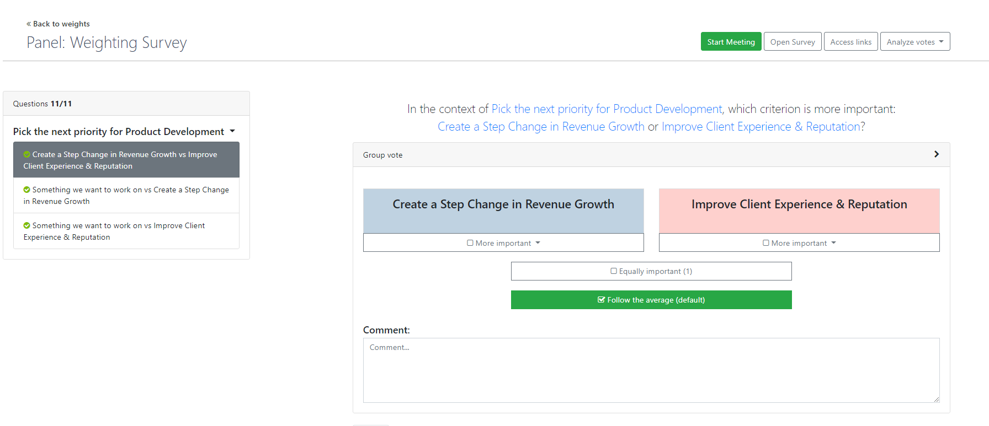
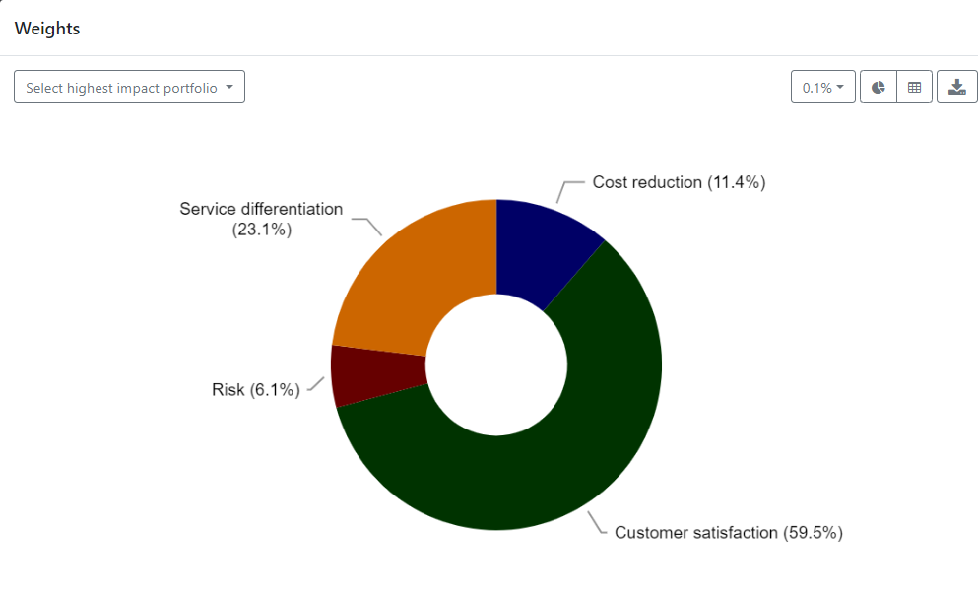
Meeting Mode: How to have a good meeting
Review the data before you meet so you know areas to focus on
  Make sure everyone has finished
  Review individuals’ Consistency
  Identify areas of Disagreement
  Check Weights for each Respondent – is there an obvious preference issue?
Agree how the meeting with run
  Facilitation approach
  Time per question
  Do you reveal others’ votes
  How to change votes – individuals re-vote live or a group agreement on a new score?
Check overall results at the end – does this pass ‘gut check’?
  This can be used as a great ‘cascade’ to the rest of the organisation

Slide 11
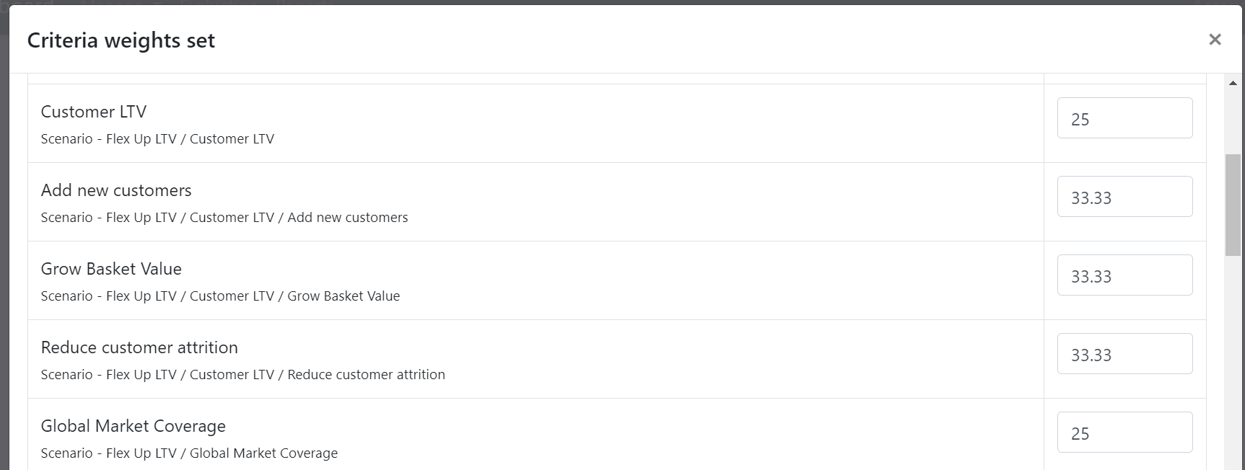
Flex weights to create value scores for different scenarios
Explore an idea or respond to a change in the market
…what would happen if we suddenly had to accelerate our Global Rollout (say)….
Make simple judgement based adjustments…
… or re-visit your original weighting panel & tweak pairwise to create ‘version 2’ scenario
Normalization means the software takes the value and turns it into a ratio, therefore ensuring the total (at any given level of the hierarchy) is always 100
NB this means by changing a value you will automatically change the values of all other sub-criteria within the same branch
If we want to see What If this criteria becomes more important….
Criteria | Base Weight | Adjusted | Normalized
One | 50 | 50 | 42
Two | 30 | 50 | 42
Three | 20 | 20 | 16

Slide 12





Weights – Best Practice
Test pairwise with a friendly exec – do you get weights that feel about right… or is there be some problem area to resolve?
Give your execs time to get fully involved – don’t try and rush it as a 30-minute agenda item. Reassure them it’s good use of time
Trust the software with the maths – Consistency & Disagreement buttons are there to help
There is tremendous value in the debate – even if people don’t align, they are communicating
Share the results – this will show the organization what matters most & can generate new ideas where they are most needed

Slide 13
TransparentChoice
Criteria Weights - User Guide
Software Set Up
Client Hub Page

Slide 15
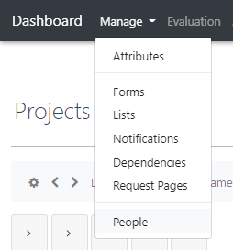
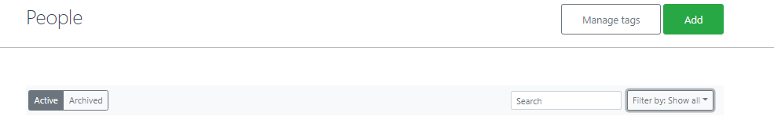
Set up People
Add in all the People who will work will be taking surveys
The People section is where we add names & emails for colleagues who will take either WEIGHTING SURVEY or ASSESSMENTS*
(NB you can add People in anytime you need)
1
People defaults to Active (available to include in new surveys) but can be set to Archived (see advanced use cases)
2
Tags can be added to People to make it easy to find groups - for example picking senior management or a specific team (optional)
3
Add enables you to start adding People – see below
2
3
1
*Also works for Legacy Scoring

Slide 16
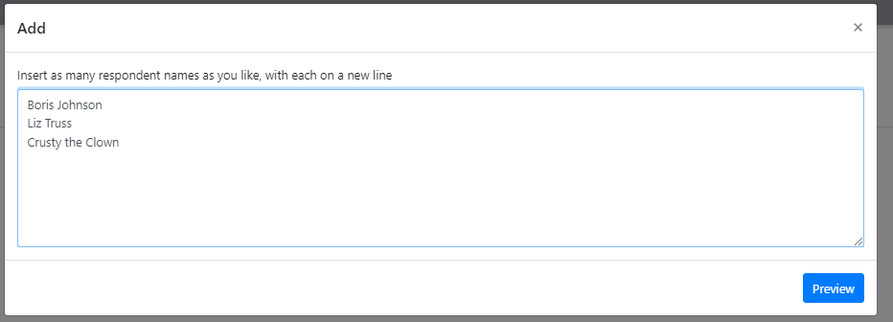
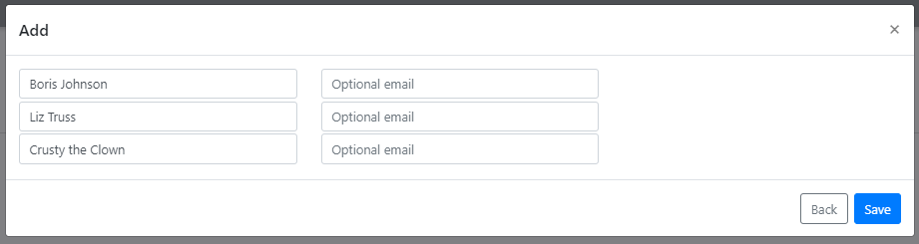
Set up People
It’s really simple…
Type in names of the People you want to include, then hit Preview
Add emails then Save

Slide 17
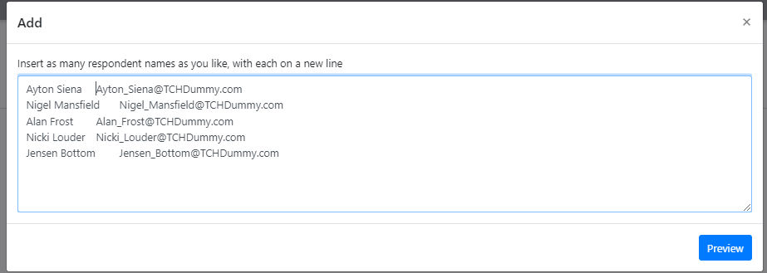
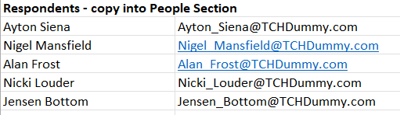
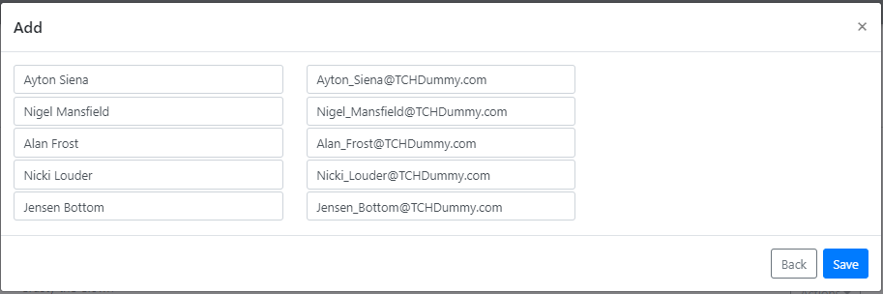
Set up People
Or use Excel if it’s easier
Copy Paste names + emails from Excel, then hit Preview
Check & Save

Slide 18
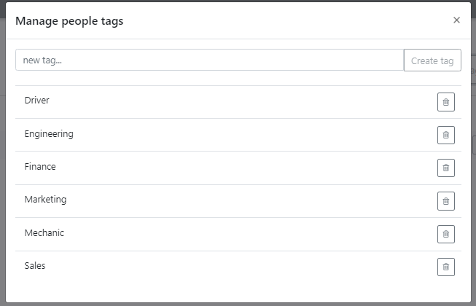
Set up People
Tags will make it easier to find People where you have a long list
For larger organizations you’ll have a lot of People – to make it easy to find the ones you need you can Tag them
Define Tags
Note that “Department” is not a Tag… it needs to be “Sales” + “Marketing” etc.

Slide 19
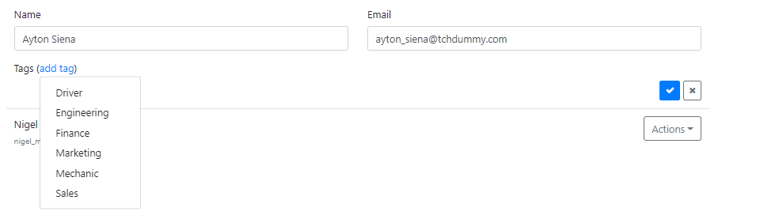
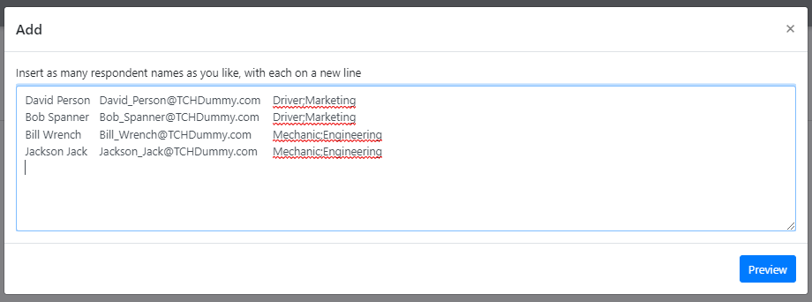
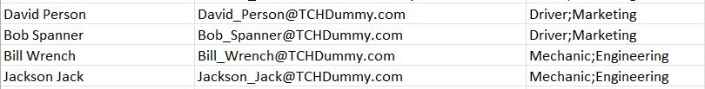
Set up People
Add Tags to People – 2 options
Add Tags manually or as part of your upload from Excel
(1) Click on a Person then select the Tag(s) you want, then hit Confirm to complete your selection
(2) Add a column in your spreadsheet for Tags, use a semi-colon ; to separate multiple tags (you can use Excel’s Concat function to merge into 1 cell if required)

Slide 20
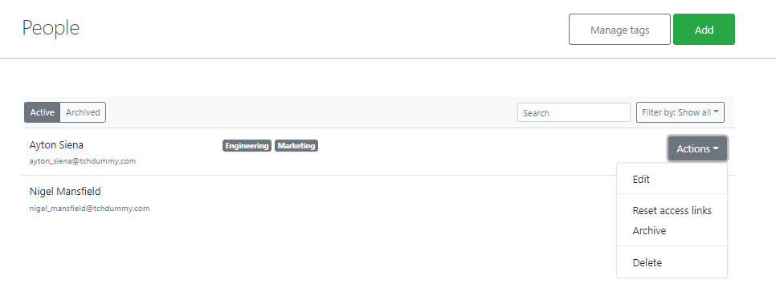
Set up People
Updating People (usually only advanced use cases)
You may need to update People as colleagues move on – here’s how…
Archive means a Person cannot be added to a new survey, but their votes remain valid in the data
Delete removes the Person from the software – note you cannot delete anyone currently included in a survey
Reset access links makes a Person’s URL expire so they cannot use a shared link
Edit enables manual changes to Tags, Name & Email to be made

Slide 21
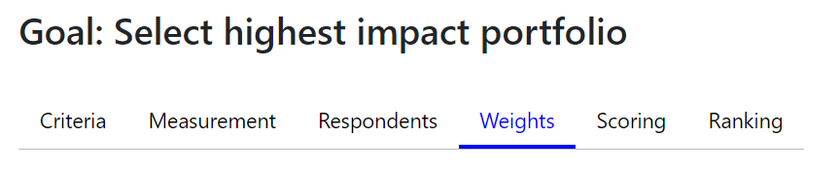

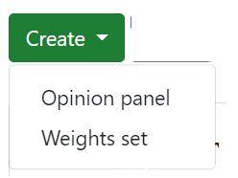
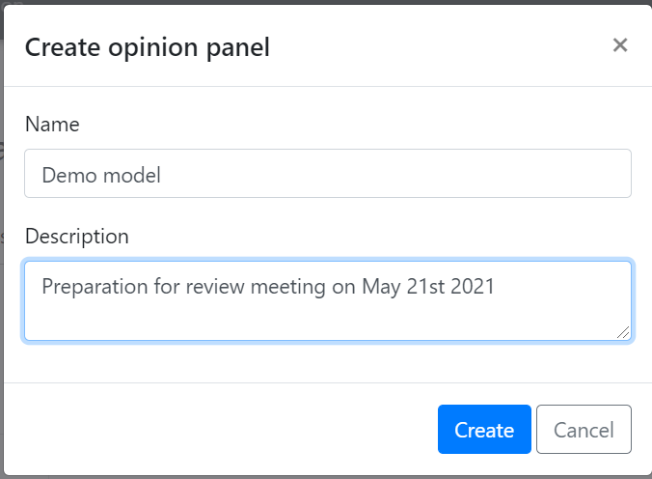
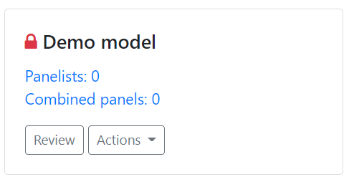
Set Up Opinion Panel
Create Opinion Panel
Create Opinion Panel – this is how you will collect data to feed into a Weight Set
Add Name + Description – include details of when the review is planned and the goal of the weight set
Hit Panelists to pick from your People – see below for how this works

Slide 22
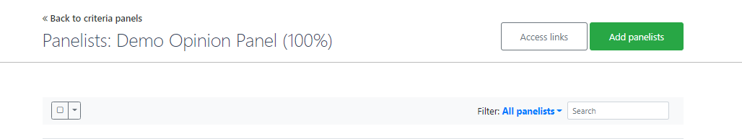
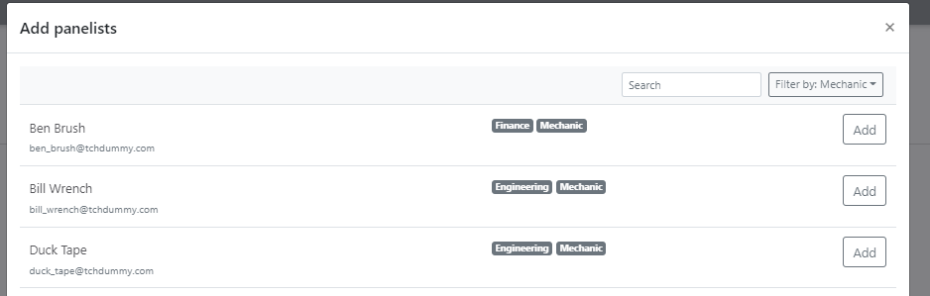
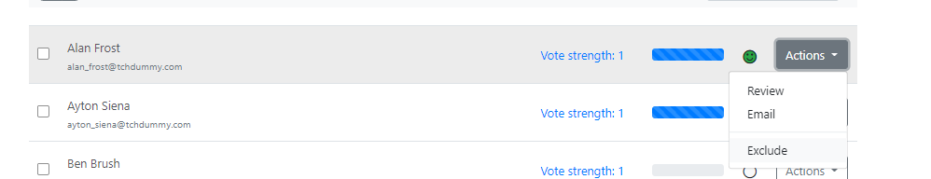
Set Up Opinion Panel
Create Opinion Panel
Add Panelists to get started
Use the Filter or Search function to find People if you have a long list
Click Add to include this Person in your Opinion Panel
TIP – if you add the wrong person don’t worry… go back to the Panelists view and Exclude them

Slide 23
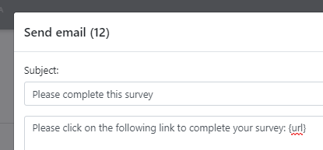
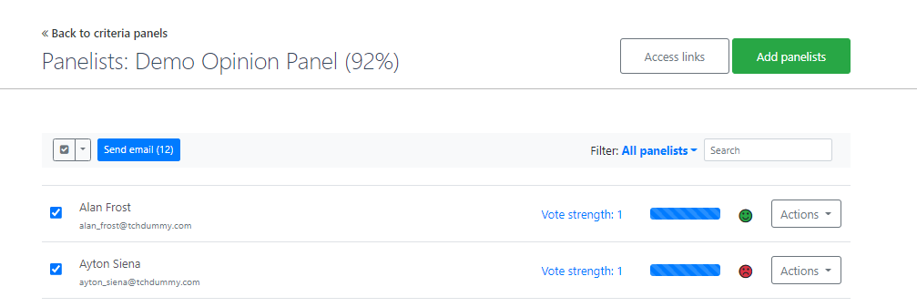
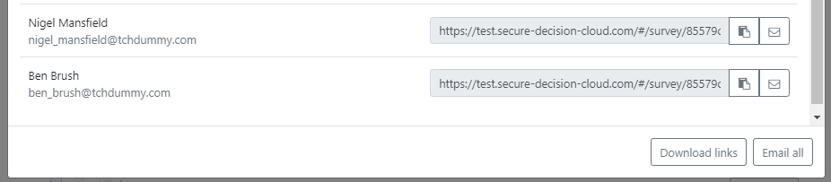
Set Up Opinion Panel
Send Out Links to Surveys
Each survey is a unique URL – this is all a Respondent needs to get started. No User Name & Password needed – there are 2 ways to share these URLs
1 – via Email
Use the Check Box to Select all Respondents, then hit Send Email to customize your message – the {url} will be a personalized link
TIP – Filter to customize the message to different audiences
2
2 - manually
1
Click Access Links to see all the URLs, then either copy individually or hit Download Links to drop them all into Excel
Note – There are other ways to get links too, but these are the simplest!

Slide 24
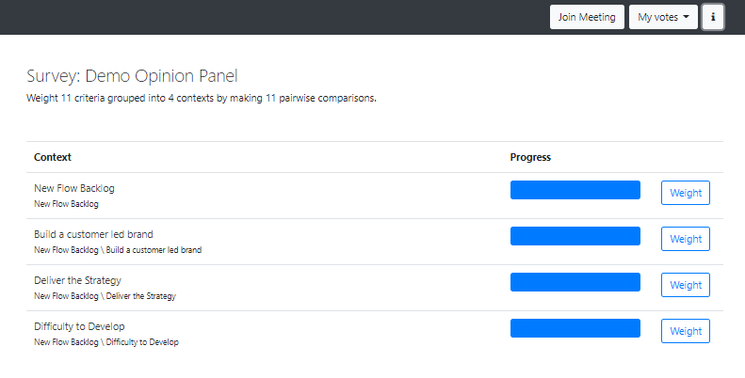

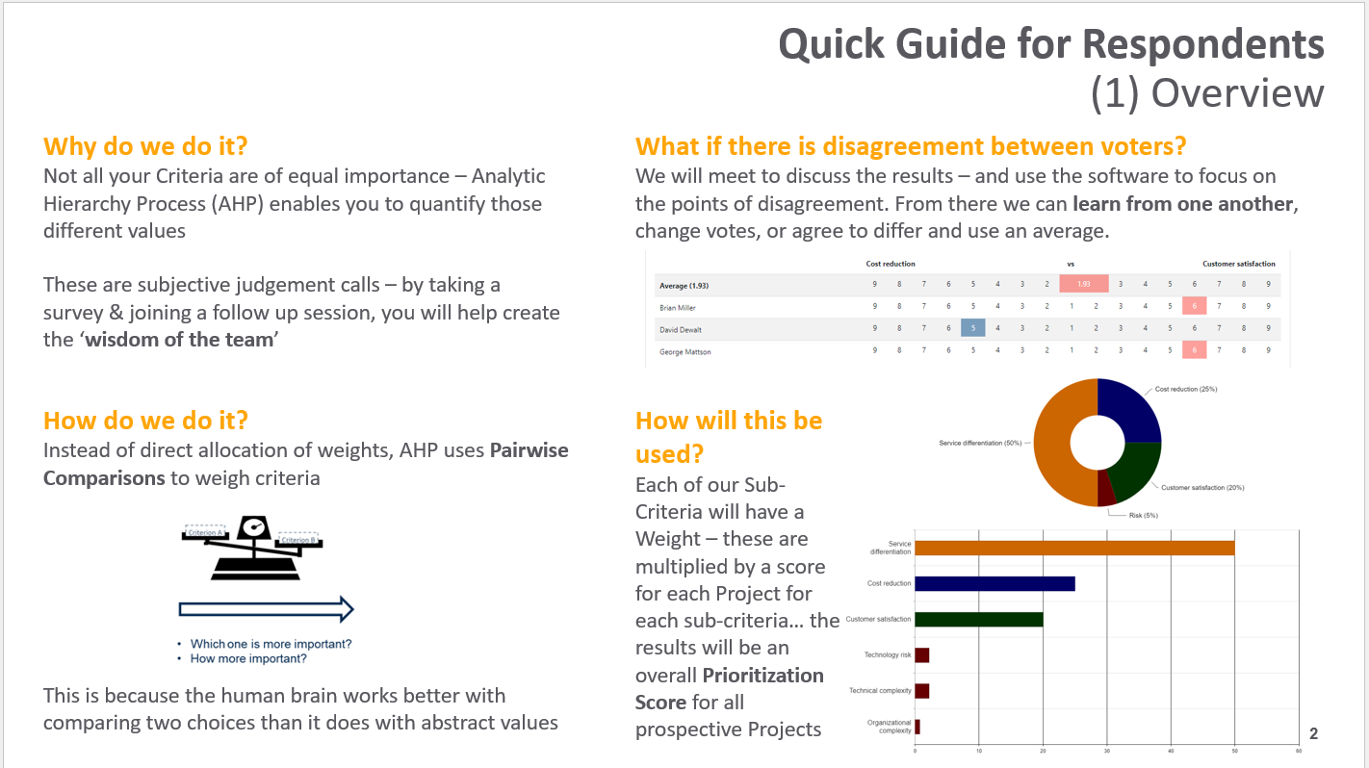
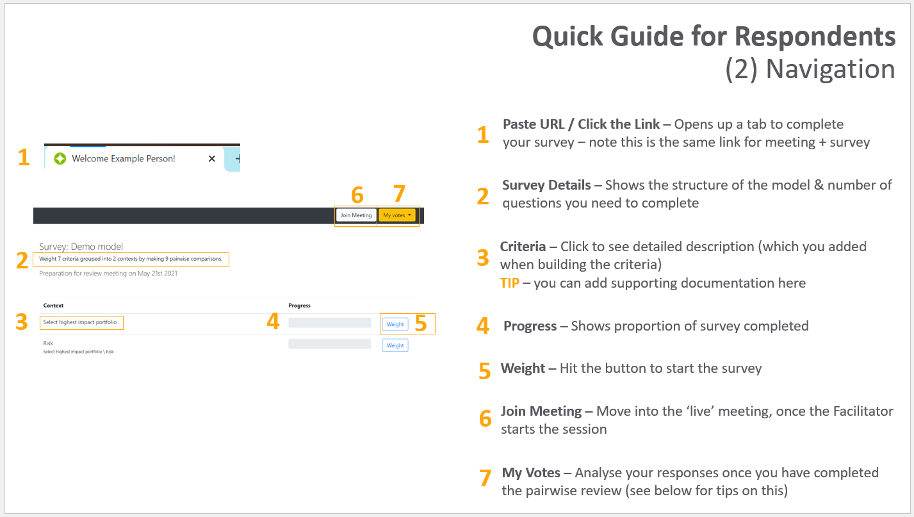
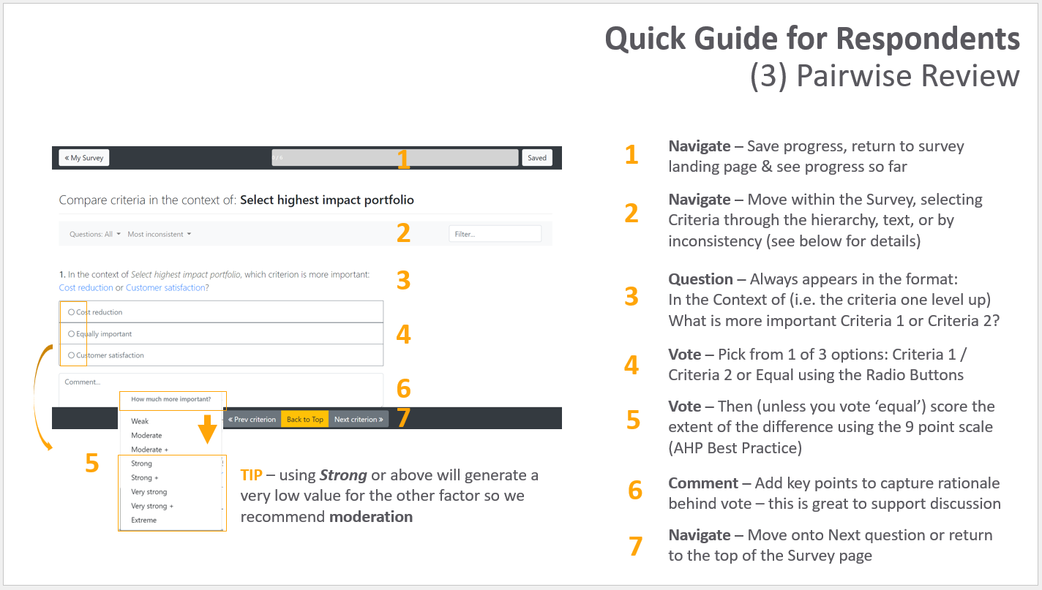
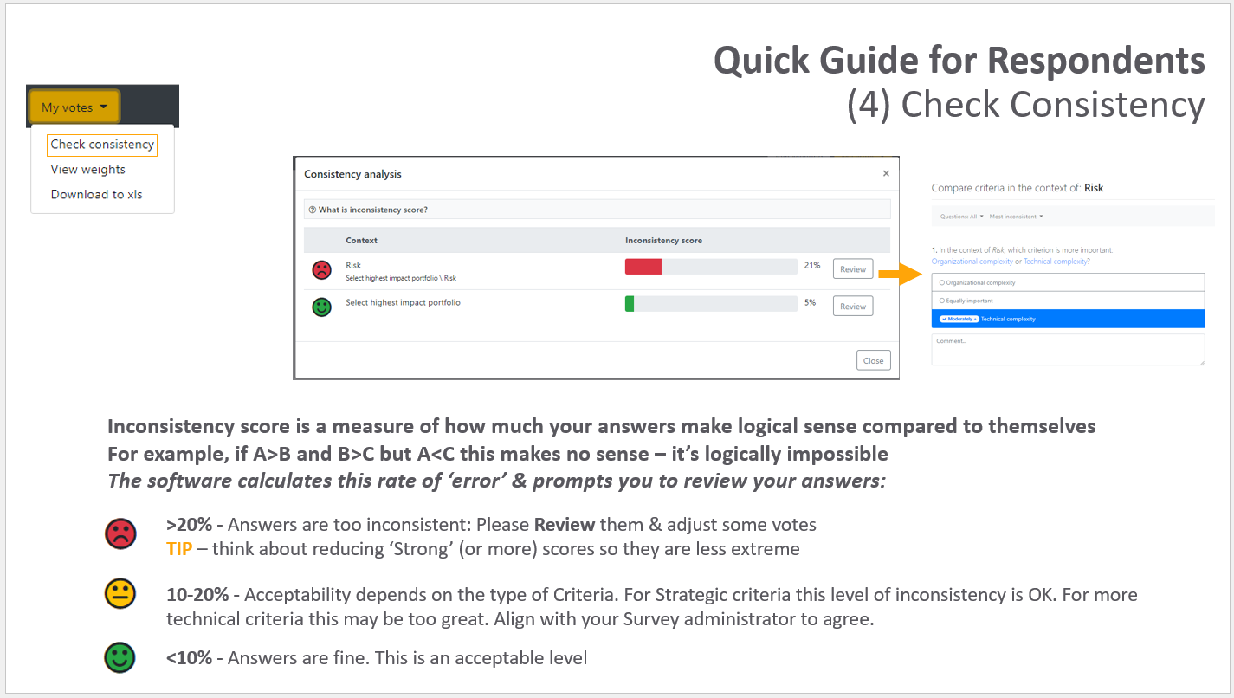
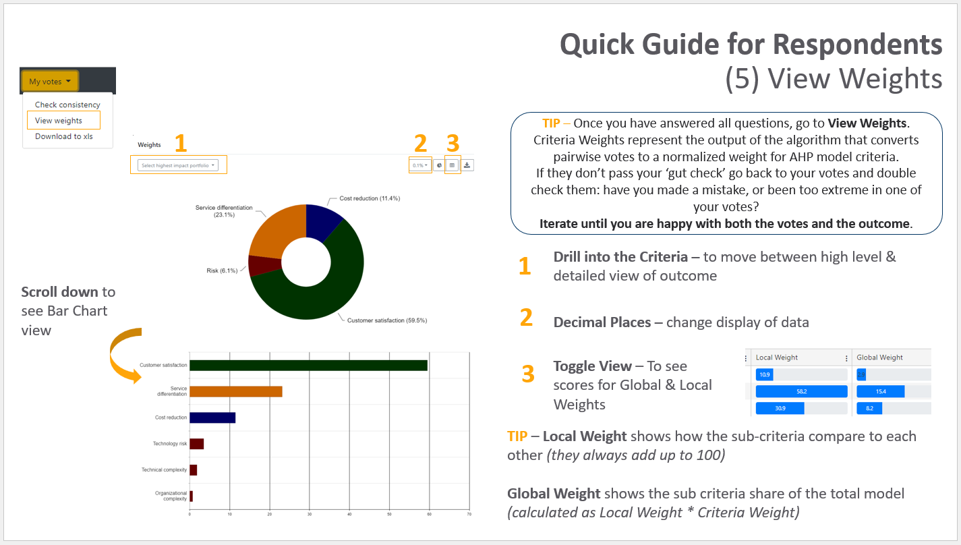
Complete the Survey
Respondents’ Guide
Respondents can click on the i button to download this guide which will step them through how to complete a pairwise survey
Get it now to learn about Pairwise, Consistency Scores, Data Visualisations and how to use the survey screen
Click here to download it now
TIP – download the guide, then edit it locally to customize it to your survey – you’re welcome to use our material!

Slide 25
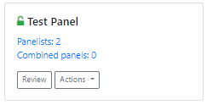
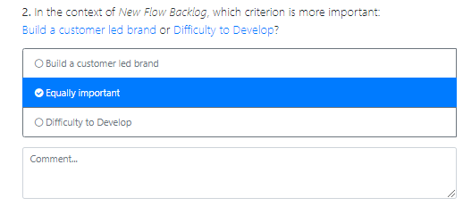
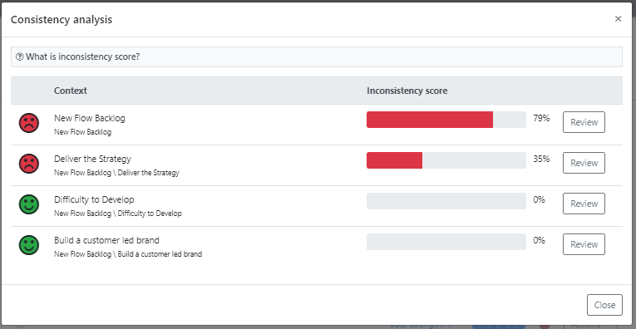
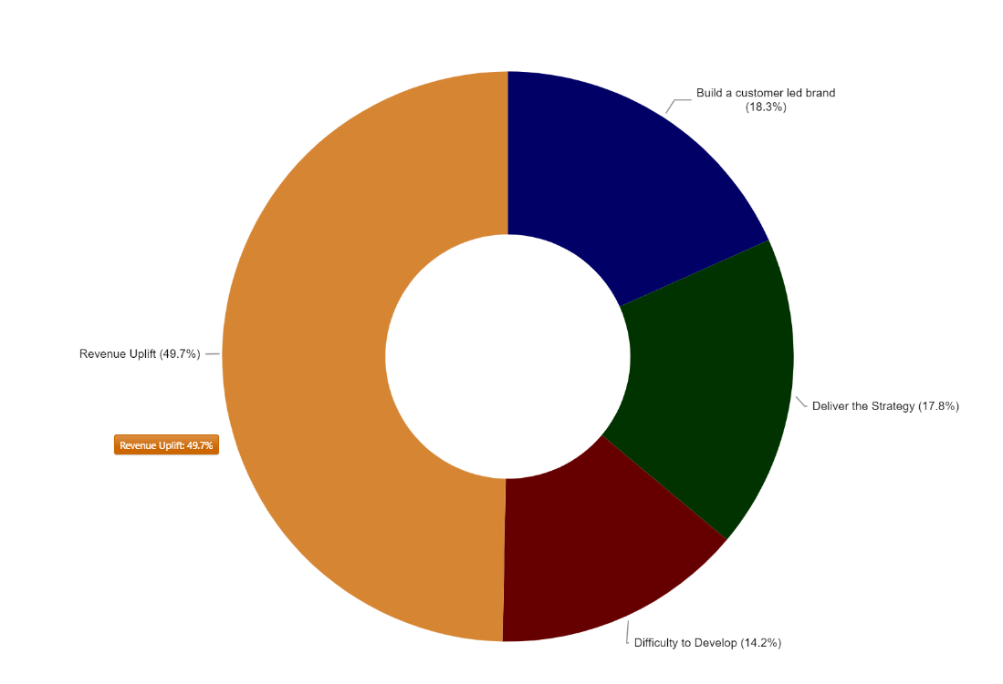
Set Up Opinion Panel
Tip –Test it yourself
It’s fine to create a Test Panel within the project team – this won’t impact your model
1
1
Take the survey – if it doesn’t read well your criteria may need work
2
2
Check your Consistency Score so you can coach your Execs on why they have a
Check the results – do they feel about right? Maybe you have sub-criteria that are almost meaningless that you could cut?
3
3

Slide 26
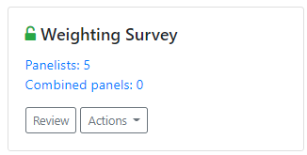
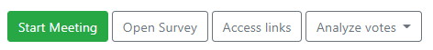
Complete the Survey
Facilitate Meeting – Control Panel
1
Start Meeting – Opens up the meeting to anyone with a Link (see below for settings)
2
Open Survey – Enables Respondents to edit their survey: recommended to keep closed during meeting
3
Access Links – Re-send links to All or specific Respondents: (see above for details)
4
Analyse Votes – After completing all questions you should focus into areas of disagreement (see below)
3
1
3
4
1
2
2

Slide 27
Complete the Survey
Facilitate Meeting - Settings
Auto-Reveal – Will enable you to reduce bias by ‘hiding’ others’ votes while people review the question – the facilitator can then reveal votes once initial opinions are captured
Anonymous Mode – Hides the names of the voters in Respondents’ screens so that people don’t follow others’ votes
TIP – Decide on how you want to run the session before you begin the meeting & set up accordingly
You’re now ready to start the meeting! Respondents will now follow your screen (via their Links) once they hit Join Meeting button

Slide 28


Complete the Survey
Facilitate Meeting - Voting
1
2
1
Settings – Same options as meeting set up
NB Analyse Votes guide is below
3
2
Pairwise question – Click on the Context or either Criterion to see Description
TIP – Clear Descriptions help Respondents vote better
4
5
3
Open / Close Voting Panel – We recommend to hide the panel & not use the Facilitator Override
6
Facilitator Override – Making a vote here will override Respondents’ votes
TIP - we recommend not to use this as standard
4
5
Revert to Average– Reset model to use Respondents’ score (rather than Facilitator Override)
6
Comment – Capture key points from the discussion (NB individual Respondents can also post comments)
7
7
Votes – See Respondents’ votes & comments in real time
TIP - don’t refresh to sync, it’ll kick you back to Q1

Slide 29



Complete the Survey
Facilitate Meeting – Question Panel
Navigation – Use the Arrow to open up the Criteria & jump to a different question
Question Status Tracker – shows you where the data for your model is currently coming from
TIP this is very important – make sure all your questions are green
Data from Votes – Respondents’ answers are being combined by an average (geometric mean) to create the model output
Data Override – Score is coming from the Facilitator: this can be a legitimate approach but don’t do it by accident!
No Data – Question has no replies & no override

Slide 30



Complete the Survey
Facilitate Meeting – Analyse Votes
Disagreements – shows where Respondents’ votes are least aligned based on distribution of scores
Click show to review answers & explore topic
TIP – Use this to focus on areas where people need to spend time discussing different points of view
Consistency analysis – Same as individual Respondents’ analysis in Survey
TIP – Inconsistencies at a group level can balance each other out. For a thorough model check at individual Respondent level

Slide 31




Complete the Survey
Review Weights
Check the Results… do they meet the ‘gut check’
View Weights
See how your Pairwise ratios translate into normalized weights across your criteria
Compare Weights – See how different Respondents’ Criteria Weights compare
TIP Use the navigation to drill into the detail

Slide 32

Publish Weight Set
Turn your Opinion Panel into Weight Set
You’ve collected the data….you have scores for each criteria from your Pairwise review
Now Create Weight Sets to feed into your AHP model. This fixes the value attributed to each Criteria in your model
What’s the difference?
Opinion Panels can be flexed – change weights, change Respondents, up-weight a particular branch of the model… or simply revisit strategic priorities after a major change
Weight Sets create snap-shots of the output of these panels, so you can have scenarios, or iterations which you can compare when completing your prioritization

Slide 33

Publish Weight Set for Model
Create weights set from survey
Once you are happy with your review you can publish the result – this moves a ‘hard coded’ output from your survey to the Weight Set
Put in a name & hit Save to complete

Slide 34





Publish Weight Set for Model
Close / Open Survey
Survey can be Closed / Opened via the Actions menu – the padlock icon shows status
Survey must be Open for Respondents to add their scores – if they see this it is because the survey is locked
TIP – Close your survey after the Meeting to lock final votes

Slide 35





Publish Weight Set for Model
Combined Panels
1
Take 2+ existing surveys & combine them into a single panel
1
2
Select from available surveys & set the vote strength you wish to give each one
All functionality will be the same as regular Surveys – except that when you view Weights Comparison you will see the scores from the underlying surveys, rather than the individual Respondents
3
3
TIP – You can use this functionality to split Respondents into stakeholder ‘buckets’ and see / weight their views easily:
e.g. Senior Execs / Managers / Customers
2

Slide 36


Publish Weight Set for Model
Create weighted score
Edit enables you to make manual changes to the data (see below)
View Weights enables you to analyse the data (same as previously)
Set as default will make this weight set the default for Ranking if using Legacy Flow
Create Weighted Score – creates an Attribute which automatically joins the weight set to data from Assessments to produce Value Score
(NB this will appear in your Attributes page)
View Dependencies – shows Attributes linked to this model
TIP
Once you Create a Weighted Score… set up a Value for Money Attribute + Set up a Report – now as soon as you hit Save in Assessments, you’ll see results

Slide 37



Create Scenarios
How to build a scenario weight set
This is optional… but powerful!
Having a second weight set means you can two sets of scores for all your projects (with no extra work) – great for seeing how different policy choices impact the portfolio choices
There are 3 ways to do this
Manually tweak your Opinion Panel
This is how you do it…
Re-Score your Opinion Panel
Have people re-vote to generate a new score. Use download to Excel if you need to create a record of original voting.
Make manual changes into weight set
see below
Review your Opinion Panel, and in Facilitator mode manually vote to ignore the Respondent’s score.
This will turn Orange in the questions. Save this as a new scenario.

Slide 38

Create Scenarios
Manual Override
For super-quick, somewhat unscientific adjustments… try this
Start editing the Input field and the Normalized Weight disappear (don’t worry)
Make manual ‘best feel’ changes to the current Local Weights & Hit Normalize
The model will build in new weights based on the adjusted ratios
e.g. If you up-weight one criteria it will have two effects:
* All the sub-criteria beneath it will increase their Global Weight – their impact in the model
* All the other criteria will reduce weight accordingly to off-set the switch
OR if you up-weight one sub-criteria it will reduce Local weight (and Global Weight) to the other sub-criteria in it’s branch, but not impact any other criteria

Slide 39


Create Scenarios
Compare Weight Sets
Compare your Weight sets
View scenarios alongside each other to see how they vary – use this as the basis for sharing results
Check the Weight Sets you want to review and hit Compare
This opens up the Weights Comparison analysis

