Slide 1



TransparentChoice
Getting Started

Slide 2
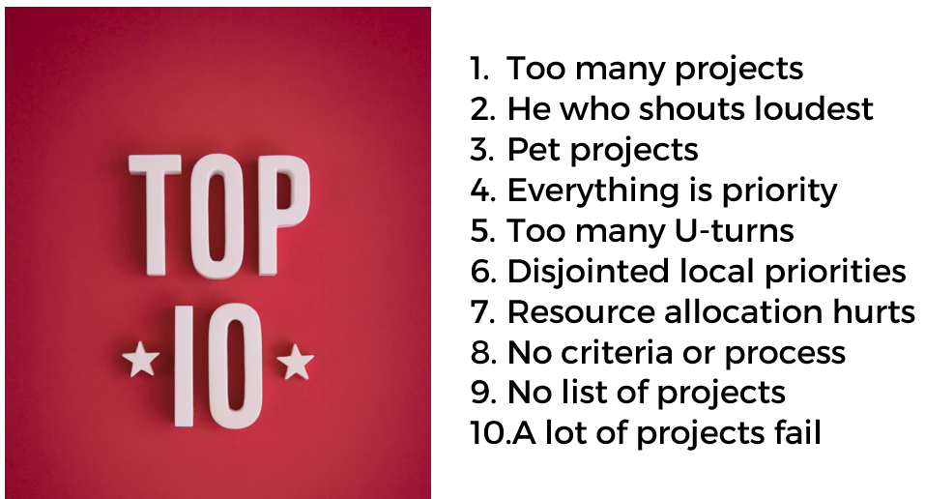

Why does Prioritization matter?
What’s broken? – Here’s our Top 10
What is that costing us? – What’s at stake?

Slide 3

Prioritization is a change process
Organize the process – plan for success
Engage stakeholders – what’s in this for them?

Slide 4

Solve prioritization the right way
Analytic Hierarchy Process (AHP) – Decision Science solution
Collaboration improves both quality and buy-in for decision making

Slide 5

Let’s get the Team Together
Core Team = 2 Super Users & Exec Sponsor
Extended Team = Exec Steering Group + Subject Matter Experts
Details in our Deployment Guide

Slide 6

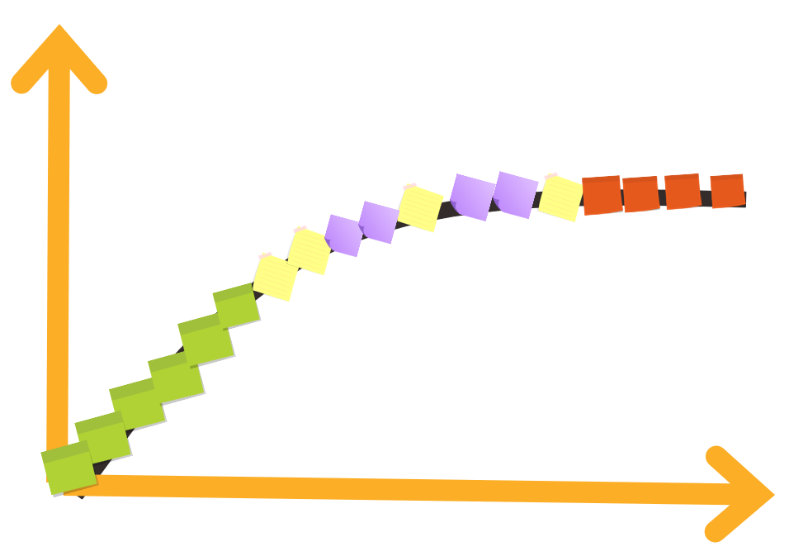

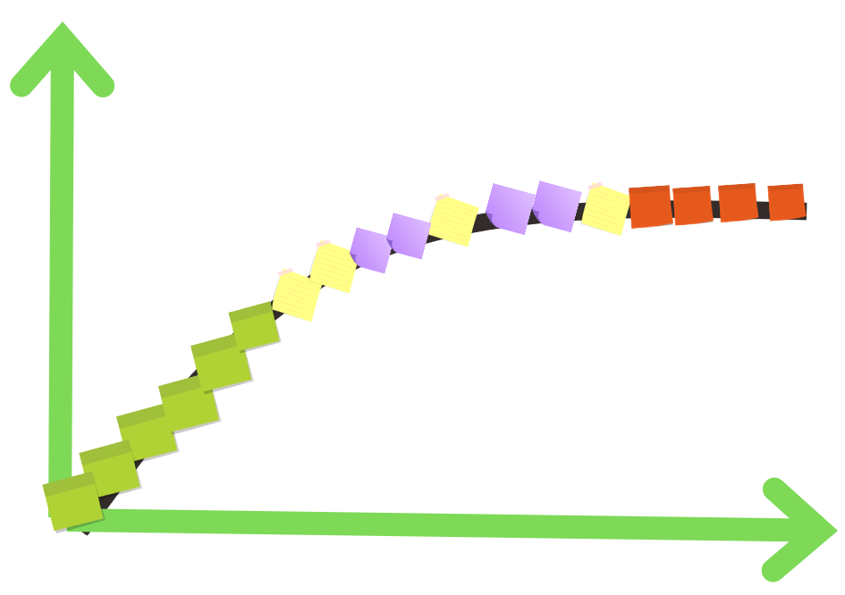

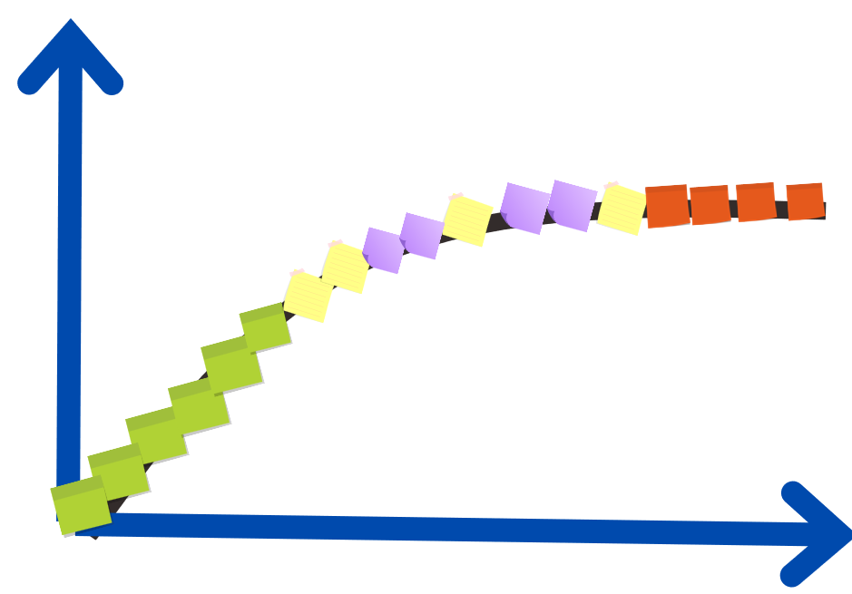
Portfolio Strategy
Put your projects into similar buckets for evaluation –these ones are common options
Each bucket will get its own criteria & its own budget - software makes this easy to organize and set-up
Maintain
Grow
Transform

Slide 7
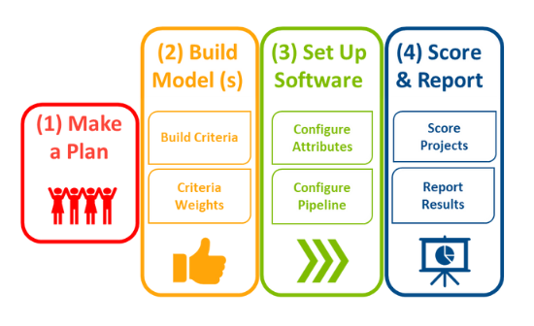
4 steps to deliver results
You can do this in 8 weeks – if you’re in a hurry
If you want to go slower that’s fine - lots of client do

Slide 8
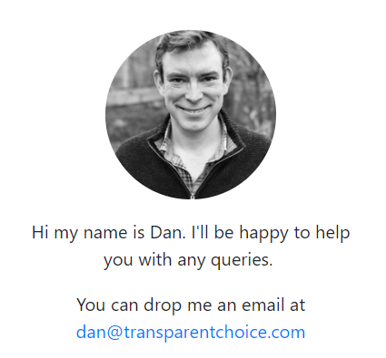
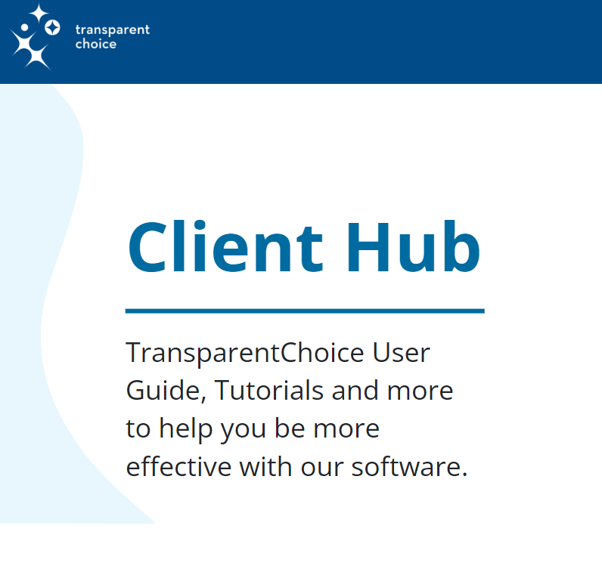
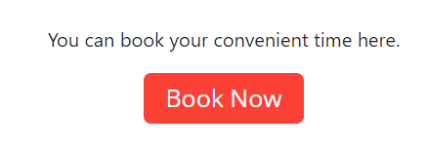
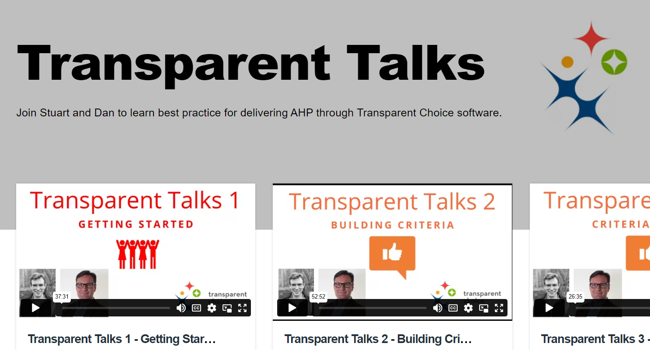
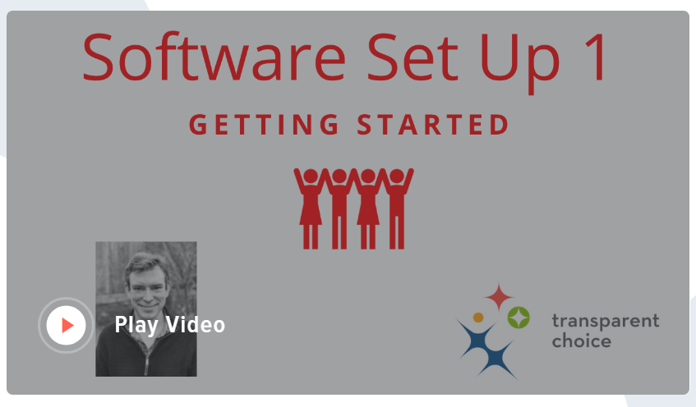
We’re here to help!
Client Hub resources – password is client@tch
Book a call or email – click for the links →
Watch our videos – TransparentTalks = Best Practice
Software Set-Up = Detailed Demo
Click here to download full documentation

Slide 9


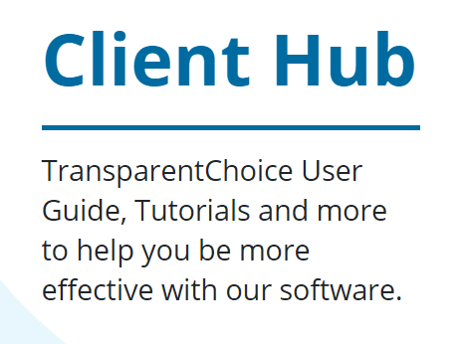
Ready to play?
Logging In: Welcome Email with location of your Instance + Log-In data
Watch Along: Software Set-Up Videos and Best Practice Videos
Create a Portfolio: Or click on our demonstration model that you can play with
Support is available: All training materials, case studies & links for getting in touch are available at Client Hub
https://www.transparentchoice.com/client-hub
password = client@tch

Slide 10
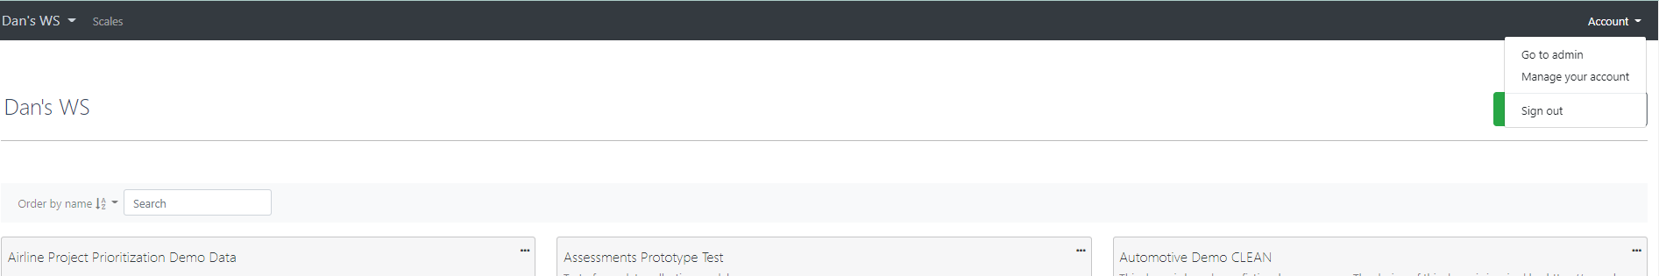
Admin Panel – how to set up
If you are set up as an Organizational Admin then you will see this option in your workspace.
This will let you add / manage users + workspaces (see below for details)
To request upgrade to admin please contact dan@transparentchoice.com

Slide 11
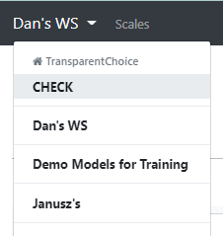
Admin Panel – Set up Flow
Set up new user
Set up user workspace permissions
Access workspace… and get started
Using name + email you can register a new user from your organization
They receive an email with password from our software – check junk if they don’t see it
Note they don’t have access yet – they need workspace access
You can have workspaces for different teams within your organization, to manage access to different models
As part of set up send an invitation to the workspace you want a user to access – note that this step is needed even if you have only 1 workspace
Workspace users will see their workspace (s) in the top right menu of their landing page

Slide 12
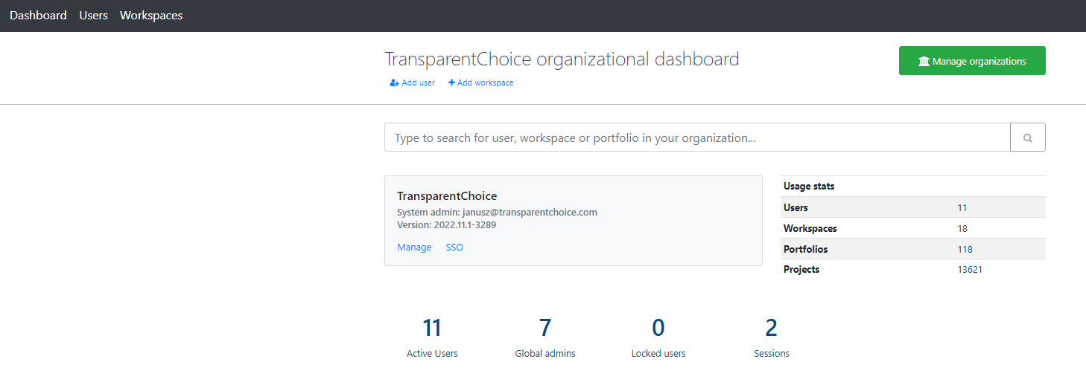
Admin Panel – Dashboard
See key stats regarding your deployment

Slide 13
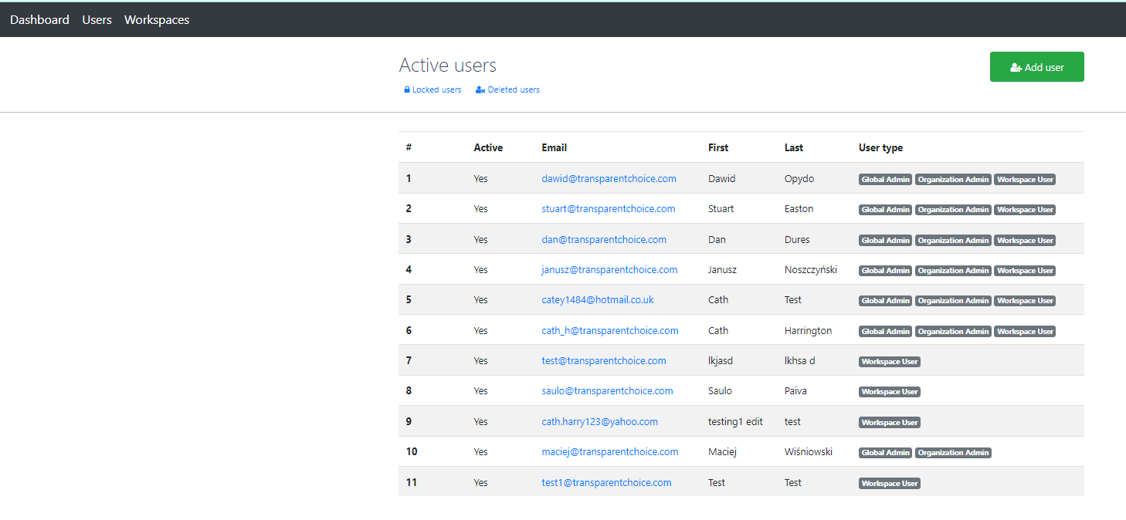
Admin Panel – Users
1
4
2
3
Manage your User Base
Add a new user
Manage existing user (see below)
See user permissions
View inactive users

Slide 14
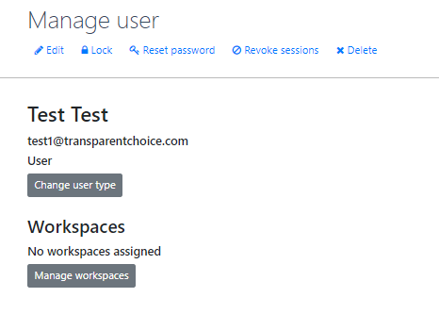
Admin Panel – Manage User
Actions
1. Edit: Change Users’ name (cannot change email!)
2. Lock: Suspend Access
3. Reset Password (NB user can do this themselves too)
4. Revoke Sessions: Stop all open sessions in the software
5. Delete: Remove user from database (their models will not be affected)
6. Change User Type: Change access rights to other users
7. Manage Workspaces: Invite User to a workspace

Slide 15
Admin Panel – User Types
There are 4 types of User
Global Admin: Always TCH admin for Cloud / Client IT for on-premise. Allowed to create new Organizations & Organizational Admins only
Organizational Admin: Able to new Workspaces & Users, and Manage User Access rights
Workspace User: Regular user – able to add & edit projects within designated workspaces
Respondent: TransparentChoice generates interactive URLs to enable colleagues to add projects, fill forms, take surveys and view reports. This access does not require password access.
Note that individuals can hold multiple roles

Slide 16
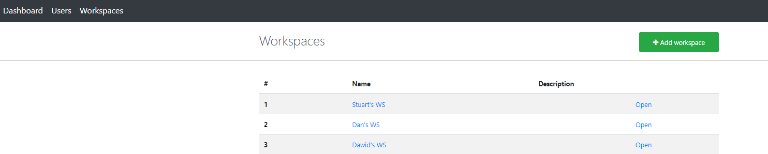
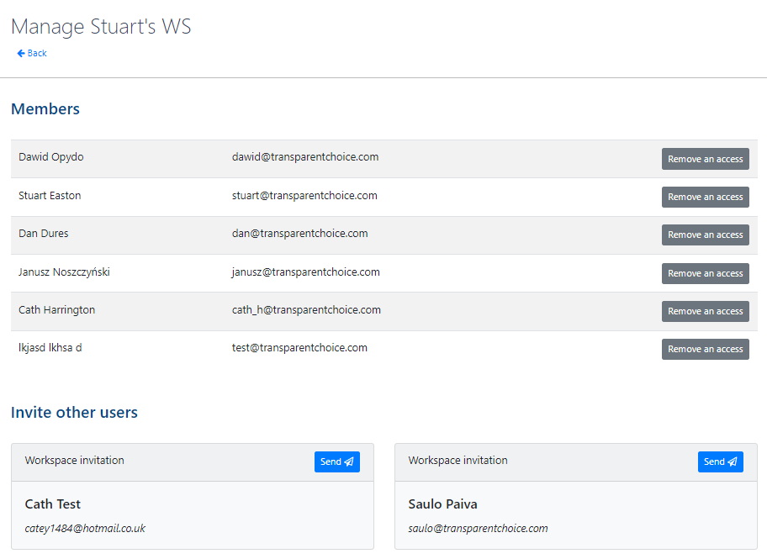
Admin Panel – Workspaces
Manage Access
Invite / Revoke Access to users
2
1. Manage Access
Invite / Revoke Access for existing workspace
1
3
2. Add workspace
Create a new workspace
3. Open Workspace
Go to an existing workspace

Slide 17
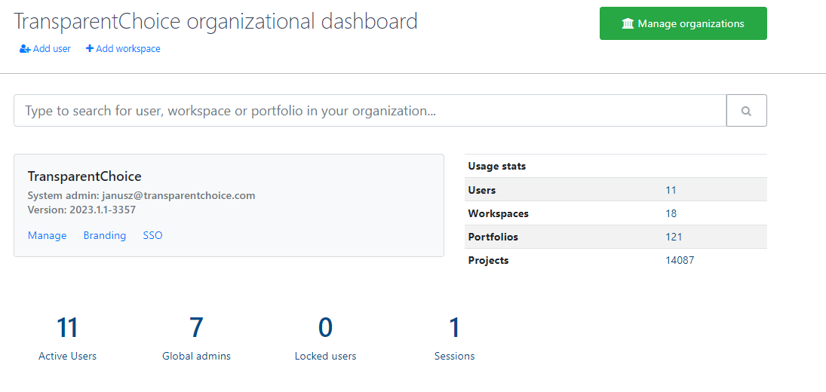
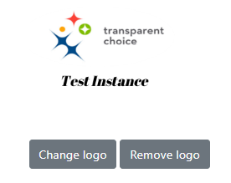
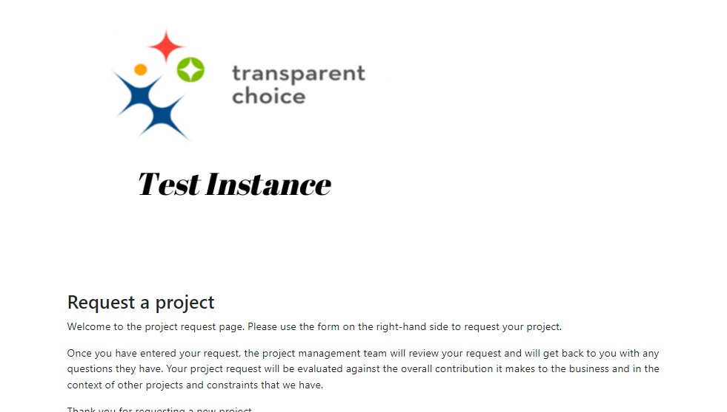
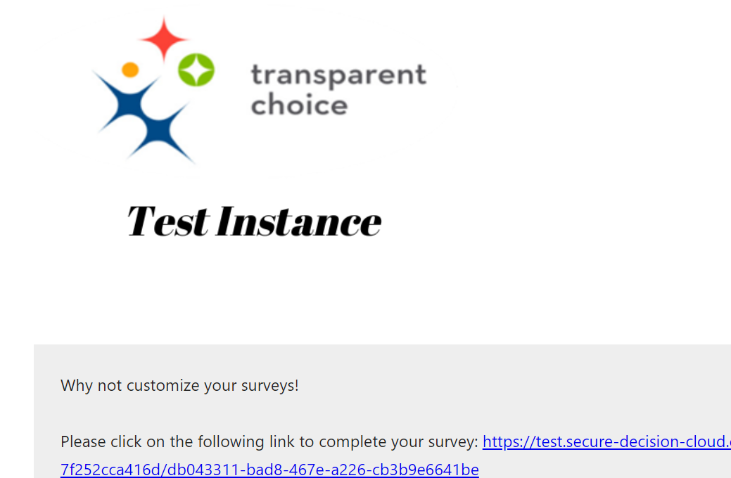
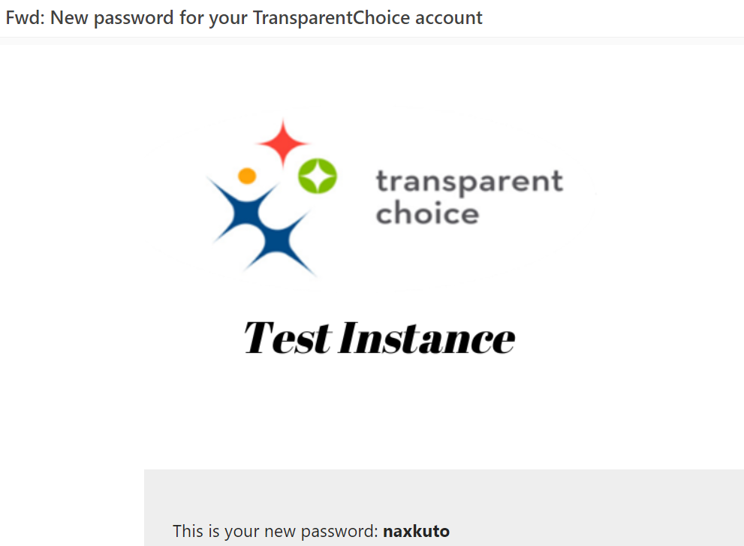
Customize Branding
Upload an image file with your logo to update logo in 3 key places in the software
(1) Request Pages
(2) Survey Emails
(3) Account Setup / Admin Emails

Slide 18
Glossary – Product Features
Alternatives – Different options under consideration within a Portfolio strategy.
Attributes – Any characteristics associated with a Project. Can include administrative details (emails, deadlines, department etc), facts (weight, speed etc), modelled data (NPV, Risk etc) or AHP model elements (i.e. criteria scores / value scores)
Assessments – Data collection mechanism in the software, used for Scoring Criteria. Can also be used to generate Estimates (e.g. for cost)
Client Hub – Landing page to support clients. Contains videos, user guide and best practice materials
Criteria – Key pillars which will deliver your Goal, which need to be traded off against one another. Measured using Attributes in software
Decision Log – Details of changes made at Project level, along with documentation and comments
Efficient Frontier – Key output chart, choosing value score vs. cost on cumulative basis. Used for Partho/ 80:20 analysis of portfolio
Forms – Flexible tool used for data capture to collect Project information. Can be embedded into emails or accessed directly at various points in the product. Typically used to collect Attribute data.
Gating Factor – Critical consideration for a project, but typically as a binary Stop-Go decision rather than a Criteria
Goals – High level objective of an AHP model in TransparentChoice
Kanban Board – Shows the flow of a decision making process, typically starting at ideation and completing at post-implementation evaluation
Lists – Groups of Alternatives created to enable aggregated analysis within a portfolio. Can be built based on Status, Attributes or as a manual grouping.
Normalization – Criteria must sum up to 100%. Normalization takes existing values and re-expresses them as a percentage
Notifications – Email alerts sent out based on automated rules, typically triggered by progression in the Kanban
Organizational Admin – Super User with rights to add new users and workspaces within the Organization
Portfolio – Model in TransparentChoice. Contains single Kanban of Alternatives, but can contain multiple AHP models
Reports – Customer dashboards which can be used to review the output of your model or share update reports to stakeholders
Scales – Determine the weighting different responses will be given in the model. Can be linear or non-linear. Set in Measurement tab in Evaluation
Status – Level of the Kanban. Editable to align to any internal review process.
Sub-Criteria – Measures beneath the Criteria which represent the different tactics / approaches for delivering the Criteria
Survey – Pairwise questionnaire which compares all Criteria against one another to determine their relative importance
Ranking – Output from AHP model. Can be used to generate snap shots of a Value Score or list order for Alternatives
Reports – Data Visualisation component win the software
Value Score – 0-100 score for each Alternative, generated by multiplying sub-criteria weight to sub-criteria score. Core output for AHP model
Weights – The value a given Criteria / Sub-Criteria achieves based on the AHP model. Produces Value Score when joined to Attribute data
Workspace – Folder to keep Portfolios organised ad manage access rights between groups of users

