Slide 1


TransparentChoice
Report Results – Best Practice
Best Practice
Client Hub Page

Slide 2
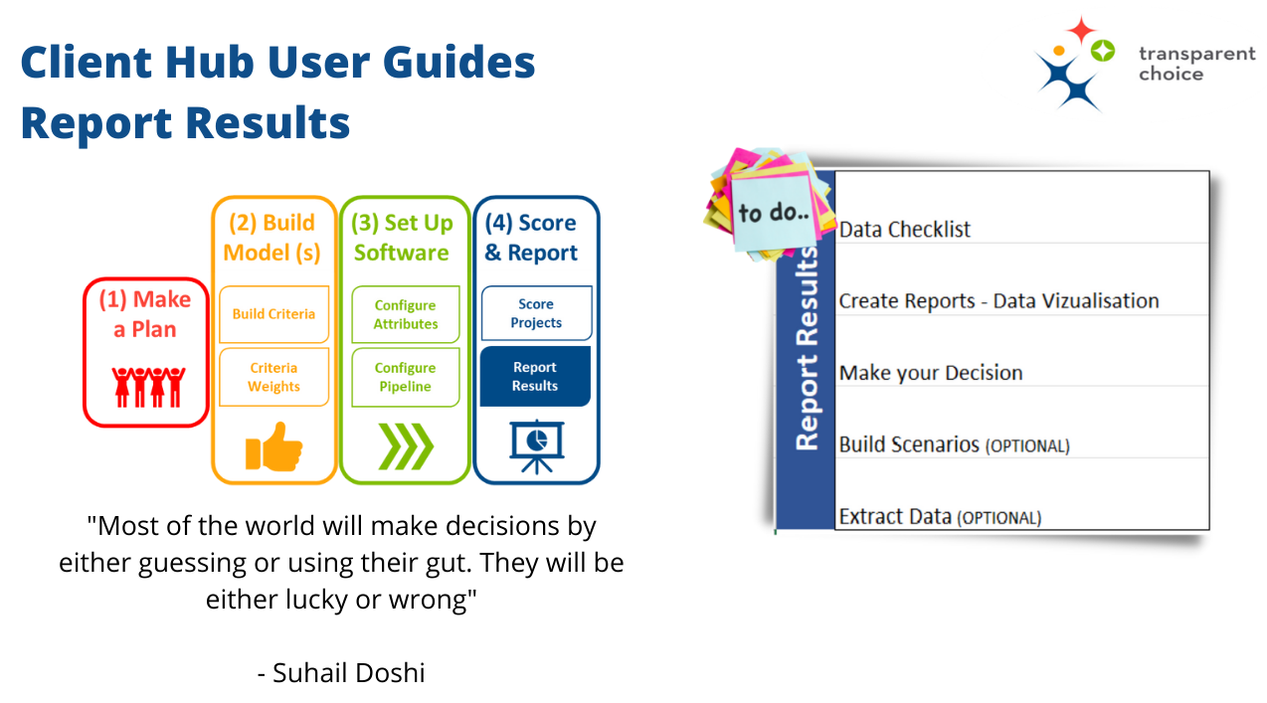

Slide 3

Checklist before building Reports
Value Scores are written to Database from Ranking – core AHP model plus Scenarios if required
Additional Project Data has been collected + reviewed
Lists are set up for each Department & Portfolio being reviewed
Text Attributes (pick from list) are in place support portfolio analysis
Calculated Attributes – esp. Value for Money – are set up including a scaling factor where appropriate
Kanban is set up for modelling – including Lists based on status for easy filtering

Slide 4
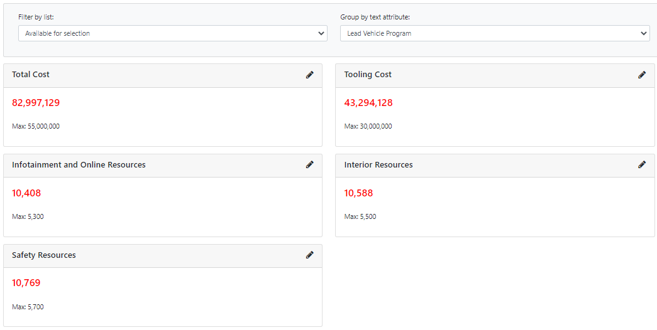
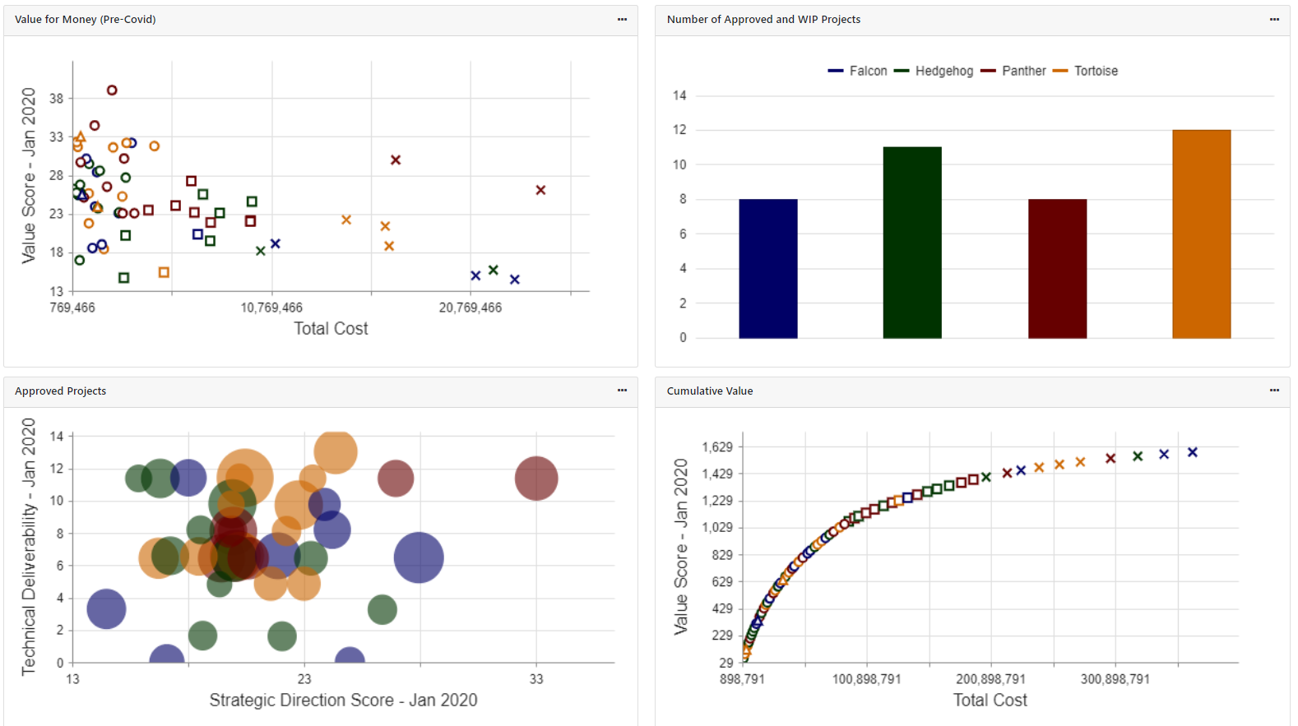
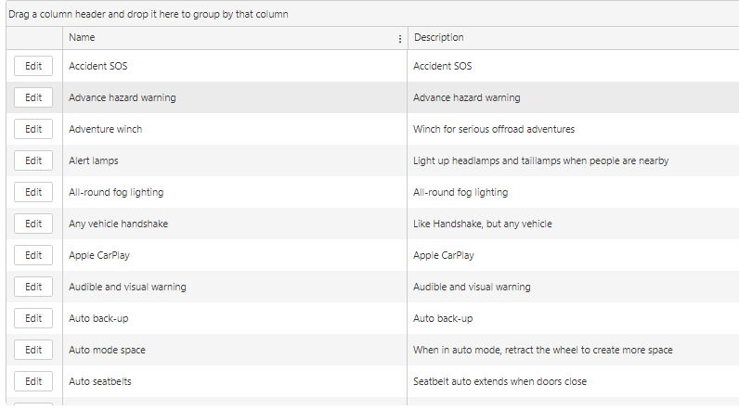
Overview
There are 5 things you can do to present the data from your model:
Split portfolio into discrete colour coded ‘pots’
Create Lists of projects to see aggregated data points
Set a Goals or Limits using Reporting metrics in a tile
Create an axis in a chart (bubble / scatter / cumulative)
Simple Grid view – with ability to Edit data or update Status
2
1
3
4
5

Slide 5
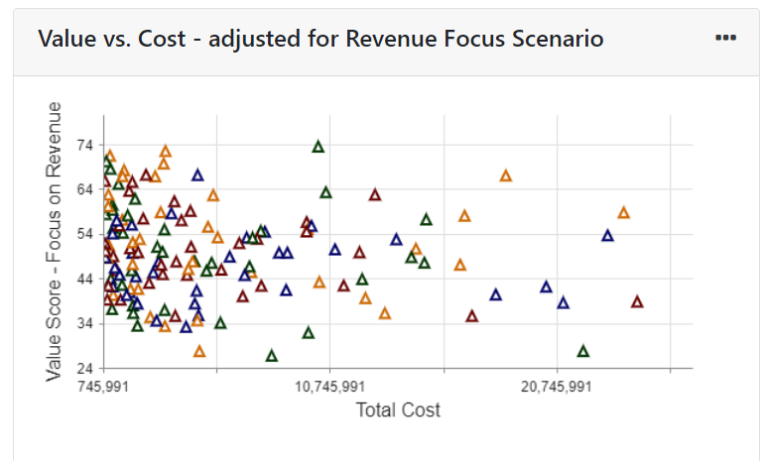
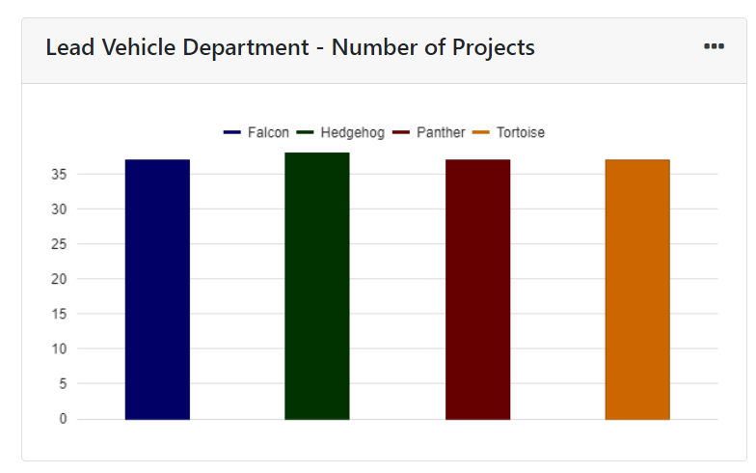
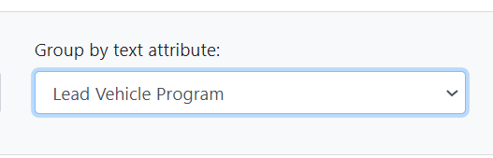
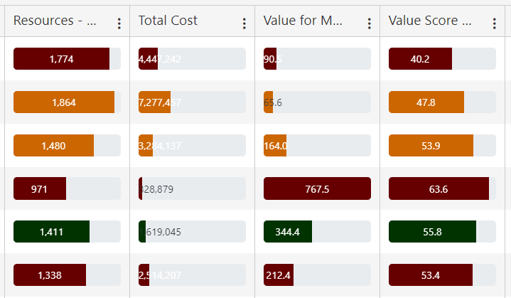
Text Attributes – add a lens into the Report
(3) Other Charts & Grid View will have the same colour coded split
(1) Pick from any Pick from List Text Attributes
(2) Create a Key showing number or projects (or cost…or both) using Column Chart

Slide 6
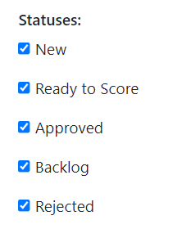
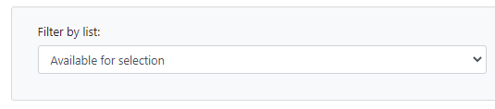
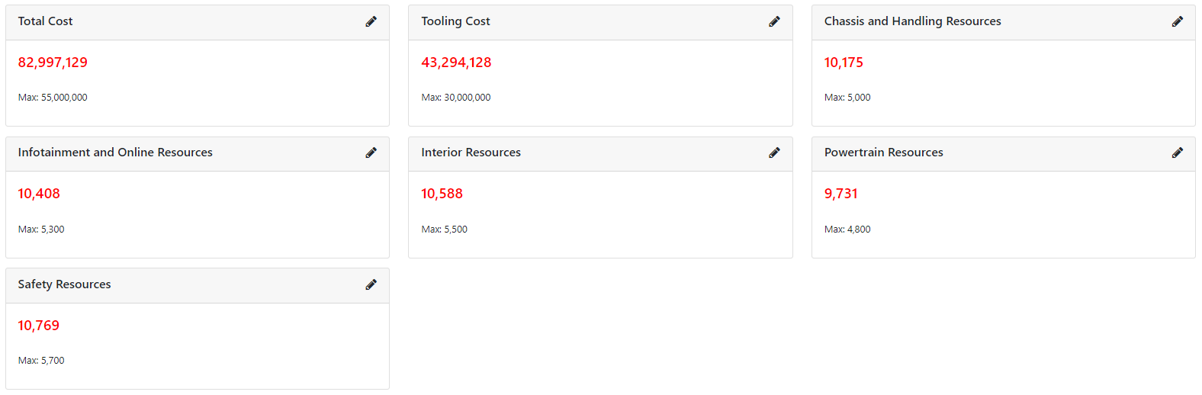
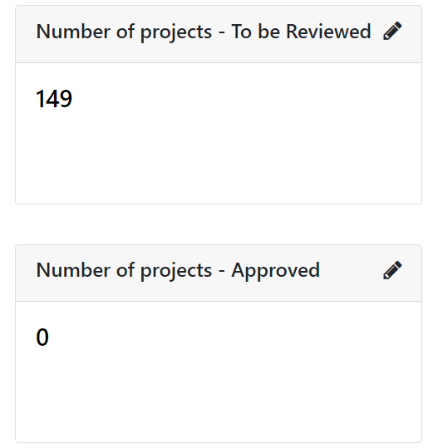
Reporting Metrics
Lists filter all projects in the Report - e.g. if you want to see one sub-portfolio
Add “Metric” tiles to present portfolio KPIs
Use MIN/MAX to flag resource limits or must-hit targets
Use Kanban Status filters to limit KPIs to specific status(es) – and track changes as you approve projects
Use your Lists to filter projects included
Use Kanban Status to filter projects included
Track your Attributes vs targets / goals by using MIN / MAX
Repeat metrics… but change Kanban Status to show approval levels

Slide 7
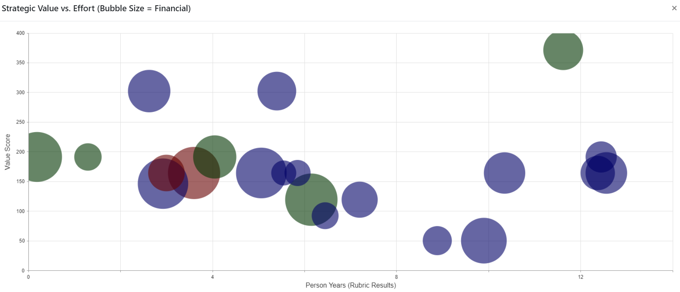
Multi-dimensional Analysis (1)
Use Bubble Chart to create
Dimensions are fully customisable with any data you collect or model

Slide 8
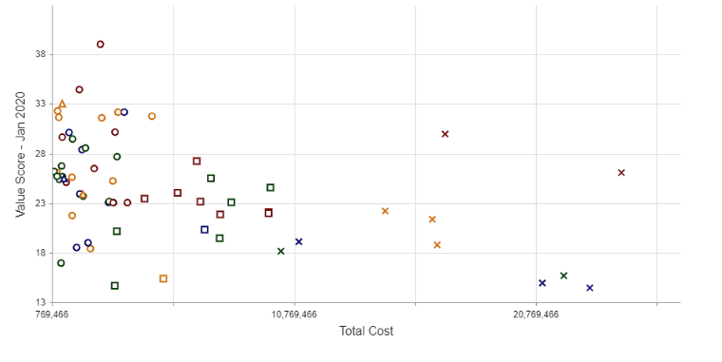
Multi-dimensional Analysis (2)
Use X-Y Scatter to create
Start to build your portfolio insights
1
(1) Great Projects – Prioritize these!
(2) Terrible Projects – don’t let these happen!
2

Slide 9
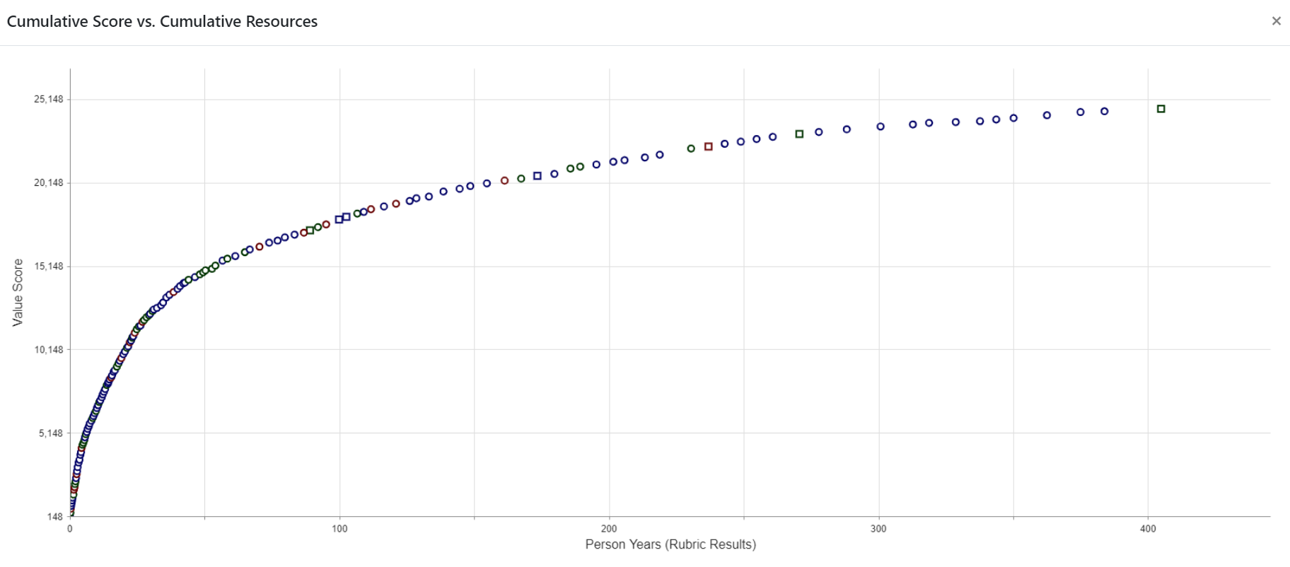
Multi-dimensional Analysis (3)
Use X-Y Scatter to create
(with value for money as cumulative variable)
73% of the value, 25% of the resources
This is the Efficient Frontier for your portfolio

Slide 10
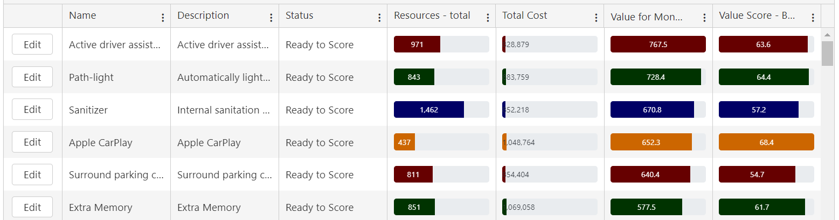
Grid View: Deep dive into the data
Customise columns, picking from any Attributes in database
Format, adding bar view & trimming decimals
Toggle to “Cumulative View” to help selection process
Double click to sort, apply filters or group into buckets
Notes:
Bar = VFM
Sort = VFM
Aum = Budget

Slide 11
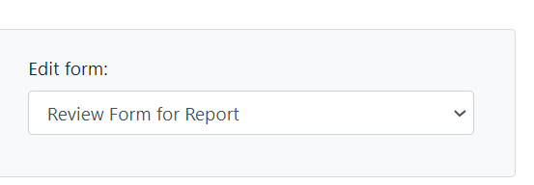
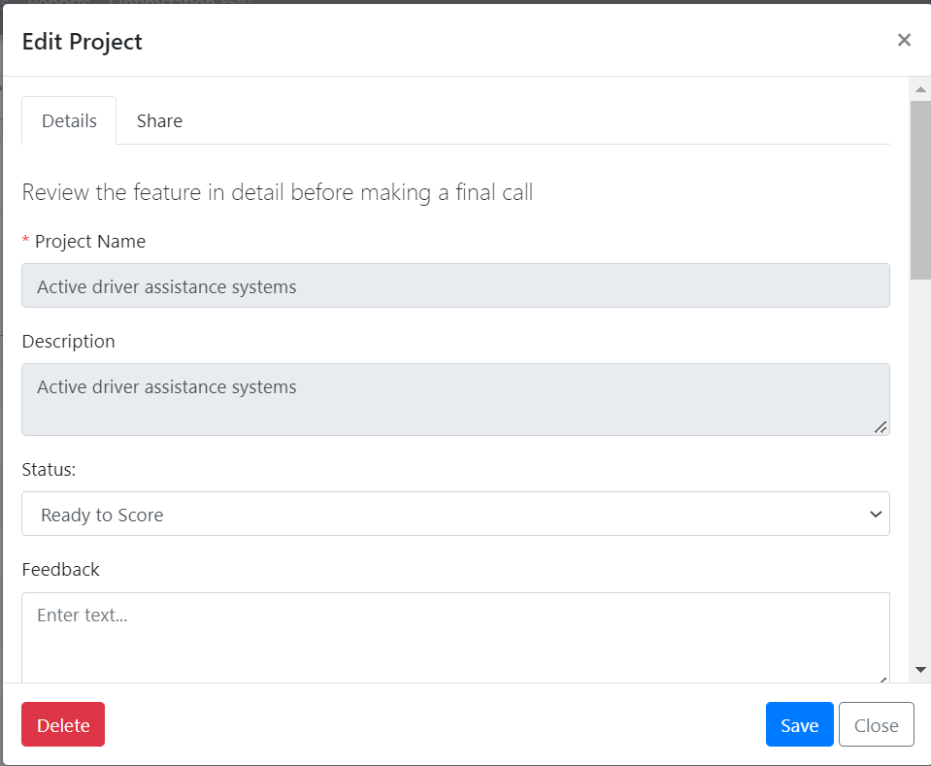
Edit Form: Add Editable Attributes
Select Form to embed in Report
Users can click project to bring up Form & make live edits to the project’s data
Best Practice for setting up an Edit Form include:
*Include STATUS update to enable live decision making
* Use READ ONLY to stop users making changes to locked data
* Add a “FEEDBACK” Attribute (multi-line text) to capture meeting notes
* Do not leave blank – it will mean anyone with the Report can make changes to any Attributes
1
3
2
TIP – if you select “none” then people seeing the Report will have no access to any extra data
Notes:
Bar = VFM
Sort = VFM
Aum = Budget

Slide 12
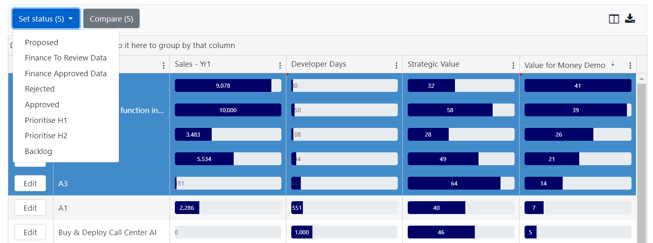
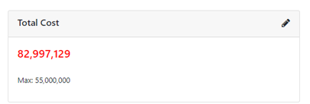
Use Set Status in Grid View to build your portfolio
Use Grid View at project level, sorting by your key selection metric (e.g. Value for Money)
Highlight projects to update Status (hold down control)
Track key constraints to make sure you’re not going beyond resource limits
Iterate…

Slide 13
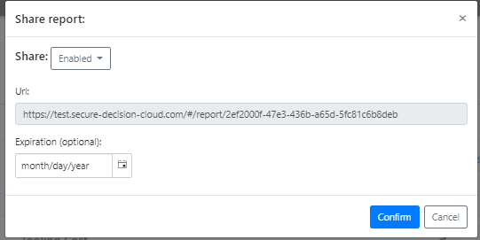
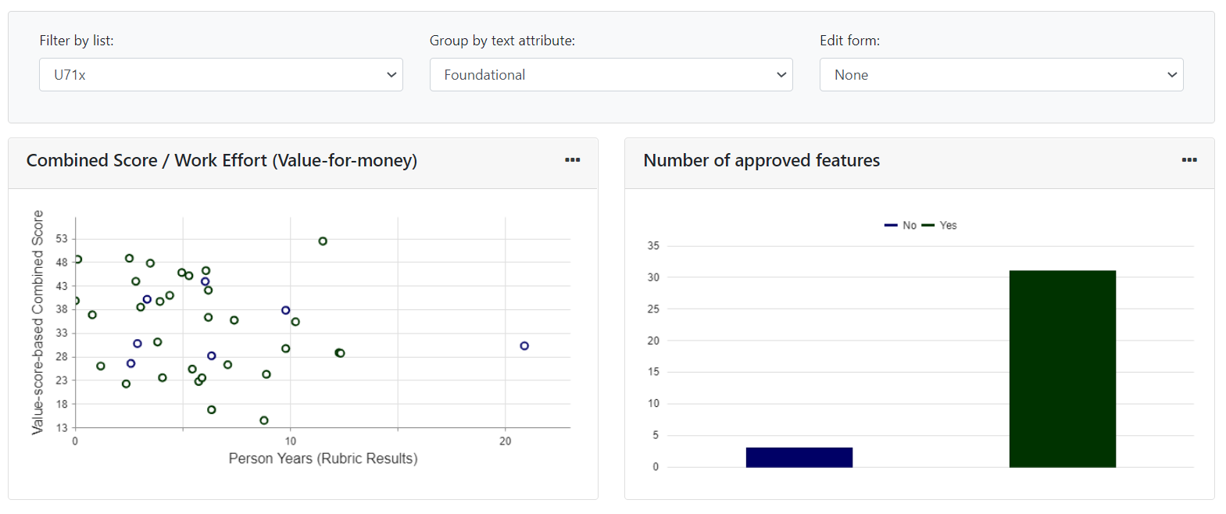
Real-time Dashboards customised by stakeholder
Set Filter / Save Report / Share Report
Different views for different teams
“My slice of the data”
Always up-to-date “dashboard”
URL based with no need for user set-up
TIP – use Clone to create and copy a template before versioning for each team
Create shareable URL

Slide 14
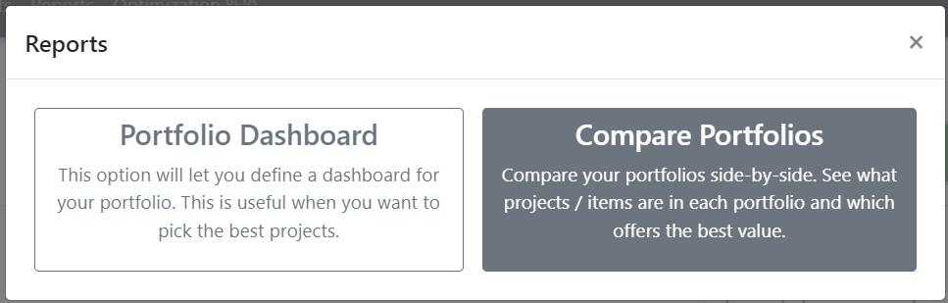
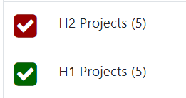
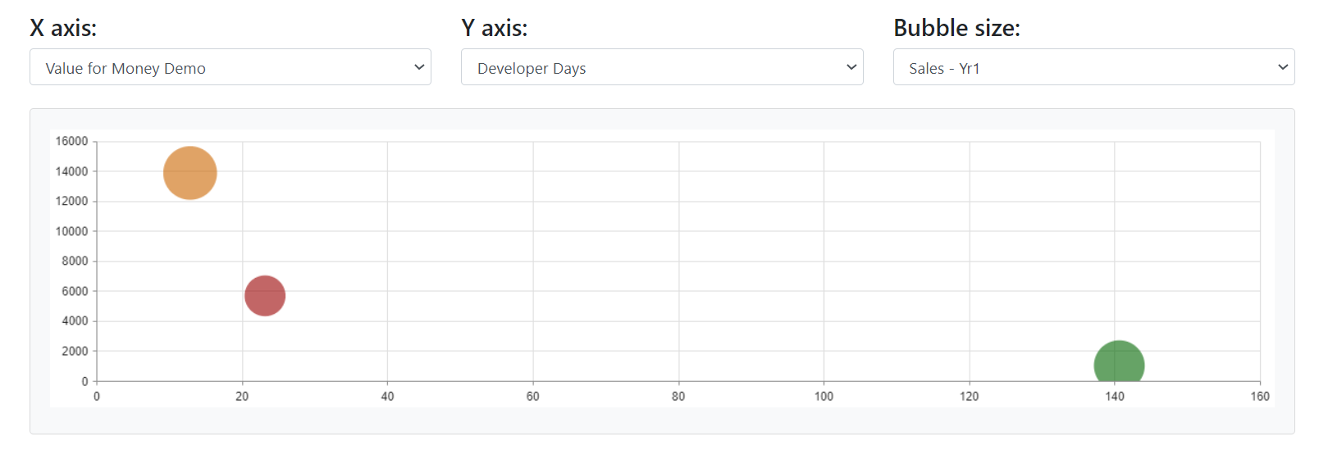

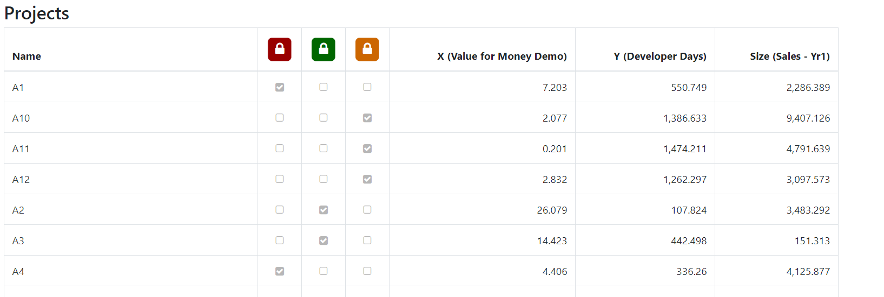
Review outcomes at portfolio level to complete process
Use Compare portfolios Report in Set Up
Use Lists to build different portfolios or scenarios
Create portfolio level comparison Reports – customise axis to see how they differ
Review at Alternative level to see what’s in / out for each List
TIP – Use dynamic lists / Kanban Status to make this process iterative

Slide 15
TransparentChoice
Report Results – User Guide
User Set-Up
Client Hub Page

Slide 17
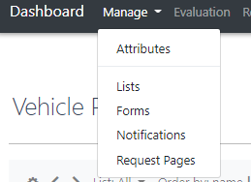
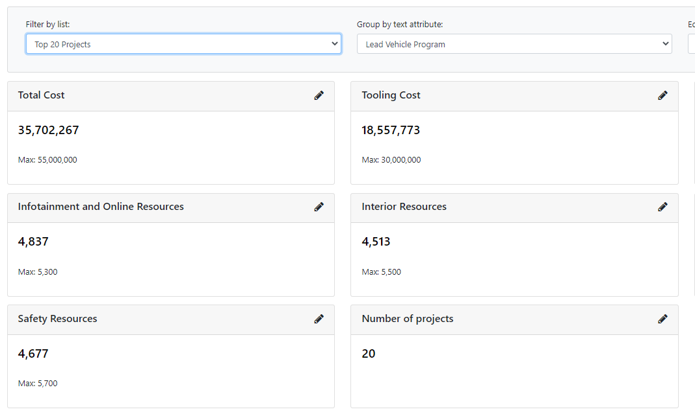
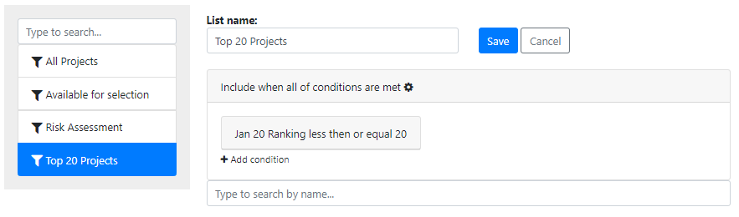
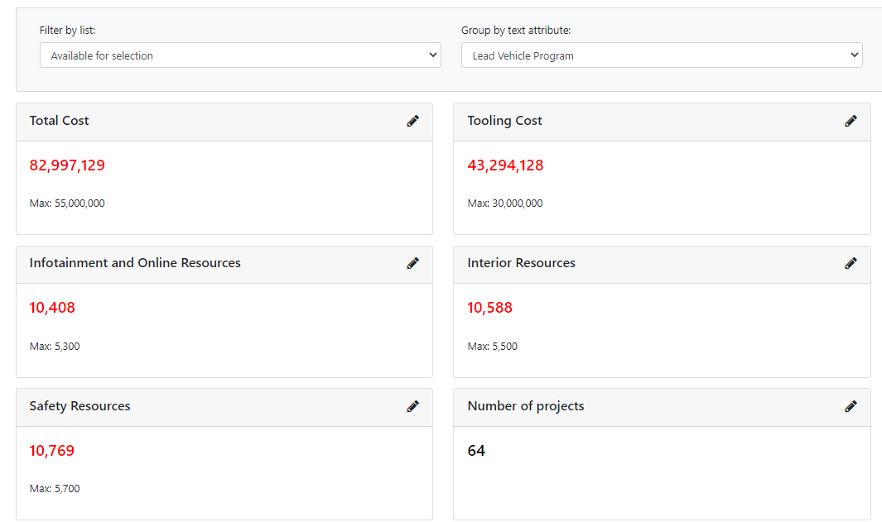
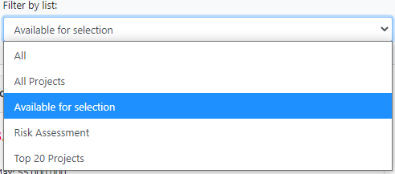
Data Checklist
Lists
1
3
Create Lists that group projects together based on either criteria (status / attributes) or manual selection
(Lists is found on Manage menu)
TIP See Kanban User Guide 2.2 for detail on managing Lists
2
Pick the List to use in Reports
Your Report will now filter based on the List to change the data in the report
TIP – Set up dynamic lists linked to Kanban status to enable ‘real time’ creation of portfolio using Reporting

Slide 18
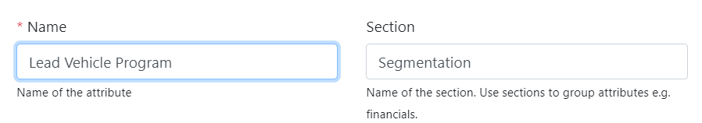
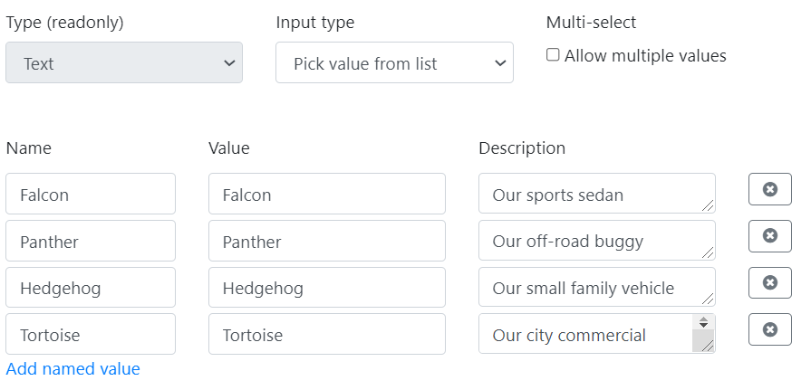
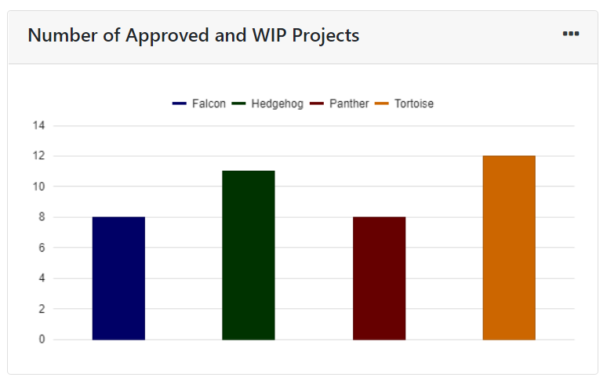
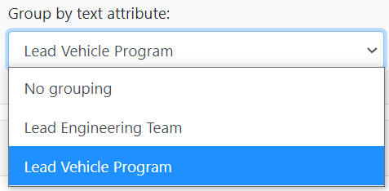
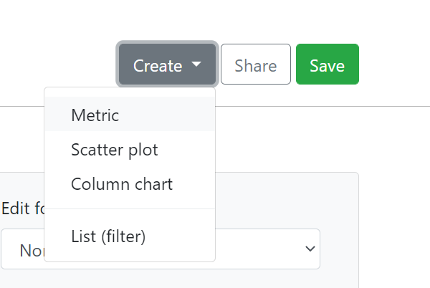
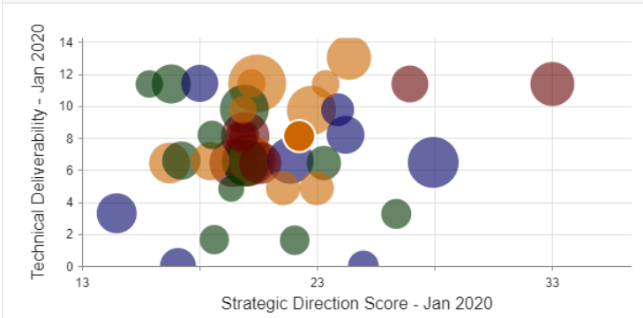
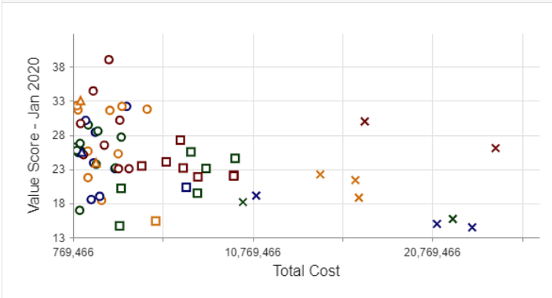
Data Checklist
Text Attributes
1
1
Set up Text Attribute / Pick from List that creates flag for Alternatives
4
2
This Attribute will be available in Reporting: Group by text attribute
2
3
Use Column chart to use the Text Attribute to cut the data
4
Create colour coded column chart
3
5
These colours now re-appear in all your other charts
5

Slide 19
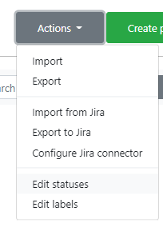
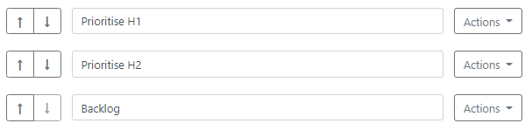
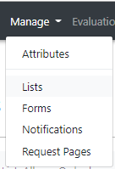
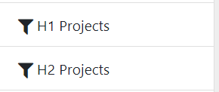

Data Checklist
Set Up Kanban for prioritization
1
2
(1) Add extra steps into the Kanban based on work scheduling
(2) Create Dynamic Lists that map onto these new statuses

Slide 20
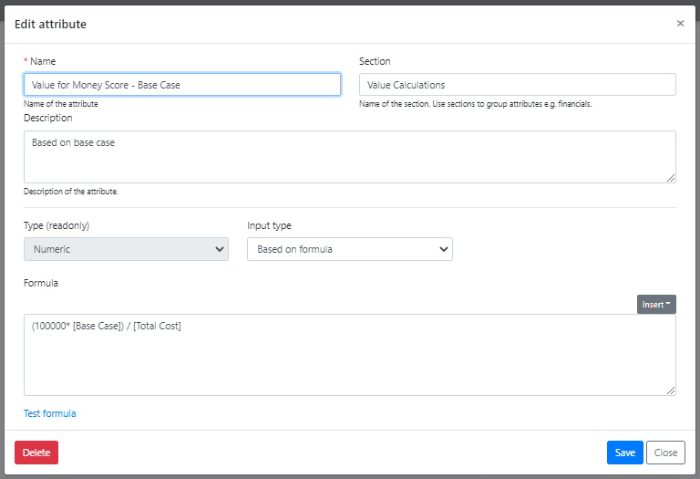
Data Checklist
Calculated Attributes
Set Attribute Type
Pick Numeric Attributes to add into formula
Use these mathematical symbols to build formula
* + / - ()
TIP – when setting up Value for Money try adding a scaling factor so that the KPI isn’t 0.00014323

Slide 21
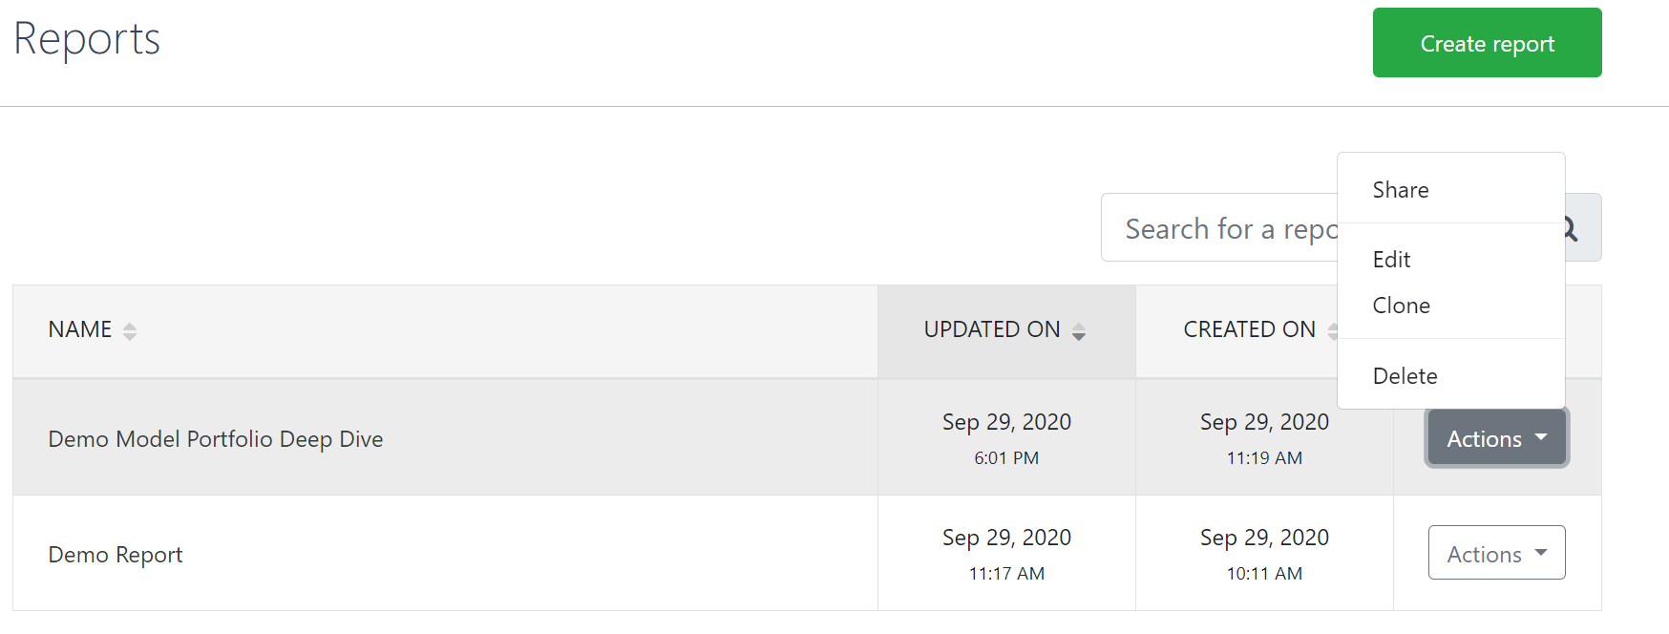
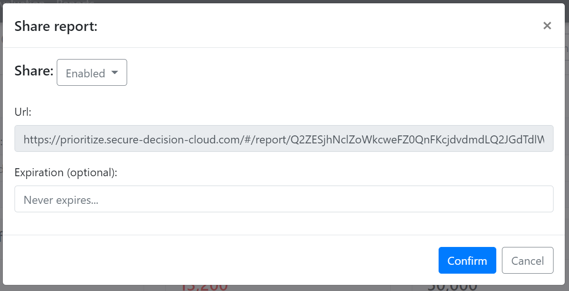
Create Reports
Getting Started
You can create as many reports as you like quickly cloning Reports
Reports can be shared via a URL to keep everyone up to date

Slide 22
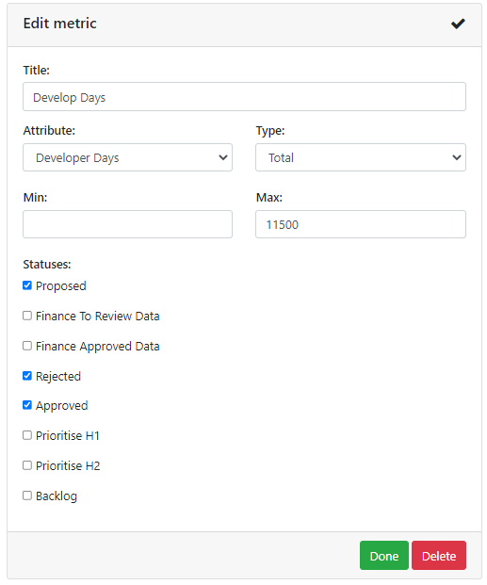
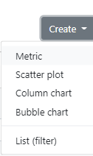
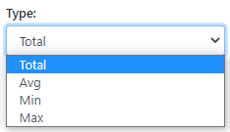
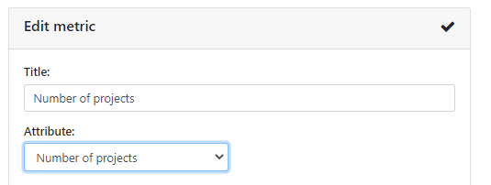
Create Reports
Adding Metrics - Set UP
2
1
Select Create / Metric to add a new tile
3
4
1
2
Add name – default will use Attribute name
3
Pick an Attribute to aggregate – this will now add up the total from all projects in the Report
5
4
Total is the default – but you can also use Average, Min or Max
6
5
Projects will filter based on Lists applied AND Kanban steps checked in the tile
TIP – the default Attribute is Number of Projects: Use this for simple count of Alternatives in your Portfolio
6
Click Done to save your new tile

Slide 23
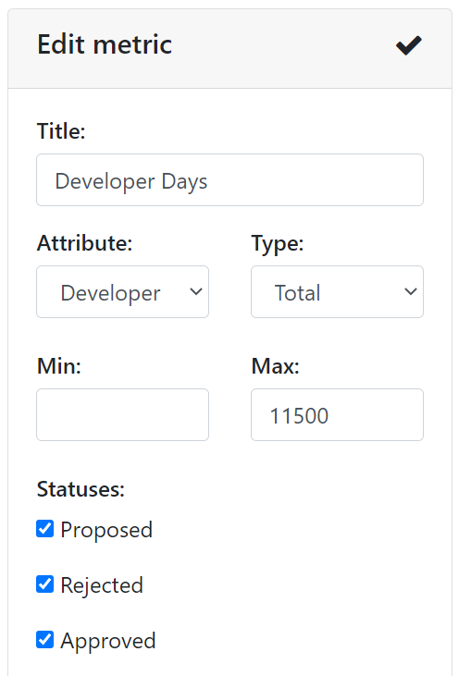


Create Reports
Adding Metrics - Portfolio level goals for Resources & Targets
xx
1
2
1
MAX should be used for Resources to mark the upper limit available for the portfolio
2
MIN should be used for Targets to mark the minimum contribution for the portfolio

Slide 24


Create Reports
Column Charts – Set Up
1
2
1
Click Create / Column Chart
3
2
Pick segmentation to use from Group by text Attribute
4
3
This brings up all Text Attributes – we recommend to use Pick Value from List for set up
4
“Name” describes the Attribute, while “Value” is what appears on the char labels – we recommend having both the same

Slide 25





Create Reports
Column Charts – Options
1
3
2
1
Use Status to align Report to the relevant steps in Kanaan
2
Attribute Values will display as a legend – these colour will be use in scatter plots & bubble charts in the rest of the report
3
Use any Attribute to split the data up – for example here we see average project rank to show the models with the best projects

Slide 26



Create Reports
Bubble Charts
Select Attributes for both Axis & Bubbles
Add Kanban Status filter
Chart complete!
TIP – Add Text Filter + Column Chart to colour code your Bubbles

Slide 27



Create Reports
Scatter Plots
Label your chart & define an X and Y axis
Use different shapes for Kanban stages
1
Chart complete!
TIP – Add Text Filter + Column Chart to colour code your Bubbles

Slide 28



Create Reports
Build an efficient frontier / view value cumulatively
1
2
3
Cumulative axis function will order your data according to metric selected and turn it into a cumulative total
This means you can see the efficient frontier
TIP – Create calculated attribute for value for money to get this view
1
2
3

Slide 29


Create Reports
Tips
Use Clone function to copy charts quickly
Use Move Up/Down function to shift components around
Change Chart Size / Metric where data is complex or just for a better format
Click on Legend to see key

Slide 30



Create Reports
Grid View Set – Select Data
Scroll down the screen to the Grid view of Projects
Hit the Edit icon to select Attributes & Confirm
Attribute data is now shown for all projects included
TIP – this list is filtered by Lists: if you can’t see you project check your Lists!

Slide 31




Create Reports
Grid View – Customise Settings
3
2
4
1
Click the action button to bring up analysis options for your data
2
3
4
1
2
3
4
Filter projects based on Attribute data
Bar – Add Bar Chart view to column
Cumulative allows you to get project level cumulative metrics… why not use Cumulative for capital, sort by value for money and then you can stop when you run out of money!
Decimals – customise view on precision of datapoints

Slide 32



Create Reports
Grid View - Customising
Drag Column headers into the bar to sort the data by Attribute
Click on Column header to sort data High to Low / Low to High
Use Edit Button to bring up the Form selected at the top on the Report
TIP – Use this Form to collect extra data
OR make it Read Only to provide detailed information

Slide 33



Create Reports
Use Case: How to create personalised reporting (1)
Create Lists based on Attribute that defined a stakeholder group
e.g. Lead Vehicle Program
(NB each value will need its own List)
Format the Grid or add visualization tiles as normal
TIP - Add READ ONLY Form to share additional detailed data

Slide 34






Create Reports
Case Study: How to create personalised reporting (2)
Share & Enable to generate URL for the Report
Return to Reports page, clone the report & resave
Add time limit if you need to
Edit the cloned report – change the List from Panther to Tortoise, Save, generate a new URL for Team Tortoise
Save & close
This is now ready to mail out to the Panther team
TIP – Post it on a team Wiki
TIP – Test your URL in an Incognito Window to double check it

Slide 35

Make your Decision
Portfolio Modelling in Reports
Click on a column to order your projects – Value for Money is usually the best option
Use CTLRL key to highlight projects
Use Set Status to change the Status of the Projects (NB this is where you want outcomes built into Kanban)
OR
Use Add to List if you’d rather create / edit a (static) list of projects for preliminary approval – for example if you’re building a couple of scenarios to chose from

Slide 36



Build Scenarios
Comparing Portfolios
Using the Project Lists we have to group up the portfolio we can see different Portfolios side by side
Selecting X/Y metrics we can therefore see which portfolio is driving the greatest value, cost etc
Pick which Lists to include in the chart
Note that using Lists (rather than Kanban status) you can include Projects in multiple different Portfolios for this review

Slide 37






Build Scenarios
Adjusting Weights to Create Scenario (1)
There are 4 options for creating a new weight set
All end up the same!
1
1
Start the Weights Process again with a new panel
2
2
Take an existing Opinion Panel & edit the answers to generate new weights
3
3
Create a new Weight Set – add values in manually
4
Take an existing weight panel, publish it as a weight set, then edit that weight set with manual overlays to reflect scenario
Adjust values in final weigh set & the software will Normalize to adjust for the AHP model
4

Slide 38




Build Scenarios
Adjusting Weights to Create Scenario (2)
See Criteria Weights for how to build Scenarios
To analyse scenarios, we recommend 3 steps:
1
Compare weights
(Weights tab)
2
X-Y Scatter new vs. old Value metrics
(Reports / Portfolio Dashboard)
TIP Add a Calculated Attribute:
Scenario Value Score / Base Case Value Score = “impact index”
3
Compare portfolios selected
(Reports / Compare Portfolio)

