Slide 1

TransparentChoice
Scoring – Respondents’ Guide

Slide 2





Respondents’ Guide
Introduction
Here’s the process you’re supporting right now:
Tips for Completing this survey:
Build model by defining & weighting criteria
Score alternatives against that model
Review results to make data-led decisions
Take your time to come up with the right answer. A nice cup of tea is recommended.
Be ready to explain your point of view. If you don’t have one it’s better to Skip than to guess.
Complete the review by the agreed deadline so we can identify areas of disagreement for focus.
To delegate or challenge definitions please reach out to your admin who controls this survey
You are here
You have been chosen to be part of the team scoring Alternatives because your opinion is valuable & will help drive the right results for this model - thank you!
Watch this video to learn more - click here!

Slide 3
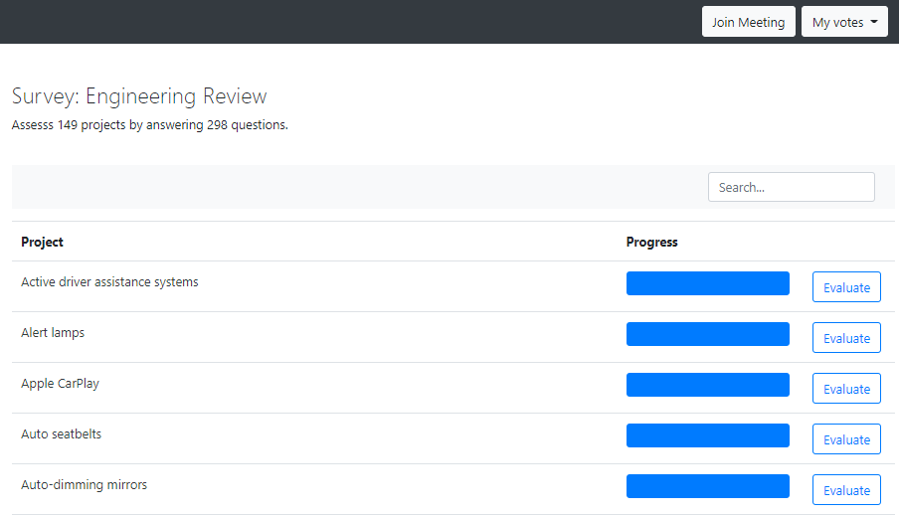

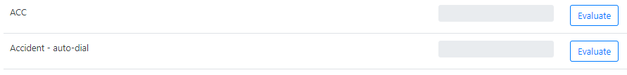
Respondents’ Guide
Landing Page
Getting Started – Use your personalized URL Link to open up your survey. Please do not share this link
1
2
1
Join Meeting to move from survey mode into a meeting:
Only available when the facilitator has opened the meeting
2
My Votes download your votes
3
Evaluate start scoring (see below)
3
4
Progress Bar Turns Blue when complete / Grey when outstanding
Please note – your link may refresh with new projects as your administrator adds projects to score
… and remove old projects as surveys are completed
4

Slide 4
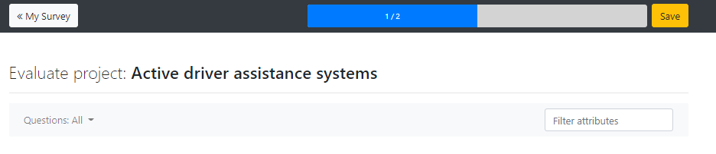
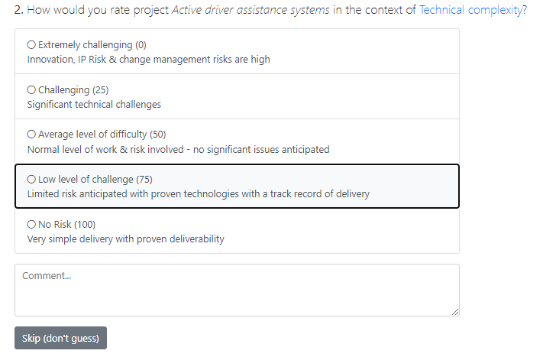

Respondents’ Guide
Scoring Page
2
1
3
1
Check Progress for given Alternative.
2
Save your answers. Note that this survey will autosave every few seconds regardless.
3
Review Detail of the question – click on Criterion and Alternative names for detailed definitions.
4
4
Score the Alternative – how important is this Alternative with respect to delivering this Criterion:
See below for best practice
5
Skip (don’t guess)
See below for best practice
5
6
Navigate to the next project or return to the top of the page
6

Slide 5





Respondents’ Guide
Best Practice
Focus on the question – specifically how important is this Alternatives to this criteria. Voting zero for one criteria does not mean it’s a bad project – it’s just not relevant to this specific objective.
Use the Scale – each scale is set up to make the question as measurable as possible, so read the detail to inform your choice.
Use Comments – capture your logic for a specific vote, especially if you are scoring high. This is invaluable in later reviews with other scorers.
Skip (don’t guess) – There may be questions where you have no idea, or no point of view. Please do not “guess” or vote mid-range – press this button to not answer. This will still count towards your overall completion rate.
Be honest – Trying to be nice or over-rating pet projects will mean the best choices get lost in the noise. If everyone is challenging & honest then the best options for your organization will stand out.

