Slide 1
Pairwise Deep-Dive Overview

Slide 2




Pairwise can be used in two places in our software
(1) Make a Plan
(2) Build Model (s)
(3) Set Up Software
(4) Score & Report
Getting Started
Build Criteria
Configure
Attributes
Score Projects
It's possible to use Pairwise here, but we don't recommend it!
Portfolio Goals
Criteria Weights
Configure
Pipeline
Report Results
We always use Pairwise here!

Slide 3
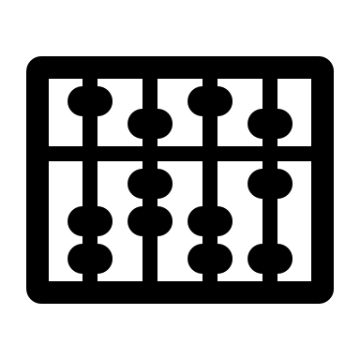
How does the Maths behind pairwise work?

Slide 4
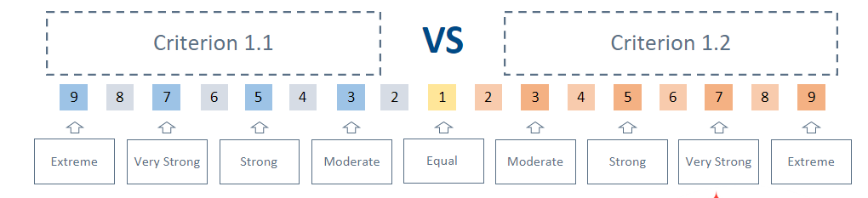
Pairwise means using ratios to generate a normalized score
Your Stated Preference is a ratio – for example scoring 5 ("Strong Preference") means Criterion 1.1 is 5x more important than Criterion 1.2
This scale is based on Saaty's research at the core of AHP
Further Reading
Decision making with the analytic hierarchy process Thomas L. Saaty

Slide 5
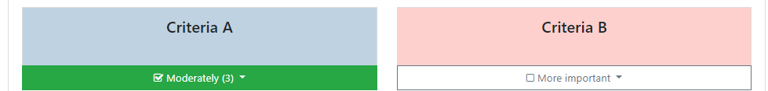
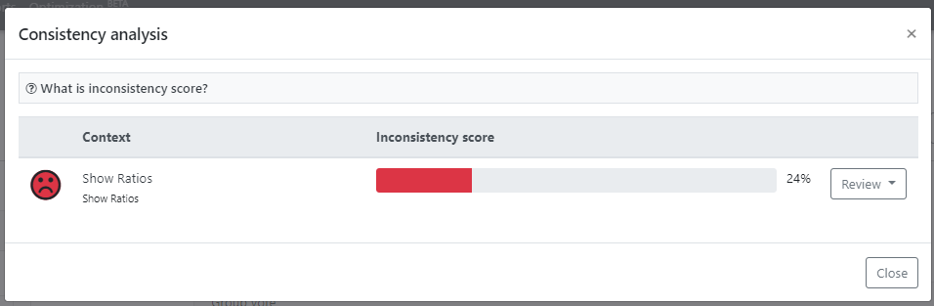
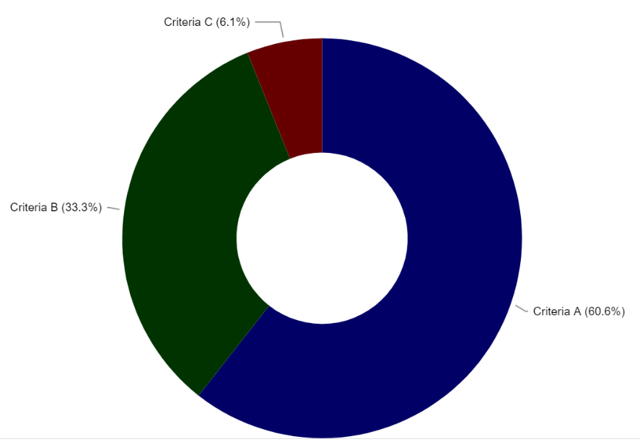
We have a 3-step process to build a weight set with Pairwise
Score Criteria against each other
Check consistency in your scoring
Publish Weight Set
This will be combined with Alternatives' scoring later...

Slide 6
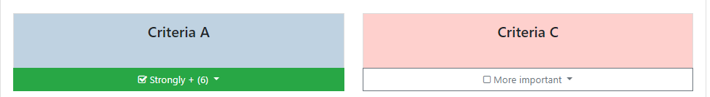
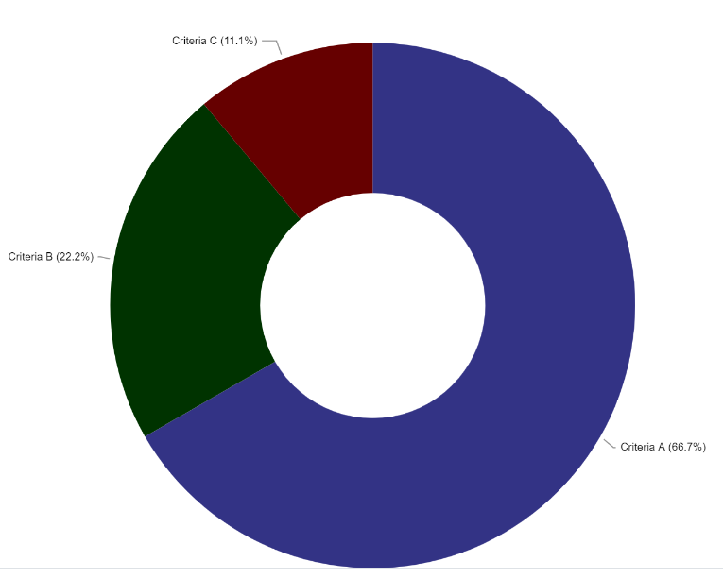
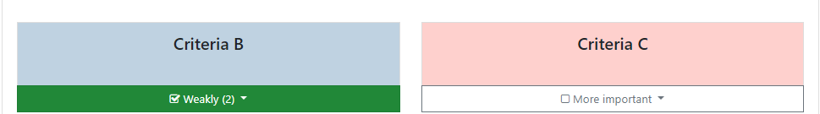
Example: Take a 3 Criteria Model: A/B/C
The software works this out for you
Expressed as Ratios
A is 3x more important than B
A is 6x more important than C
B is 2x more important than C
Expressed as Weights
A+B+C = 1 (normalization)
That means (for example) 6C + 2C + C = 1
i.e. C = 1/9 (11.1%)

Slide 7
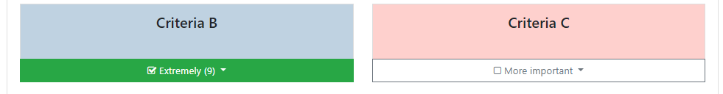
Example: Consistency Matters
Let's change one of these votes
A is 3x more important than B
A is 6x more important than C
B is 9x more important than C
Hang on a minute... That's right it doesn’t make sense. The Respondent has made a mess of things!
The software still produces Weights, but uses an algorithm to factor in this error

Slide 8
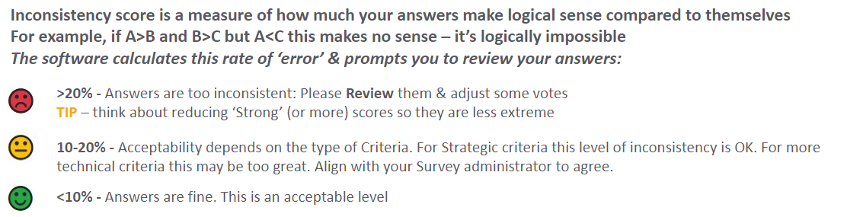
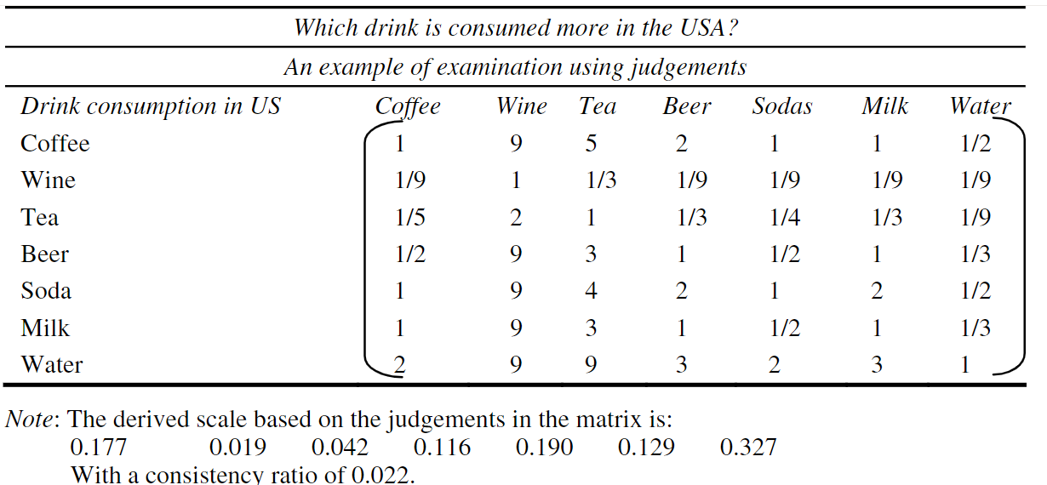
Modeling Inconsistency: the complex bit
We present Consistency Ratios as simple Emojis
Illustration: Preference Matrix
Further Reading
Algorithm uses preference matrix to generate an Eigenvector & Eigen Score & applies 'Saaty Test'. Result is Weights + Consistency for each Respondent and overall model.
Review of the main developments in the Analytic Hierarchy
Process Alessio Ishizaka and Ashraf Labib
In our software we have built AHP best practice into the code
Decision making with the analytic hierarchy process Thomas L. Saaty

Slide 9

Scoring Alternatives: Pairwise vs. Attributes

Slide 10
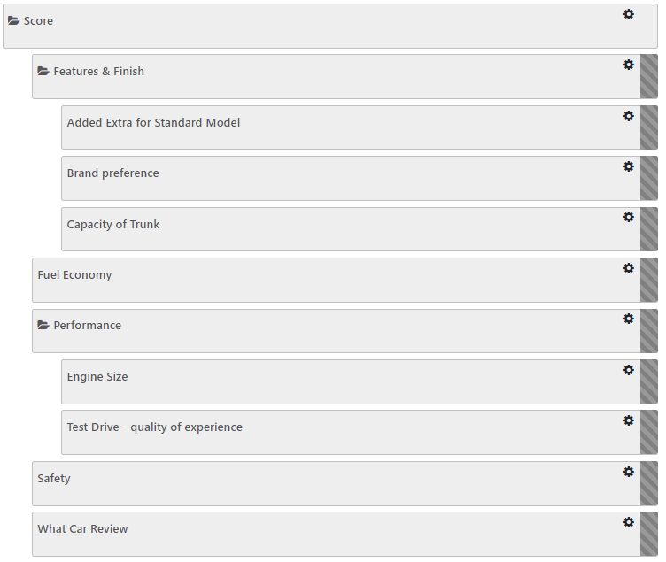
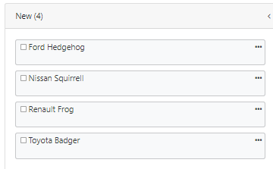
We have built this "Buy a Car" model for both solutions to explore how they work
Alternatives
Scoring can be through Pairwise OR Attributes - but we recommend Attributes

Slide 11
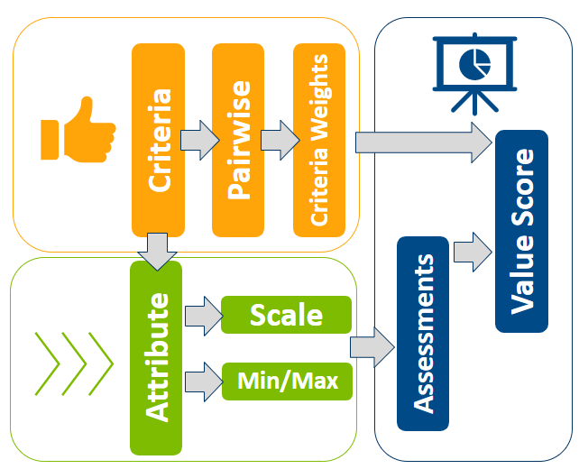
Attributes: Flow

Slide 12
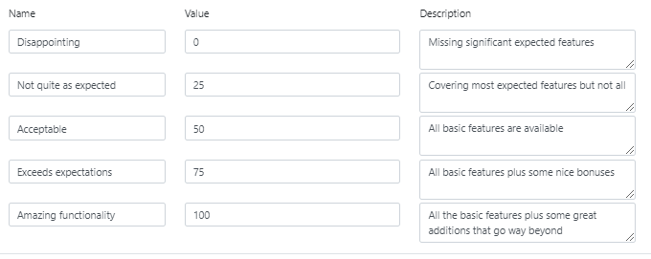
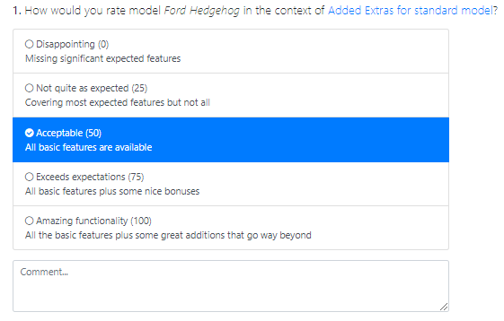
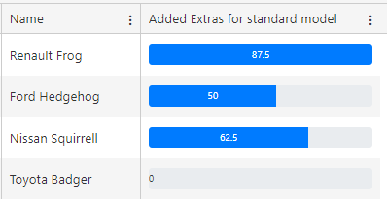
How to Score using Attributes
These choices feed into a survey where Respondents vote
Set up a scale – we recommend 5 levels as standard but it's flexible. Assign a value to each level which builds the AHP score.
Use relatable language to make each level distinct & specific for your Respondents to score.
These votes translate into the AHP model

Slide 13
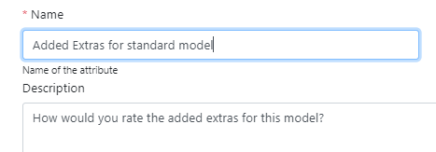
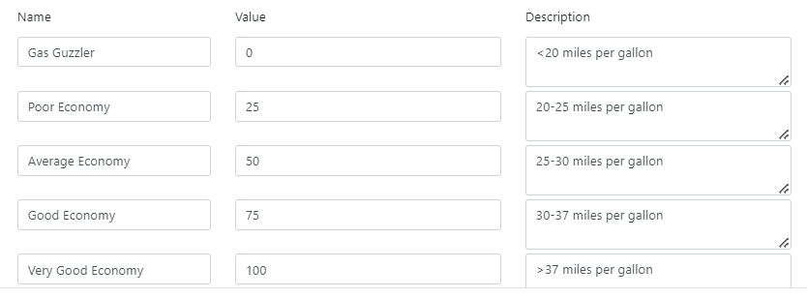
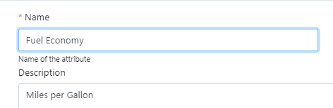
Adding Scales to Attributes enables greater precision
Articulate what each level means in the context of each criterion, and add a score to represent it
Create quantifiable steps that enable a 'fact' (fuel consumption) to fit into a scale

Slide 14
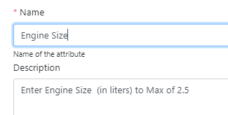
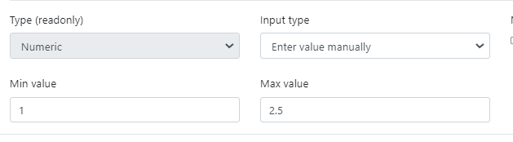
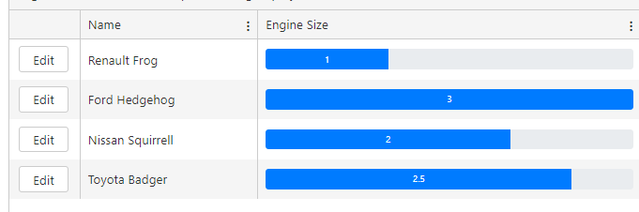
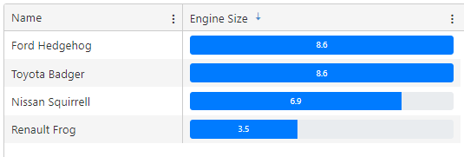
Direct data feed is another option with Attributes
Fix a maximum value, beyond which there's no extra value add
Input data - Hedgehog is over the Max, while Badger is at Max
Therefore, in the final model Hedgehog & Badger score the same
Note: Direct values must 'point up' where higher values relate to better scores

Slide 15
Other advantages for Attribute based scoring
For 4+ alternatives pairwise surveys can get large (9 is technical max but 4-5 is practical limit we recommend)
Using Attributes means late additions can be added to the process without impacting existing scores. For pairwise extra Alternatives can change existing Alternatives' scores
Complex data collection is best supported by Attributes. You can share scoring across multiple people & track completion more easily in software

Slide 16
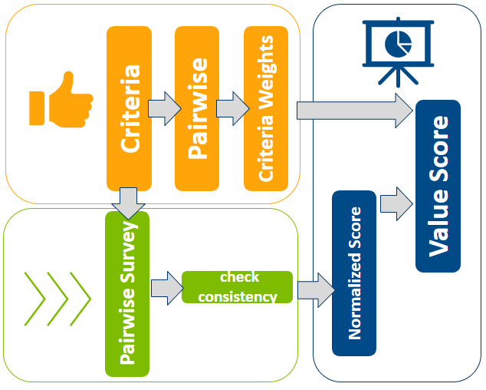
Pairwise: Flow
Vs. Attribute based collection

Slide 17
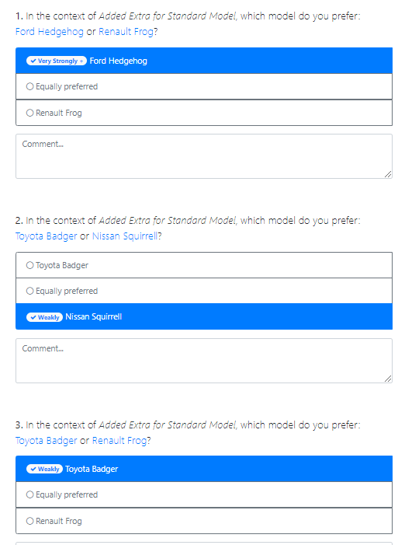
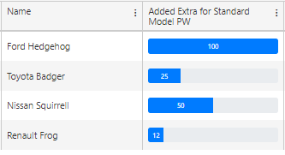
How to Score using Pairwise
Rate the relative strength of each Alternative for a given criteria using the scoring survey
These ratios translate into a score – based on the ratio to the strongest option
 | Hedgehog | Squirrell | Badger | Frog
Hedgehog | 1 | 2 | 4 | 8
Squirrell |  | 1 | 2 | 4
Badger |  |  | 1 | 2
Frog |  |  |  | 1
e.g. Hedgehog is 4x better than Badger on this criteria: hence 100 vs. 25 score

Slide 18
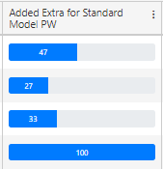
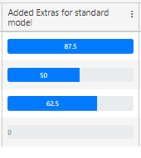
Technical differences: 2 limitations of pairwise
Pairwise
Attribute
Attributes have a "0" option where an Alternative has no relevance on a given criteria: Pairwise cannot have a zero
Pairwise always has one "100" option – there's no scope for all the choices being poor

Slide 19
Is Pairwise ever better? It can be…
Simple reviews (for 2 options it's half the questions!)
Criteria which are opinions rather than judgements - “Which option would make you happier?"
Criteria which are framed as relative - “How much more time will X take vs Y?"

Slide 20

Completing your AHP model

Slide 21
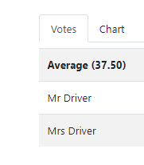
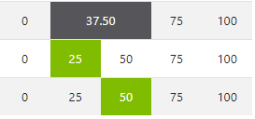
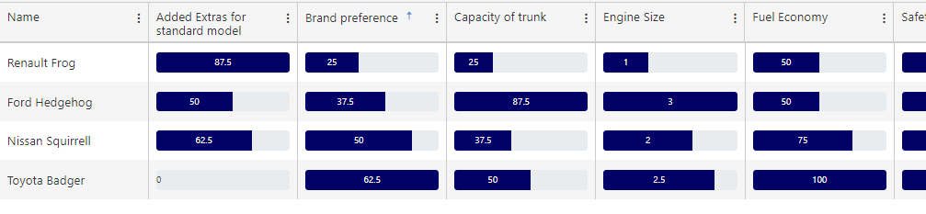
Complete your scoring review (with either methodology)
Review the scores from different Respondents to reduce noise in your data
Set up Reports to show the outcome from across all alternatives / criteria

Slide 22
Combine these scores with Criteria Weights to generate Total Value Scores for each Alternative
We have 4 sub-criteria & 3 Alternatives in our model which have been weighted & scored as follows…
Criteria
C1.1 = 20% C1.2 = 40% C2.1 = 10% C2.2 = 30%
Alternative 1
50 100 0 50
Alternative 2
0 0 100 100
Alternative 3
100 100
100
100
TOTAL VALUE SCORE
65
40
100
Alternative 1 strong for Criteria 1.2 which is most important criteria – hence a high score
Alternative 2 is relevant to less important criteria, and therefore only scores 40
Alternative 3 is 100 for all criteria – and therefore scores a perfect 100

Slide 23
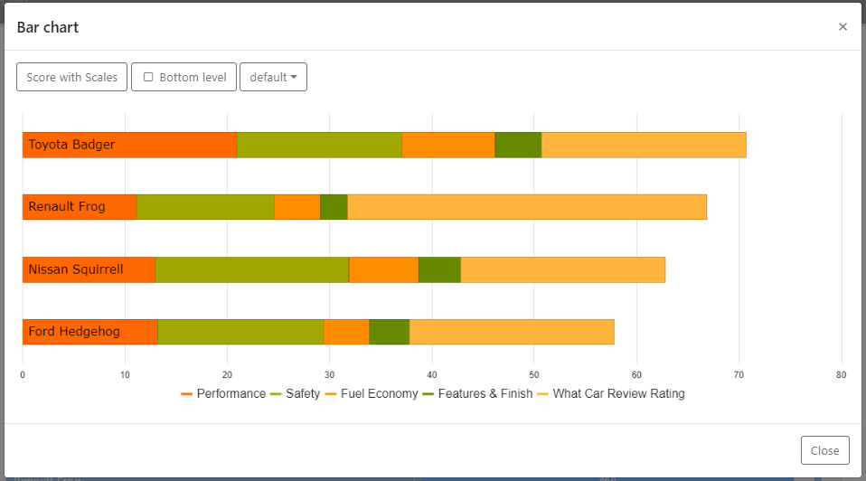
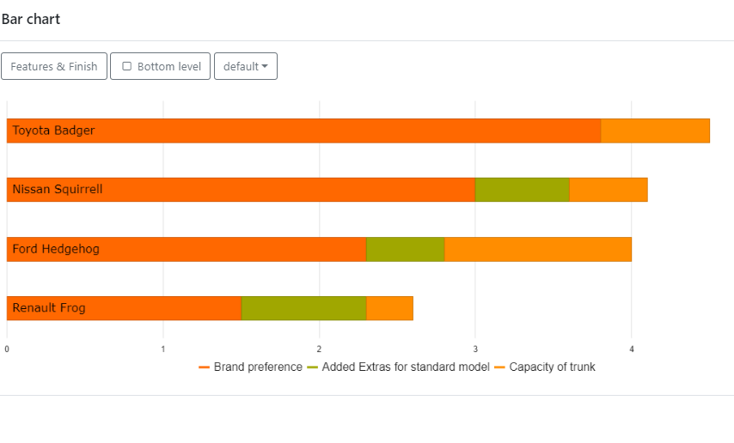
Review your model to understand value drivers
You can also deep dive to look at specific Criteria

Slide 24
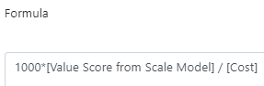
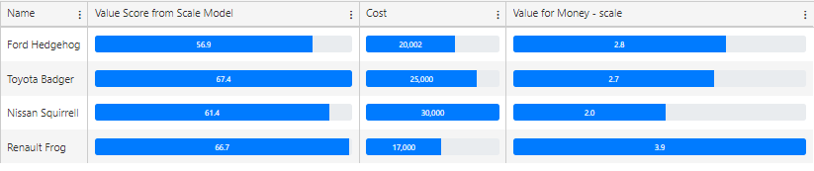
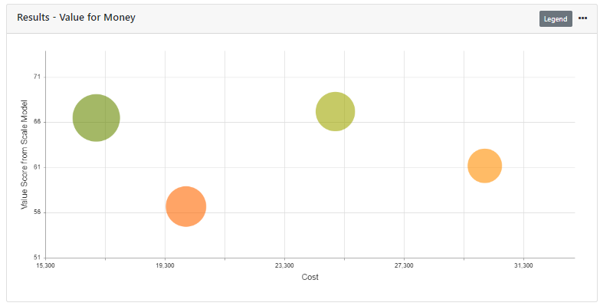
Value Score can be used as a numerator in a 'Value for Money' equation
Add Calculated Attribute to Combine Cost + Value Score
Tip – you can collect "Cost" data as $ or people (or whatever) * … you can collect estimates from one person or ask a group to share different points of view**
Complete your review with built-in visualization options
*One client used "weight" as key 'cost' because they were developing satellites ** Daniel Kahneman has done some great research into how varied estimates of effort really are in his book on "Noise"

Slide 25
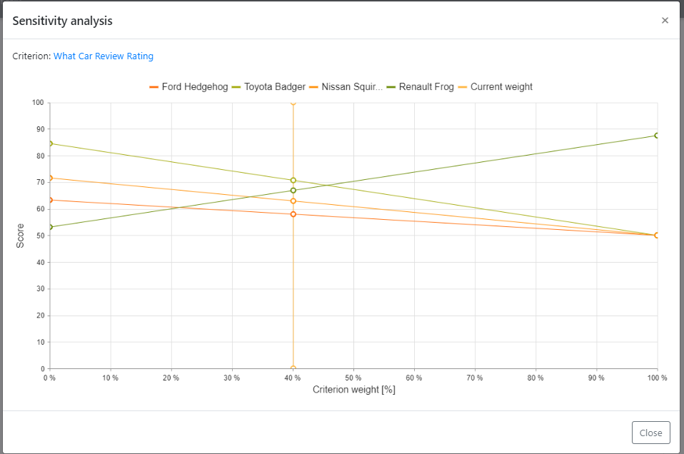
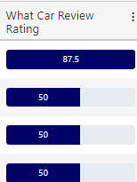
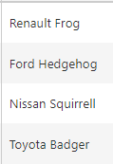
Check the sensitivity of a specific criterion to review a close call
In this example the Frog would do much better if "What Car Rating" weight was increased because it scored well on this criteria

Slide 26
Thank you

