Slide 1
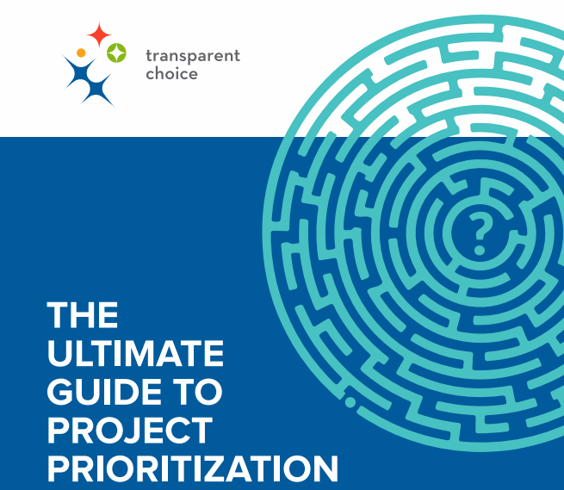


If you need support building your business case for prioritization or want to learn more about AHP then reach out and contact the team behind the guide.
Dan Dures
VP Customer Success
dan@transparentchoice.com
See Dan's diary
Stuart Easton
CEO & co-founder
stuart@transparentchoice.com
See Stuart's diary

Slide 2
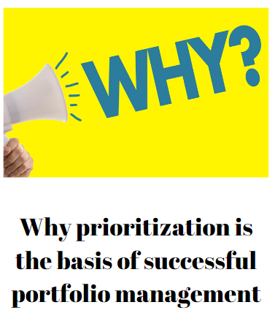
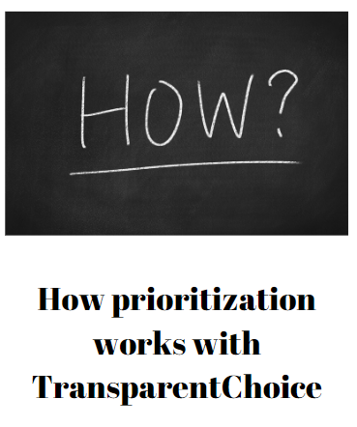
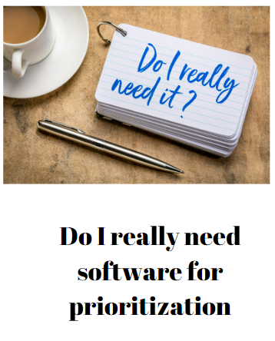
We will focus on 3 questions…

Slide 3
Organizations that prioritize effectively get better results
Poor prioritization creates waste
Good leadership means good prioritization
Strategic planning is pointless without aligned prioritization
Prioritization is key to project flow

Slide 4


Organizations that prioritize effectively achieve financial outperformance
  McKinsey research over 15 years showed pro-active prioritization out-performing 'fair' allocation of capital by +40%
  PMI data showed that organizations with mature prioritization processes achieved 3x better financial KPIs
  Forbes analysis measured that 80% of value growth came from the top 20% of companies in the S&P 500
Source: Forbes / McKinsey / PMI

Slide 5

Prioritization will cut waste
  20% of typical portfolios are waste
  Spending money 'because you did last year' is wasteful: but agility at scale takes structure & process
  Overloading delivery teams reduces their output through disrupting project flow
Source: PMI / McKinsey / Mike Hannan

Slide 6

Project delivery KPIs are significantly improved through effective prioritization
  57% more likely to succeed
  50% more likely to complete on time
  45% more likely to be on budget
Source: PMI

Slide 7

Good Prioritization is a cornerstone of leadership
  Only 60% of strategic goals get successfully delivered
  95% of employees don't understand their organization's strategy
  Productivity improves when people are motivated
  Prioritization is a key component of any transformation process
Source: PMI / Adam Grant/ Kaplan & Norton

Slide 8
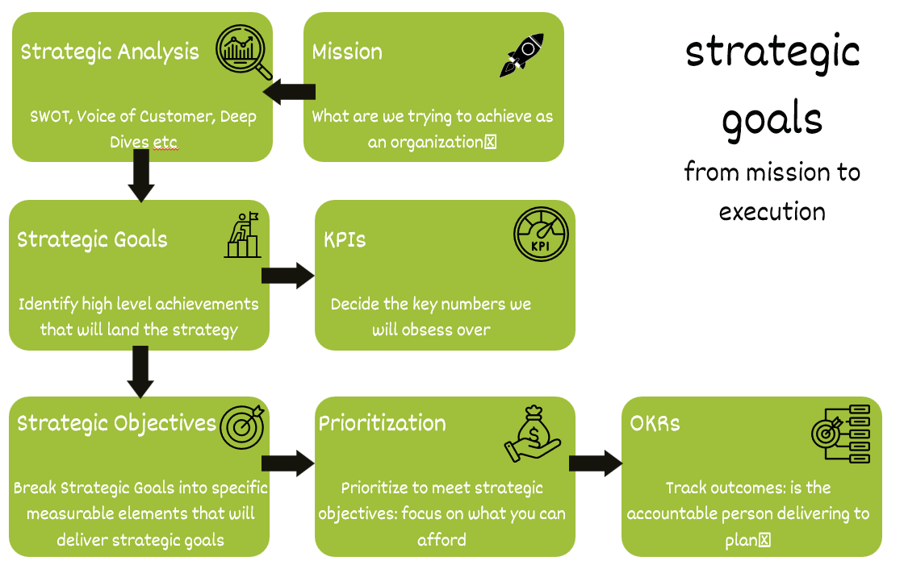
Prioritization should be a cornerstone of your Strategic Planning Process
  The value of a strategy is determined by how well executed it is
  Prioritization is the critical link between what we want to achieve and what we can afford to get done
  The cost of doing prioritization well, should be seen as how much do I value my strategy?
If you don’t align spending to Strategic Objectives your strategy is nothing but expensive mood music!!

Slide 9
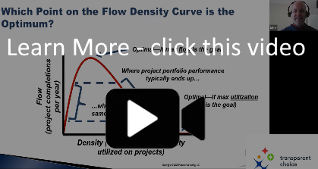
Project flow depends on prioritization
Peak Flow
(Point C)
Point A
Point B
Project “flow”
How can you explain this drop?
Excessive multi-tasking kills productivity
Nothing ever gets finished, but new projects keep coming
Utilization rate
Based on project flow diagram by Mike Hannan (see video)
PMI research papers

Slide 10

You cannot execute your portfolio well if you have too many projects…
We are passionate about improving prioritization and have developed sector-leading insight into why it matters… and how to fix it.
Join our CEO, Stuart Easton, at the Global Portfolio Management Forum to hear his take on how to drive more value from your portfolio.

Slide 11
The best way to solve prioritization is AHP – The Analytic Hierarchy Process
Quantifying project value means you can be analytical in how you build a portfolio
Getting the C-Suite on the same page is a massive win
Use TransparentChoice software to deliver prioritization in just 8 weeks

Slide 12


Analytic Hierarchy Process (AHP) is the best way to prioritize
Enables ‘soft’ & ‘hard’ metrics to be measured together in one model
Cuts Noise by >50% by getting 3 points of view instead of 1
Reduces error from blind spots, unconscious bias, conscious bias, subjectivity & anchoring
Delivers academic rigor: recommended for prioritization by University of New South Wales

Slide 13
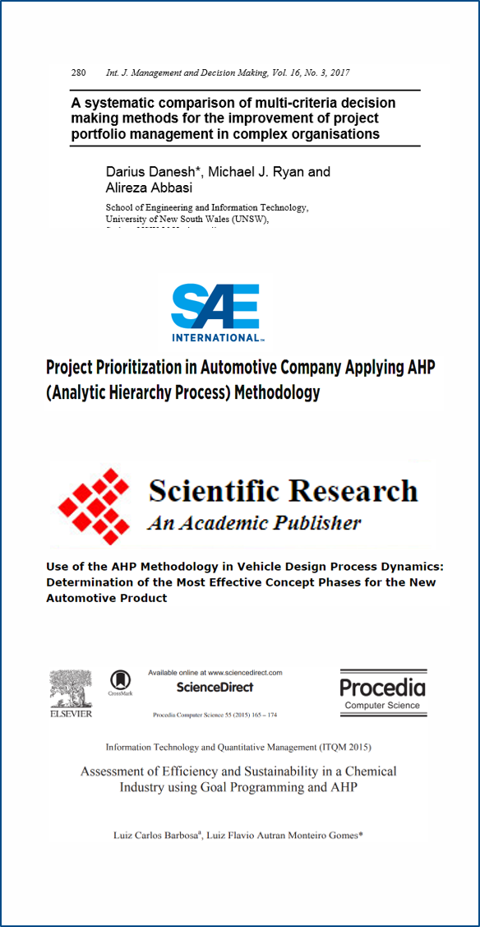
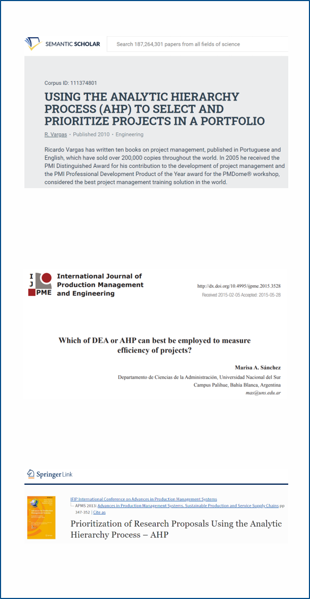
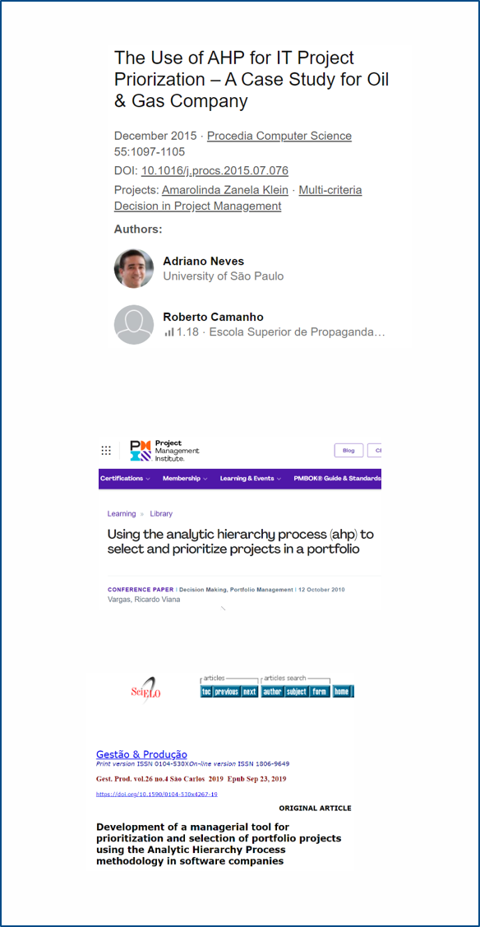
External validation for AHP

Slide 14

Prioritization modelling creates balance between competing criteria
  Short term KPIs
  Competing strategic priorities
  Saving money
  Sustainability / ESG / Stakeholders
  Risk reduction
  Project feasibility / riskiness

Slide 15











Effective prioritization needs these charts
rolls royces
plan A
stars
value
backpack Fillers
cumulative value
pet Projects
cost
cumulative cost
Determining project value & project cost is key for any effective prioritization model

Slide 16

Ignoring conflicting views & stuffing the backlog is setting the PMO up to fail
Let’s just do everything just in case
Stretch goals will be good for the PMO
My project has the best ROI
This project is strategically critical
This guy doesn’t get basic finance
I’m the only one here with vision
Spoiler Alert
Ignoring this mis-alignment does not make it go away

Slide 17
Good Prioritization turns diverse views into a shared model
How lucky we are to have all this expertise in the room… let’s use it to build a prioritization framework
All that matters is CASHFLOW
All that matters is GROWTH
This is well balanced
This a fair
By focusing on criteria before projects you increase the probability of finding common ground

Slide 18





Use TransparentChoice software to deliver AHP in just 8 weeks
Automate, track & connect for easy-to-use data at scale
Collect Data
Decision Science solution with proven credentials for building alignment within your leadership group
Build AHP Model
Get this done in just 8 weeks if you need to deliver change fast
Improve data quality as a team with less bias & noise and more structure and accountability
Score Projects
Use Data Visualization, shareable reports or rules-based algorithm to decide which projects to work on
Select Portfolio

Slide 19
Take our Top Ten self diagnostic – any uncomfortable truths?
Do you want to improve project delivery success rate… but you’ve already done ‘the basics’ (templates, training, PPM)
Cumulative value generation – why solving prioritization is urgent
Thinking of doing this in Excel? Don’t

Slide 20

10 signs you have a prioritization problem
  Too many projects
  He who shouts loudest
  Pet projects
  Everything is priority
  Too many U-turns
  Disjointed local priorities
  Resource allocation hurts
  No criteria or process
  No list of projects
  A lot of projects fail
A spreadsheet will not solve these problems

Slide 21


Your delivery problem might actually be a prioritization problem….
Excessive multi-tasking
Too Many Projects
How much time do you spend fighting fires from this perspective?
No buy-in to the plan
Not enough resources
Low morale
Resource bottlenecks
Lack of clarity on what matter most
Cost overruns, late projects, missed business goals
Lack of training
Weak Project Prioritization Process
Lack of exec sponsorship
Loss of interest / focus
Selection of non-strategic projects
Fixing prioritization will reduce delivery crises
Scope creep
Poor understanding of project business goals
No clear “business case” from start
Weak control over changes
Why prioritize symptoms when you can fix the cause?

Slide 22
Solve prioritization now for long term value
Effective prioritization will grow the $ return of your portfolio
Consolidating performance gains means cumulative value from the portfolio
20% of projects are waste
  Project Management Institute
50% of projects are under-resourced
  Project Management Institute
Alignment – explains 80% of overall organization’s performance
  Uni Brunel, London
Reducing multi-tasking can boost productivity by 80%
- PMI / Confluence Case Study
30% Boost
Cumulative Added Value
5% boost
Year 1
Year 2
Year 3
Year 4
Year 5
Year 6

Slide 23



Pick the right tool if you want to deliver on both quality and buy-in for prioritization
AHP
Quality
Weighted Score
ROI model
RICE / Kano
Steering Group
Excel / PPM Rank
Most PMOs are still getting this wrong
Project Poker
He Who Shouts
Buy-In

Slide 24

6 reasons spreadsheets aren’t ‘free’
Opportunity cost from not doing prioritization well
Spreadsheets can make expensive mistakes
‘Black Box’ solutions don’t build trust for their results
Spreadsheets ignore decades of Decision Science
Teams create better data than individuals
Spreadsheets aren’t really meant for data collection

Slide 25
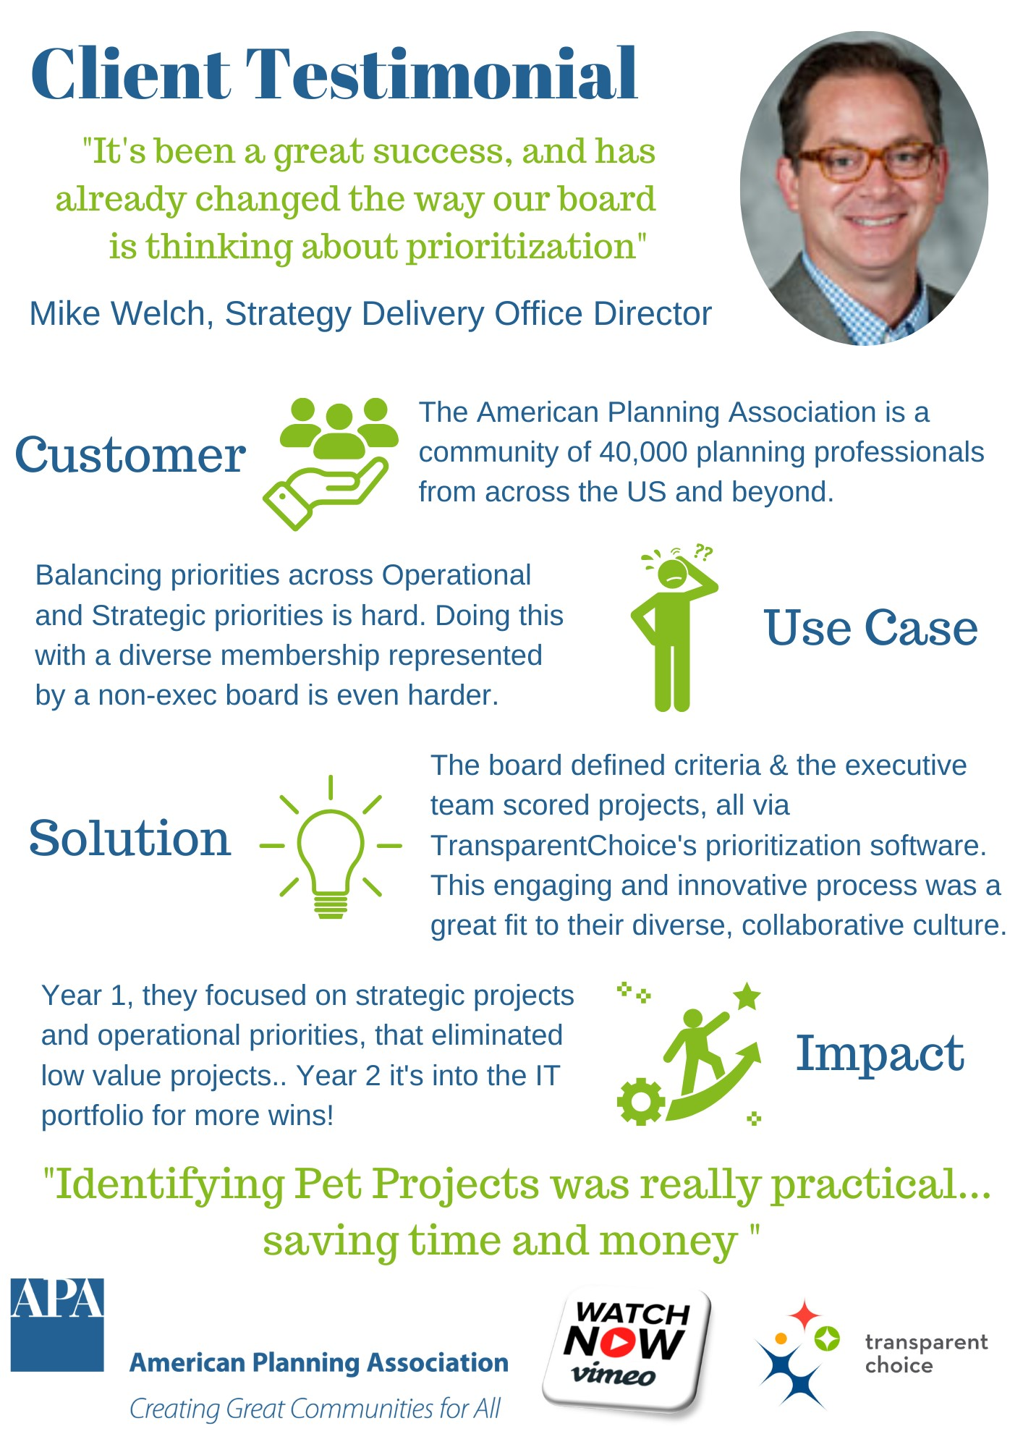
If you have a diverse set of stakeholders who struggle to agree, then check out Mike’s story
He’s also been able to double his impact by getting the IT sub-portfolio to adopt the software too!

Slide 26
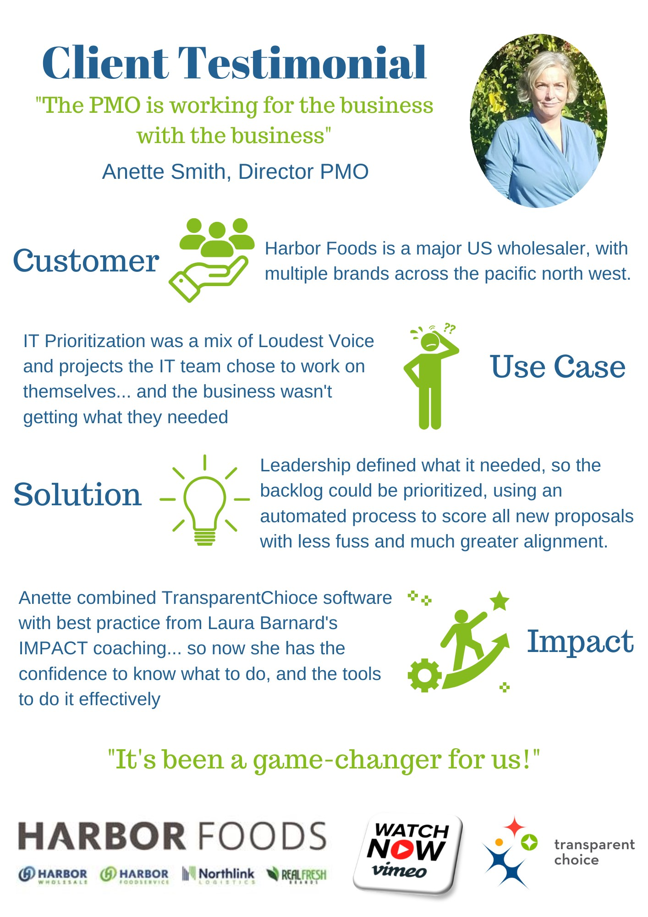
If you have an IT Portfolio with too many projects and a loudest voice issue, then check out Anette’s story.
This is also a great example of software and coaching double teaming to maximise impact, with a bundled deal of TransparentChoice and IMPACT coaching

Slide 27
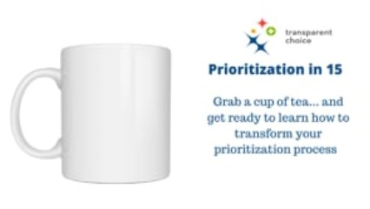
Check out the software to learn more
Great software should be simple, so we decided to showcase is just 15 minutes, the time it takes to drink a nice cup of tea.
So, grab a brew and come see how simple solving prioritization could be…

Slide 28
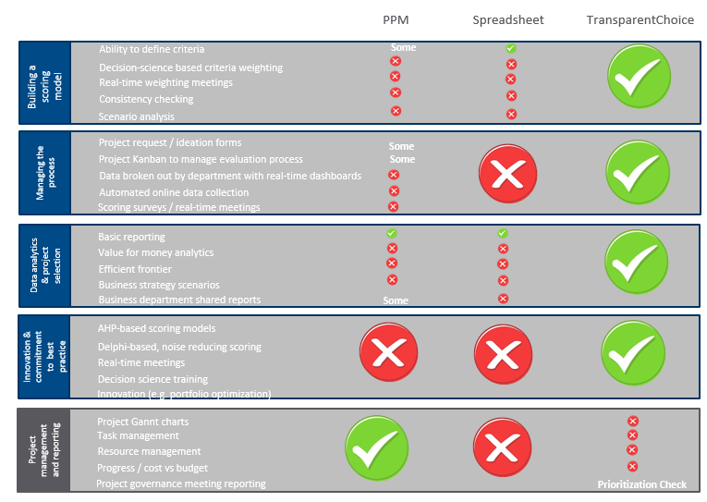

We have the right tool for prioritization
Why not start a no-commitment 2 months trial?
Book a free consultation with our expert to see if you qualify

Slide 29

5 reasons prioritization goes wrong
  Choosing Excel (because it's 'free')
  Ignoring it and hoping it gets better
  Rolling it into a PPM deployment
  Treating it as a one-off job, not an ongoing process
  Re-inventing the wheel with a homespun solution

